Slide 1
Cha. 8
Earth Systems & Resources

Slide 2
Earth’s resources determined when the planet was formed.

Slide 3
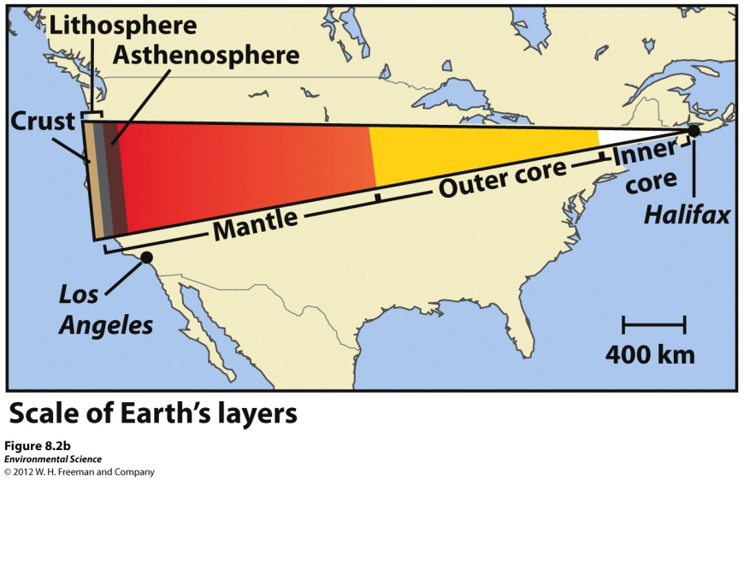
Earth’s Layers
Core- the innermost zone of the planet made of nickel and iron.
Mantle- above the core containing magma
Crust- the outermost layer of the planet.
Asthenosphere- the outer part of the mantle, composed of semi-molten rock.
Lithosphere- the brittle outermost layer of the planet that is approximately 100 km thick.

Slide 4
Convection and Hot Spots
The Earth is very hot at the center.
This heat causes plumes of hot magma to well upward from the mantle.
Hotspots- places where molten material from the mantle reach the lithosphere.

Slide 5
Plate Tectonics
Plate tectonics- the theory that states that Earth’s lithosphere is divided into plates, most of which are in constant motion.

Slide 6
Tectonic Plates

Slide 7
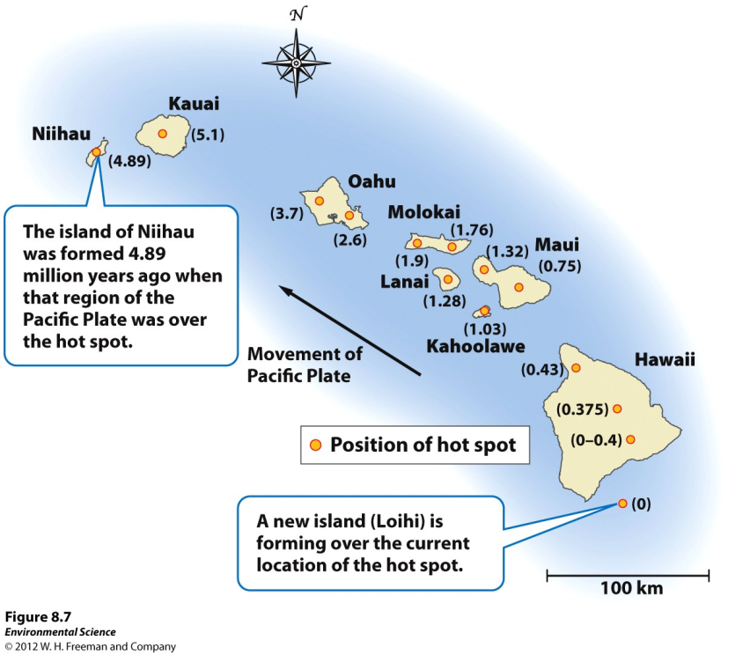
Consequences of Plate Movement
Volcanoes- as a plate moves over a hot spot, rising magma forms a volcano.

Slide 8
Types of Contact
Divergent plate boundaries- when plates move apart from one another.
Convergent plate boundaries- when plates move toward one another and collide.
Transform fault boundaries- then plates move sideways past each other.
Movement Link

Slide 9
Faults and Earthquakes
Faults- a fracture in rock across which there is movement.
Earthquakes- occur when the rocks of the lithosphere rupture unexpectedly along a fault.
Fault zone- large expanses of rock where movement has occurred.
Epicenter- the exact point on the surface of Earth directly above the location where the rock ruptures.
Richter scale- a measure of the largest ground movement that occurs during an earthquake. The scale increases by a factor of 10, so an earthquake of 7 is 10 times greater than an earthquake of 6.

Slide 10
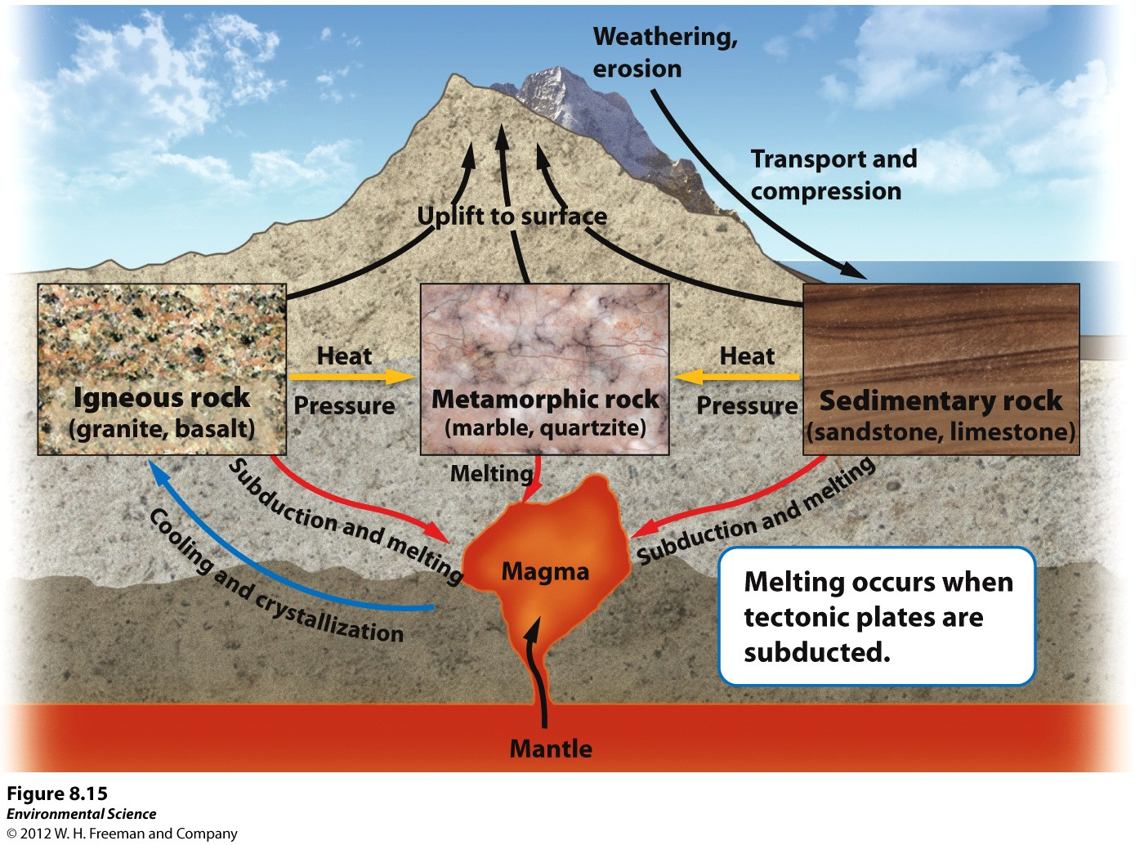
Rock Cycle
Rock cycle- the constant formation and destruction of rock.

Slide 11
The Rock Cycle
Igneous rocks- rocks that form directly from magma.
Intrusive igneous- form from within Earth as magma cools.
Extrusive igneous- from when magma cools above Earth. (ex. A volcano that ejects magma out will form this)
Sedimentary rocks- form when sediment such as mud, sands, or gravels are compressed by overlying sediments.
Metamorphic rocks- form when sedimentary, igneous or other metamorphic rocks are subjected to high temperatures and pressures.

