Slide 1
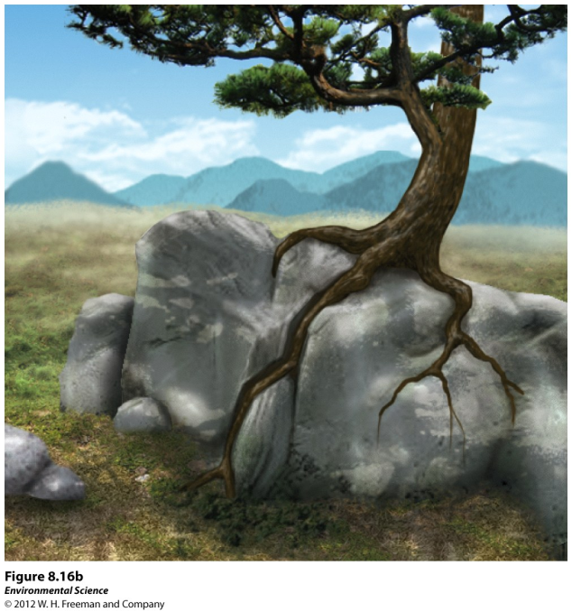
Weathering and Erosion
Weathering- when rocks are exposed to air, water, certain chemicals or biological agents that degrade the rock.
Physical weathering- the mechanical breakdown of rocks and minerals.

Slide 2
Weathering and Erosion
Chemical weathering- the breakdown of rocks and minerals by chemical reactions.

Slide 3
Erosion
Erosion- the physical removal of rock fragments from a landscape or ecosystem. Wind, water, ice transport and living organisms can erode materials.
Deposition- the accumulation or depositing of eroded material such as sediment, rock fragments or soil.

Slide 4
Soil
Soil is important because it
Is a medium for plant growth
Serves as a filter for water
A habitat for living organisms
Serves as a filter for pollutants

Slide 5
Formation of soil
Factors that determine the formation of soil:
Parent material- what the soil is made from influences soil formation
Climate- what type of climate influences soil formation
Topography- the surface and slope can influence soil formation
Organisms- plants and animals can have an effect on soil formation
Time- the amount of time a soil has spent developing can determine soil properties.

Slide 6
Soil Horizons
O horizon- (organic layer) composed of the leaves, needles, twigs and animal bodies on the surface.
A horizon- (topsoil) the zone of organic material and minerals mixed together.
B horizon- (subsoil) composed primarily of mineral material with very little organic matter
C horizon- (parent material) the least weathered horizon and is similar to the parent material.

Slide 7
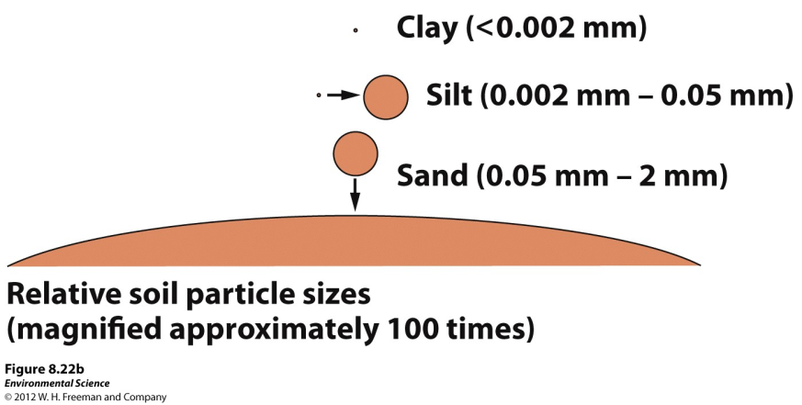
Physical properties of soil
Texture- the percentage of sand, silt and clay the soil contains.

Slide 8
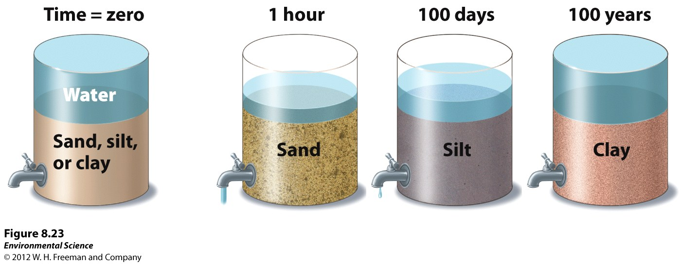
Physical properties of soil
Porosity- how quickly the soil drains (which depends on its texture)

Slide 9
Chemical properties of soil
Cation exchange capacity- the ability of a soil to adsorb and release cations, positively charged mineral ions.
Soil bases- calcium, magnesium, potassium and sodium
Soil Acids- aluminum and hydrogen
Base saturation- the proportion of soil bases to soil acids

Slide 10
Biological properties of soil
Many organisms are found in the soil including fungi, bacteria, protozoans, rodents and earthworms.

Slide 11
Elemental Composition of Earth’s Crust

Slide 12
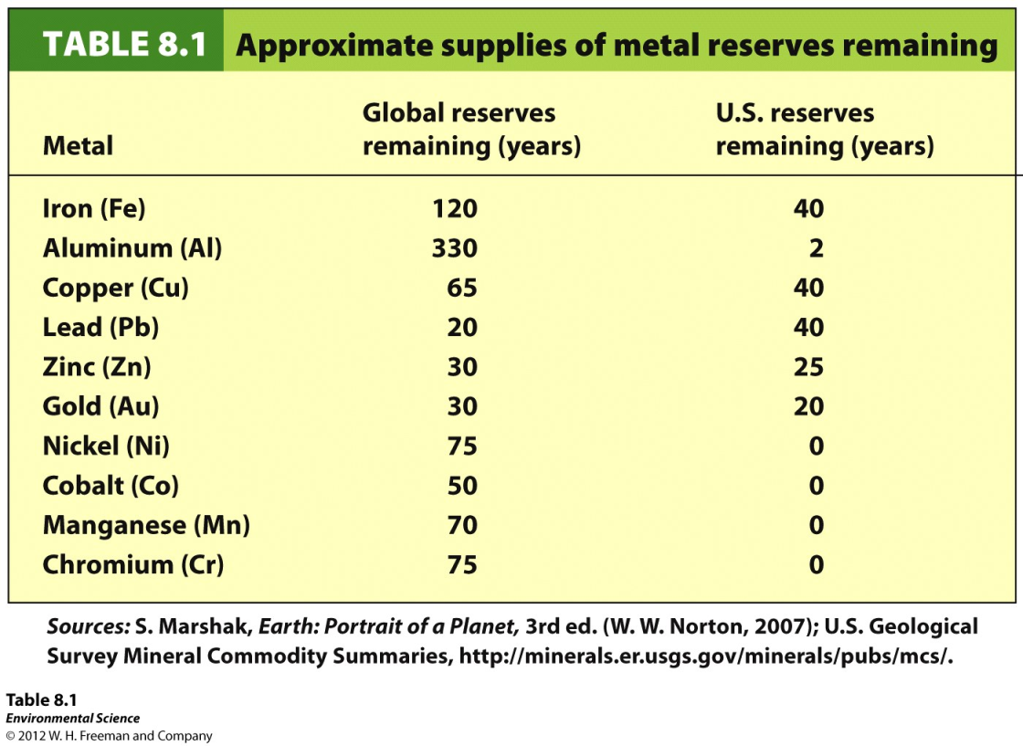
Reserves
Reserves- the known quantity of a resource that can be economically recovered.

Slide 13
Types of mining
Surface mining- removing minerals that are close to Earth’s surface.
Strip mining- removing strips of soil and rock to expose ore.
Open pit mining- the creation of a large pit or hole in the ground that is visible from the surface.
Mountain top removal- removing the entire top of a mountain with explosives.
Placer mining- looking for metals and stones in river sediments.

Slide 14
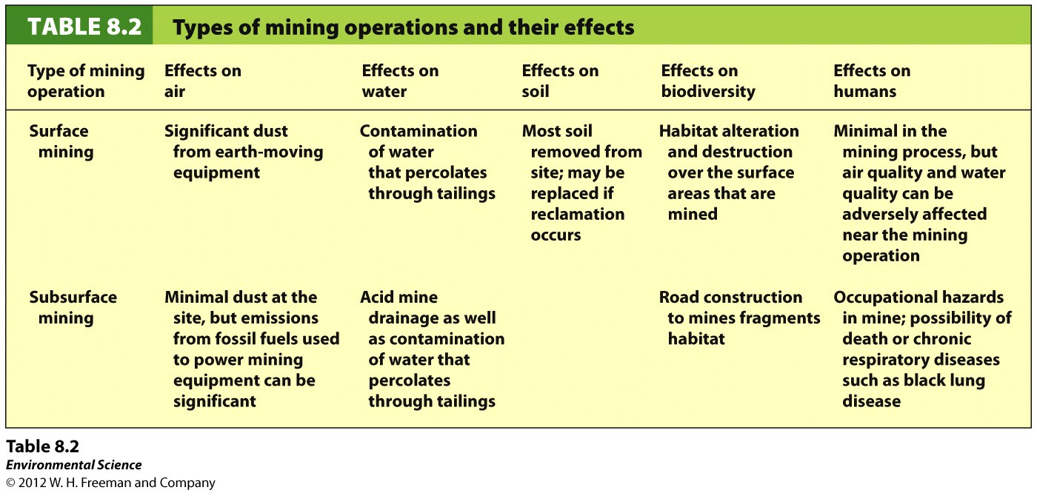
Types of mining
Subsurface mining- mining for resources that are 100 m below Earth’s surface.

