Slide 1
Cha. 13
Renewable Energy

Slide 2
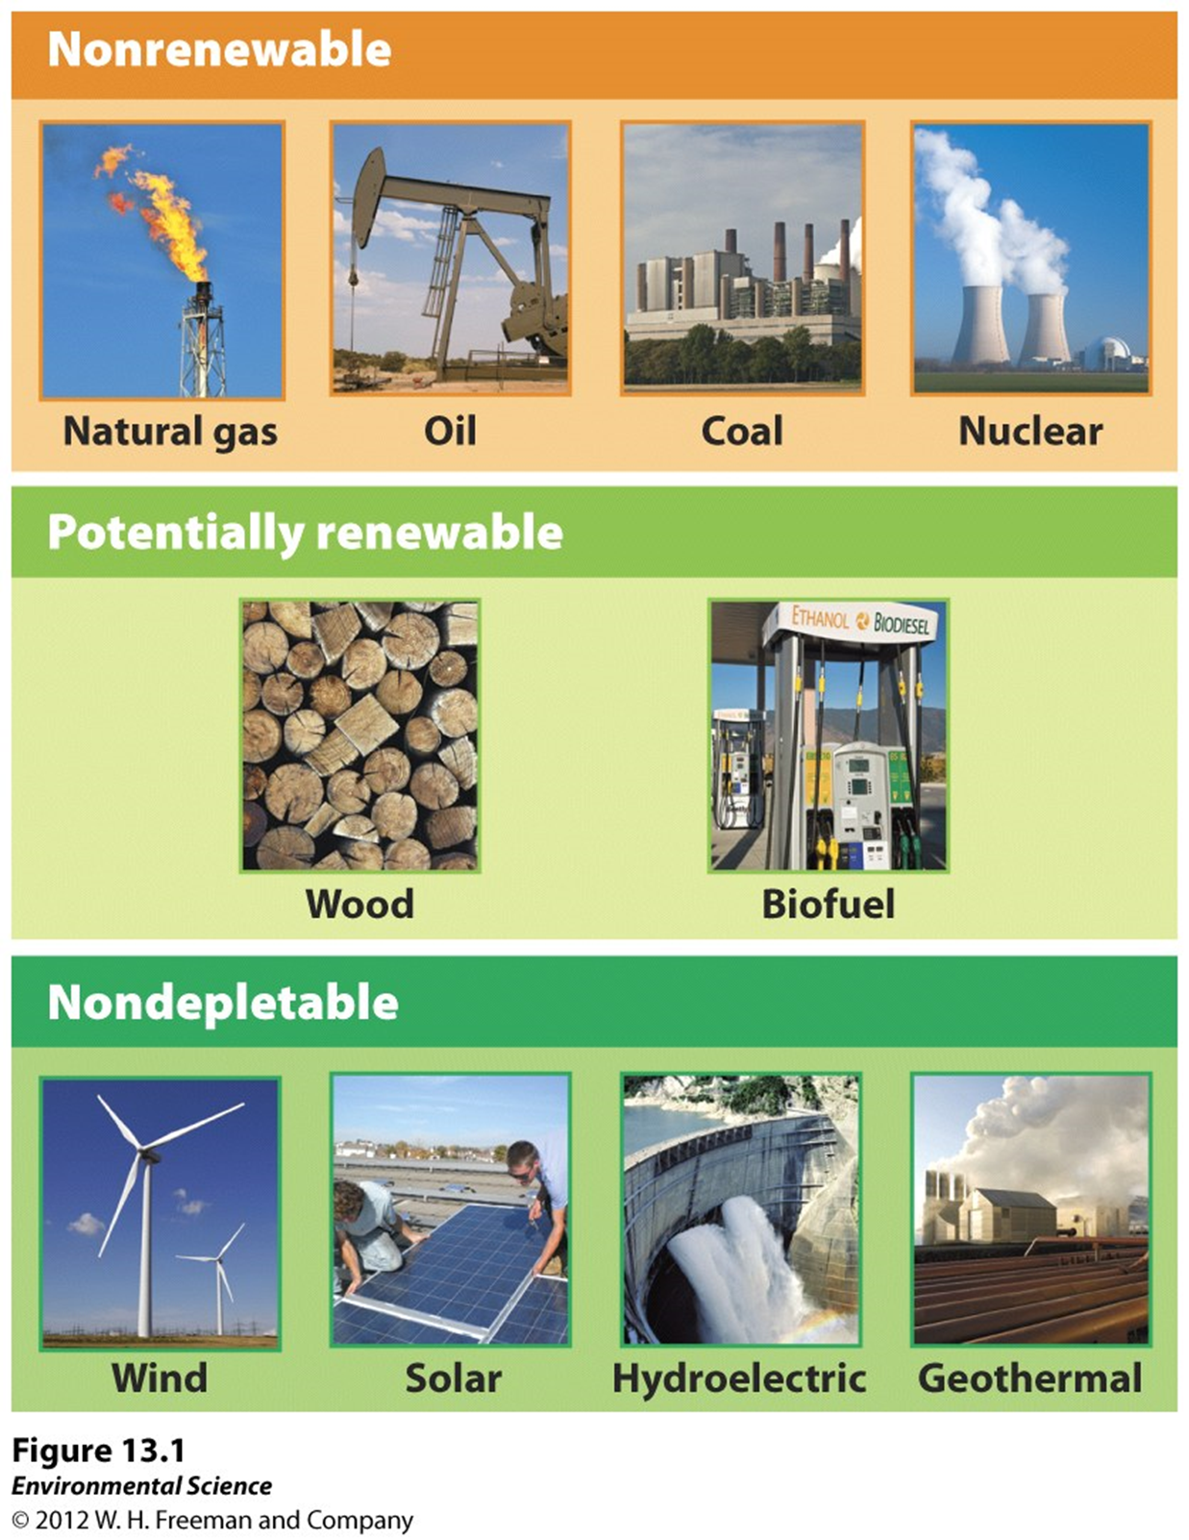

Slide 3
How can we use less energy?
Energy conservation- finding ways to use less energy. For example, lowering your thermostat during the winter or driving fewer miles.
Energy efficiency- getting the same result from using a smaller amount of energy.

Slide 4
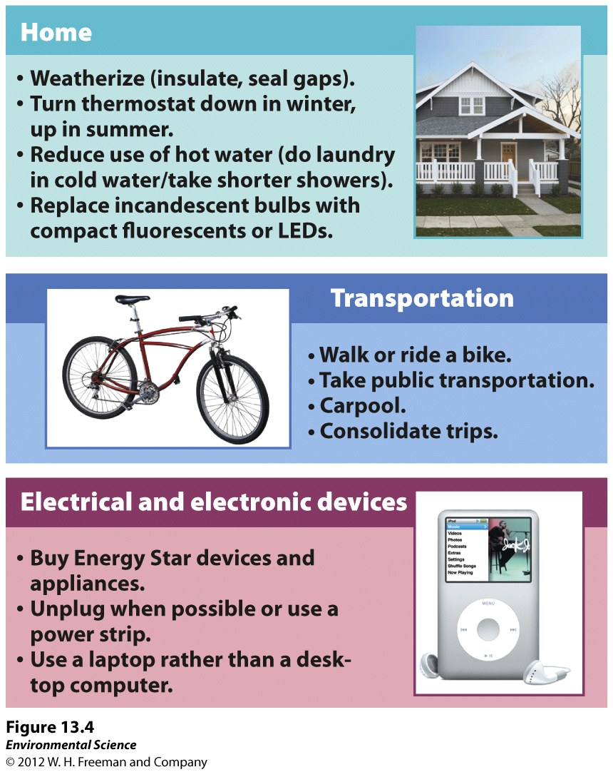

Slide 5
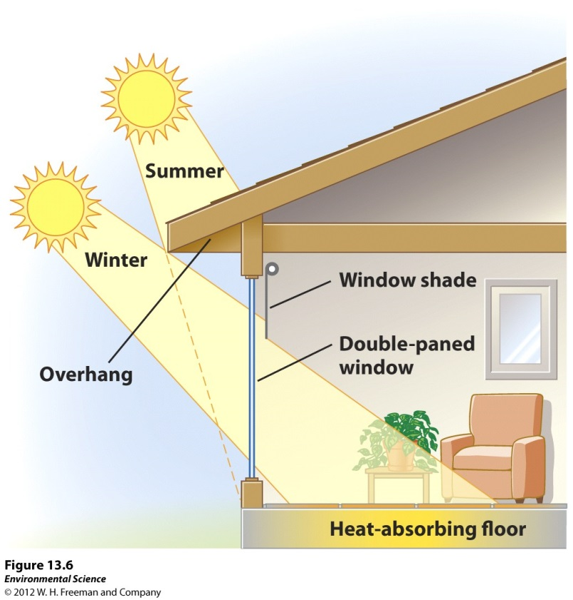
Sustainable design
Using passive solar energy can lower your electricity bill without the need for pumps or other mechanical devices.
Building the house with windows along a south-facing wall which allows the Sun’s rays to warm the house would be an example.

Slide 6
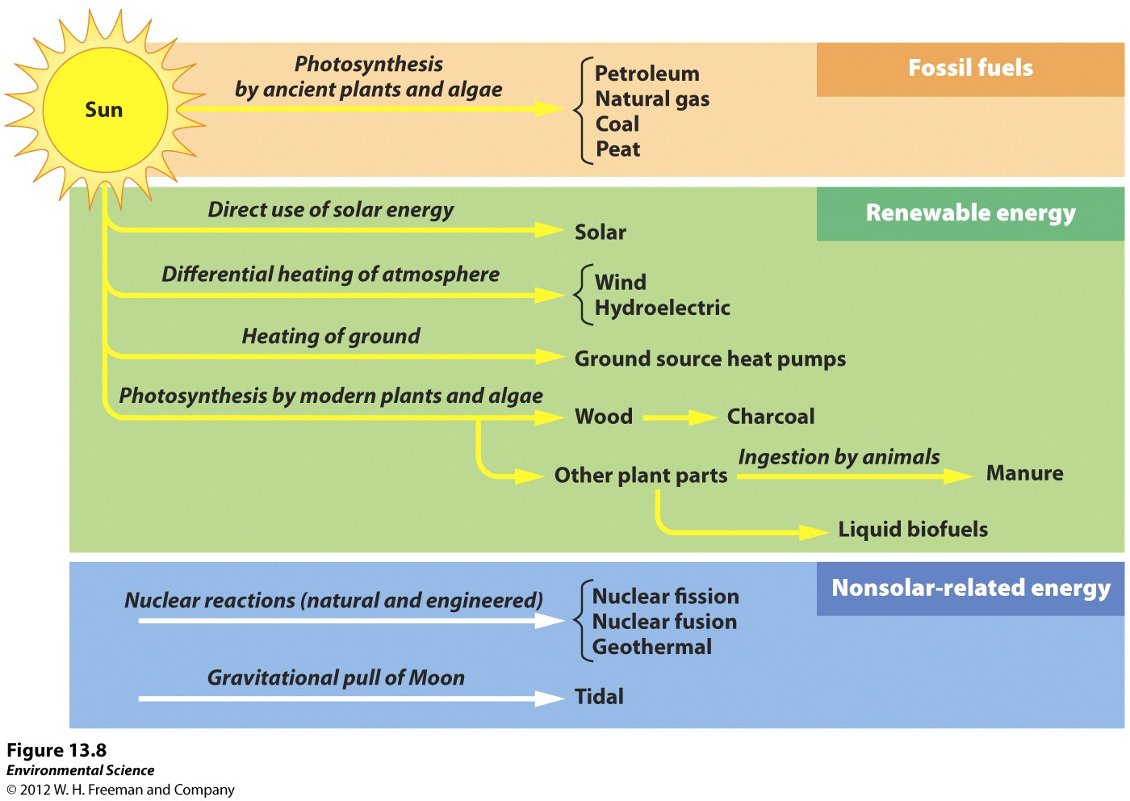

Slide 7
Modern carbon v. Fossil carbon
Many people are confused how burning biomass such as wood is better then burning coal.
The carbon found in biomass was in the atmosphere as carbon dioxide, taken in by the tree, and by burning it we put it back into the atmosphere
Burning coal is carbon that has been buried for millions of years and was out of circulation until we began to use it. This results in a rapid increase in the concentration of carbon dioxide in the atmosphere.

Slide 8
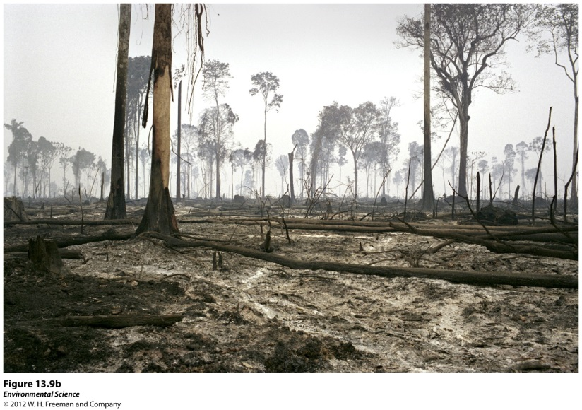
Biomass
Wood, Charcoal and Manure- used to heat homes throughout the world.
Ethanol and Biodiesel (biofuels)- used as substitutes for gasoline and diesel fuel.

Slide 9
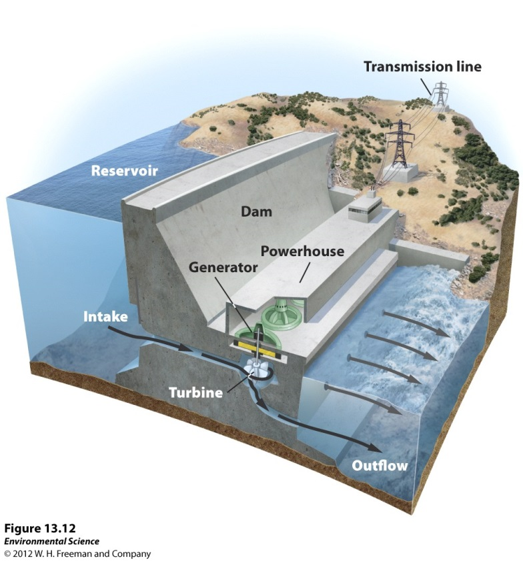
Hydroelectricity
Hydroelectricity- electricity generated by the kinetic energy of moving water. This is the second most common form of renewable energy in the world.
  Run-of-the-river systems- water is held behind a dam and runs through a channel before returning to the river.
  Water impoundment- water is stored behind a dam and the gates of the dam are opened and closed controlling the flow of water.
  Tidal systems- the movement of water is driven by the gravitational pull of the Moon.

Slide 10
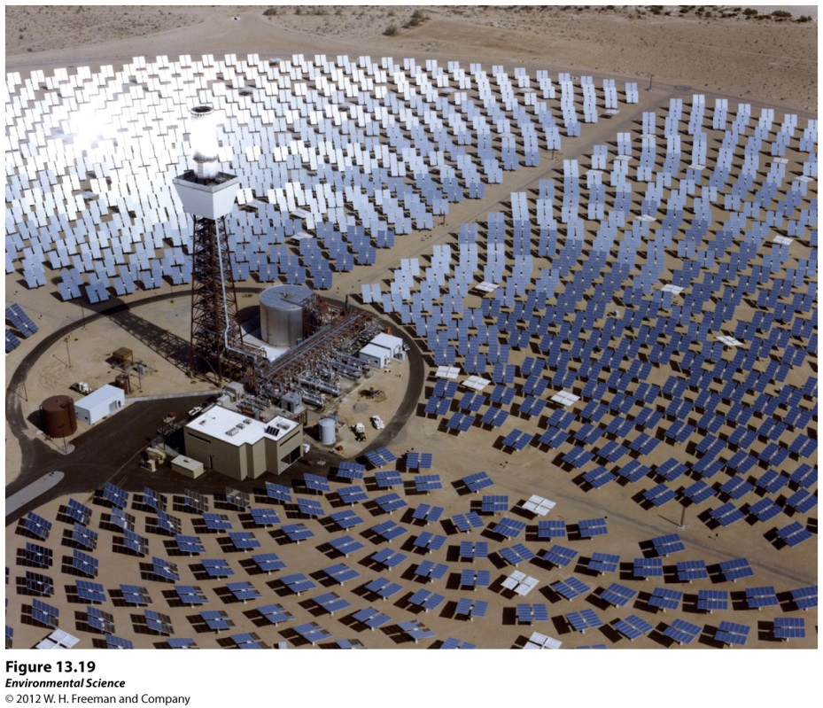
Solar Energy
Active solar energy- capturing the energy of sunlight with the use of a pump or photovoltaic cell and generating electricity.

Slide 11
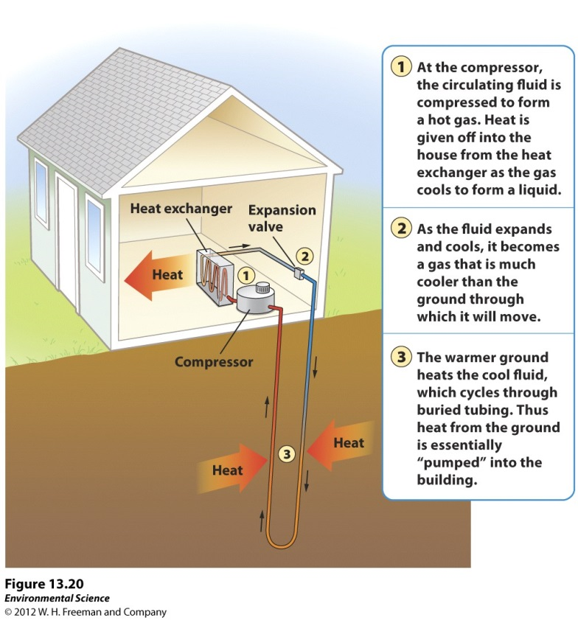
Geothermal Energy
Geothermal energy- using the heat from natural radioactive decay of elements deep within Earth as well as heat coming from Earth.

Slide 12
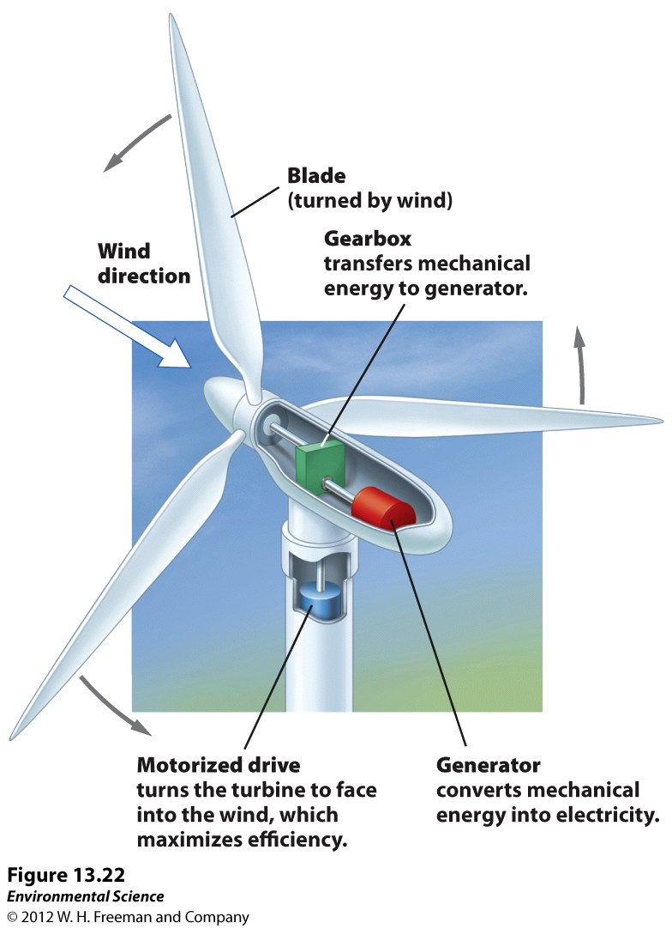
Wind Energy

Slide 13
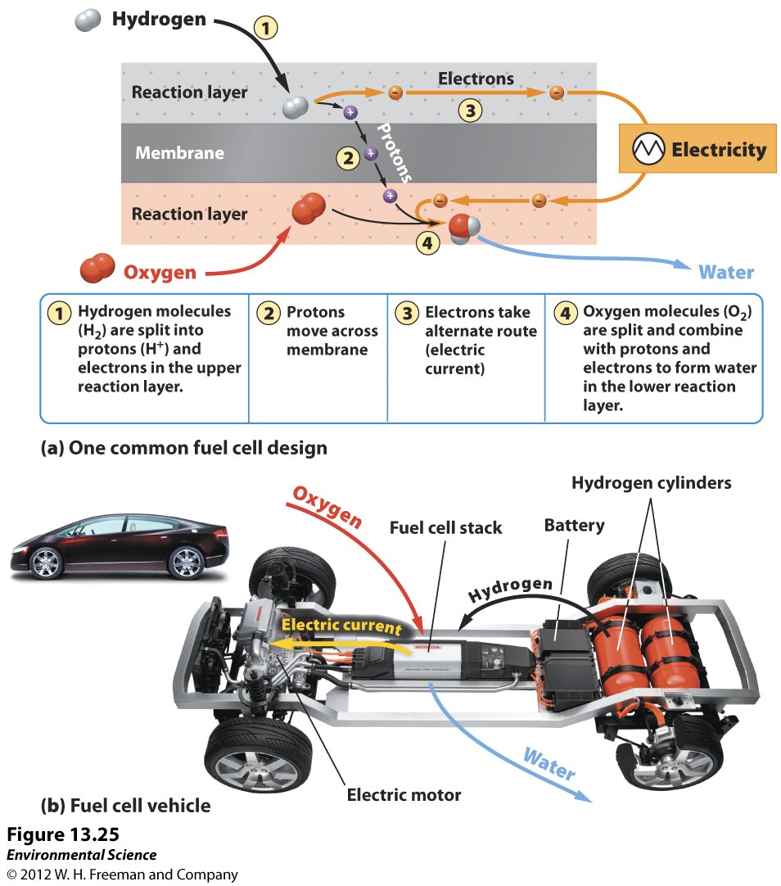
Hydrogen fuel cells
Fuel cell- a device that operates like a common battery where electricity is generated by a reaction between two chemicals.

Slide 14
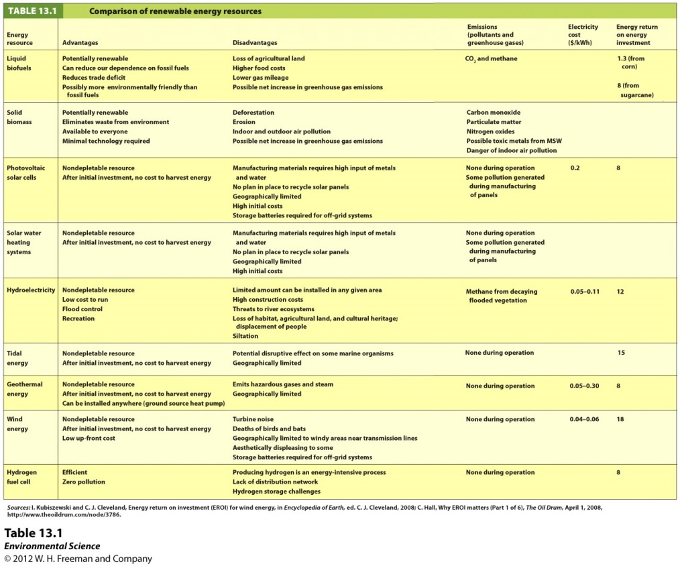
Know!

