Slide 1
Cha.19
Climate Change

Slide 2
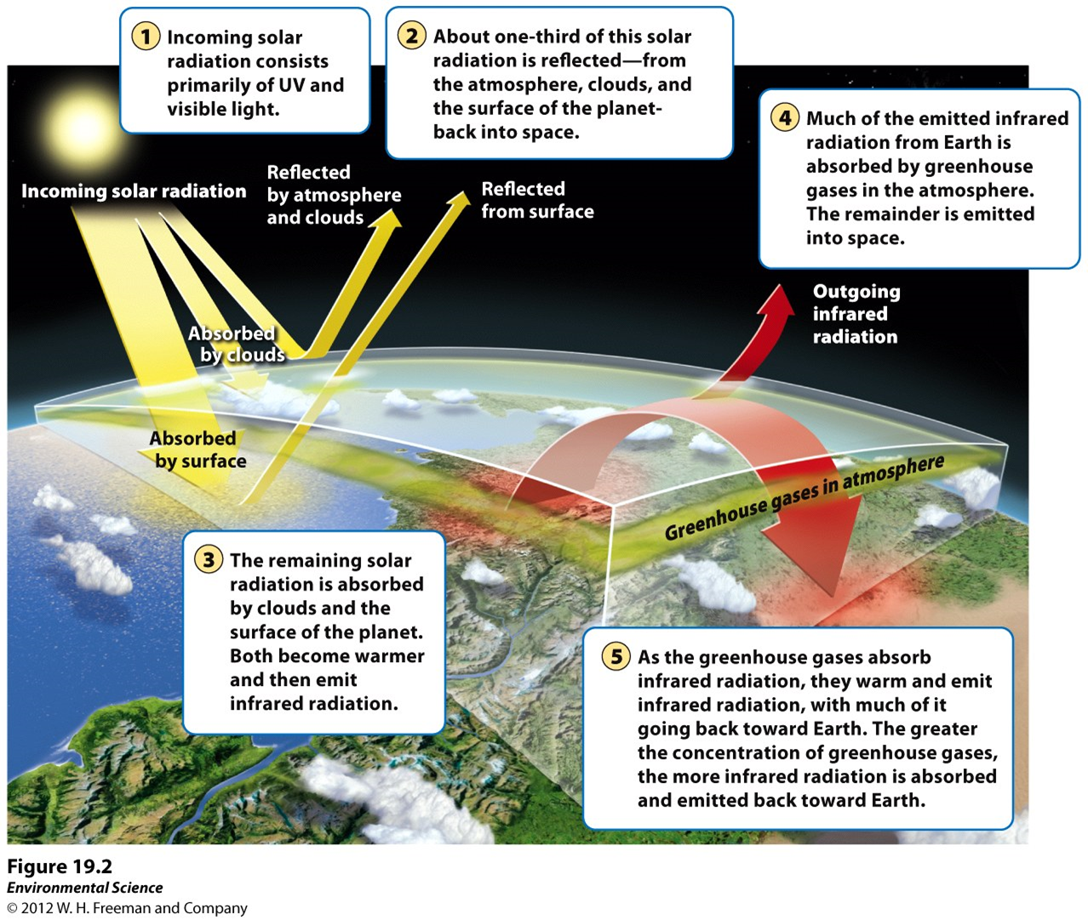

Slide 3
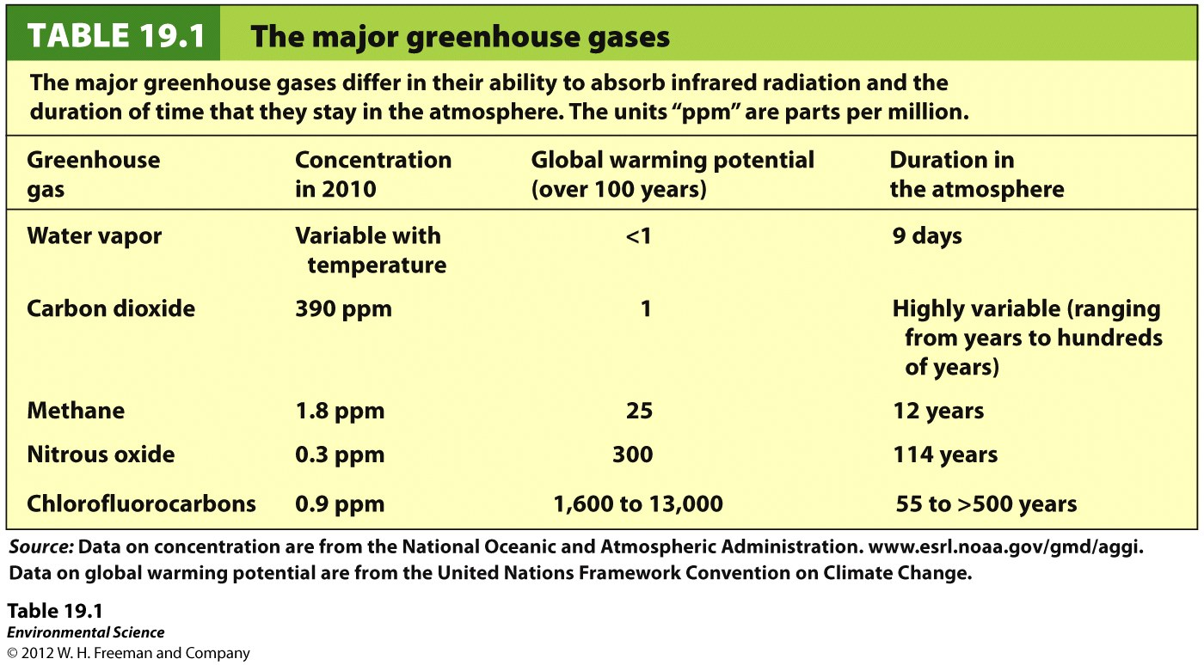

Slide 4
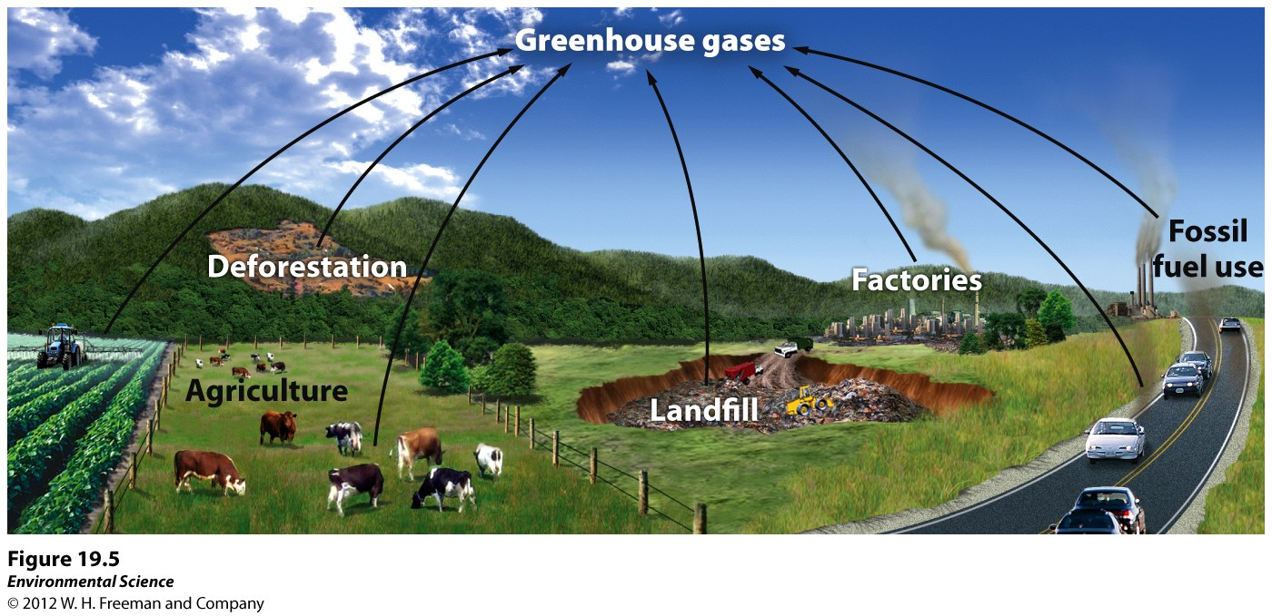

Slide 5
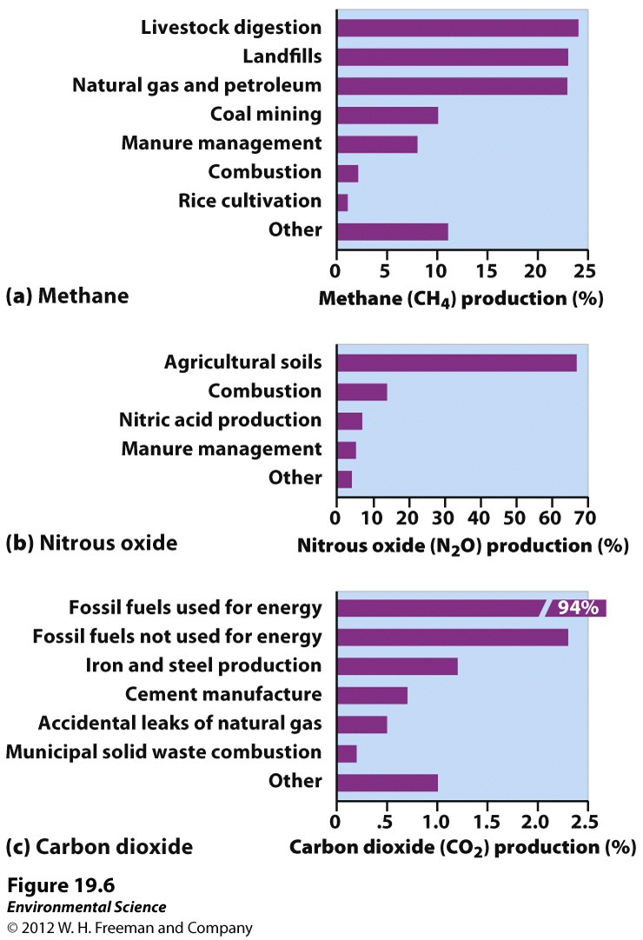

Slide 6
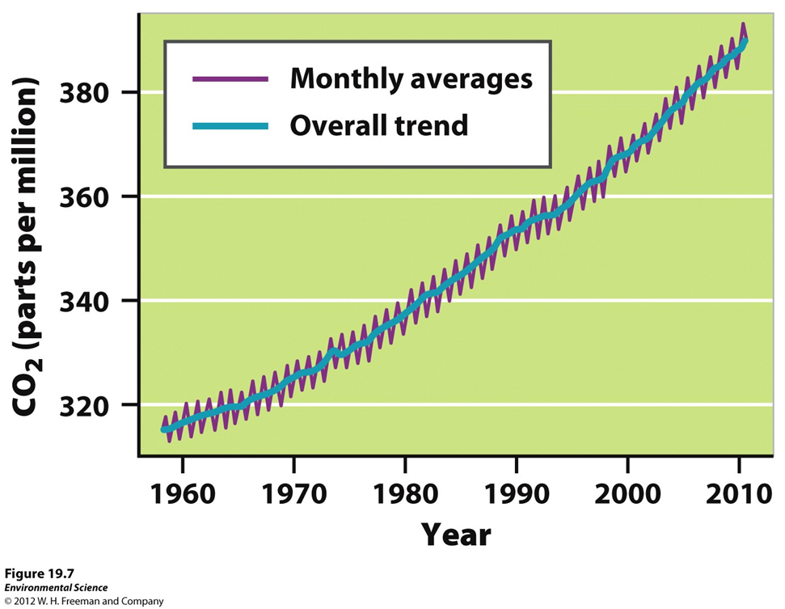
Began measuring in 1958…

Slide 7
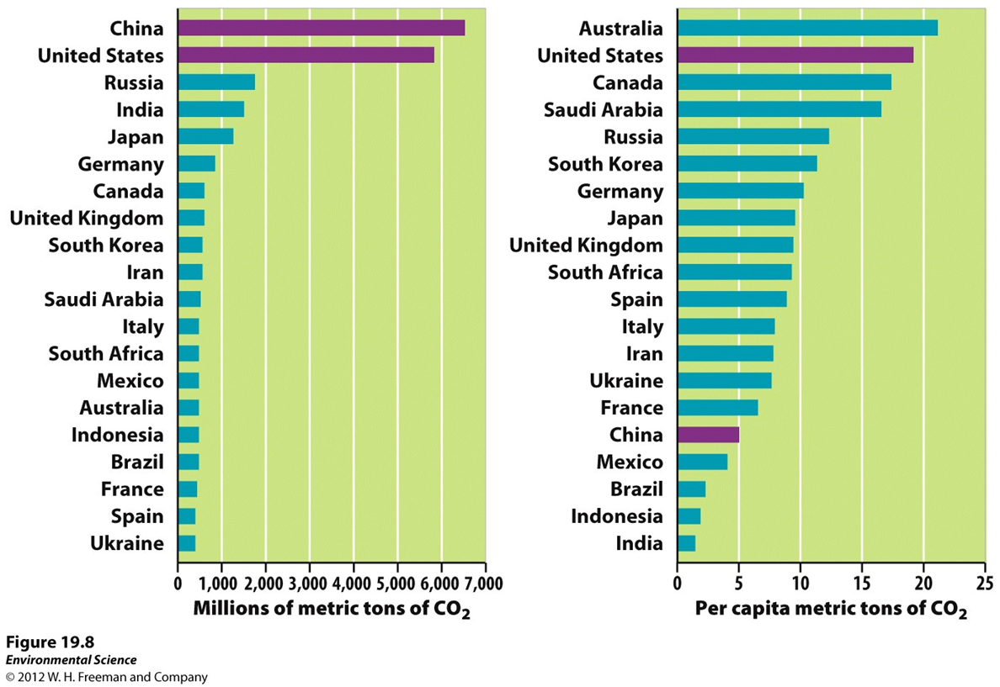

Slide 8
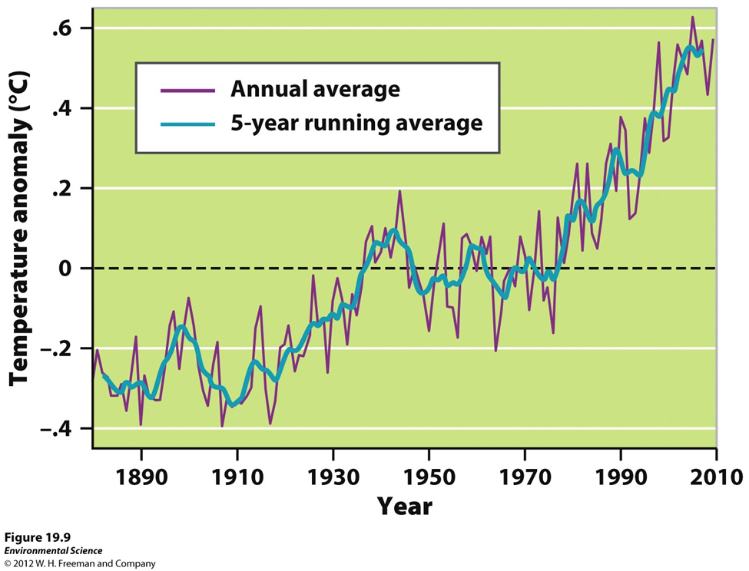
Since 1880 .8◦C Rise

Slide 9
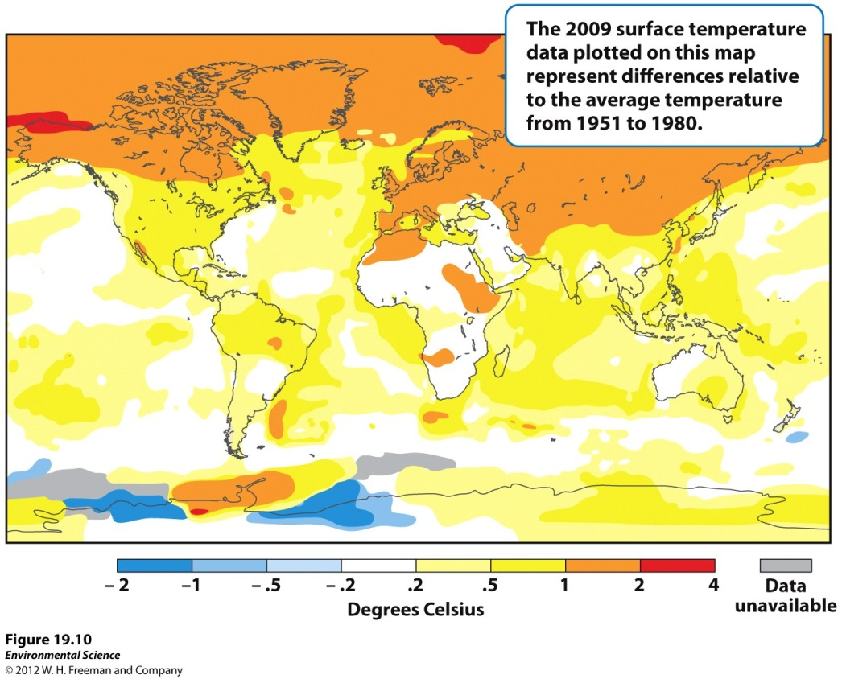
Where it is happening

Slide 10
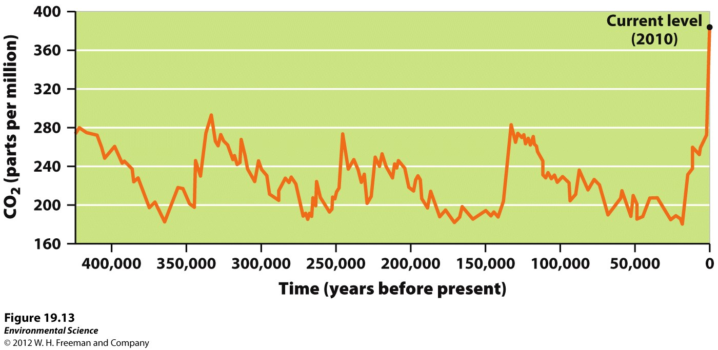
From ice cores…

Slide 11
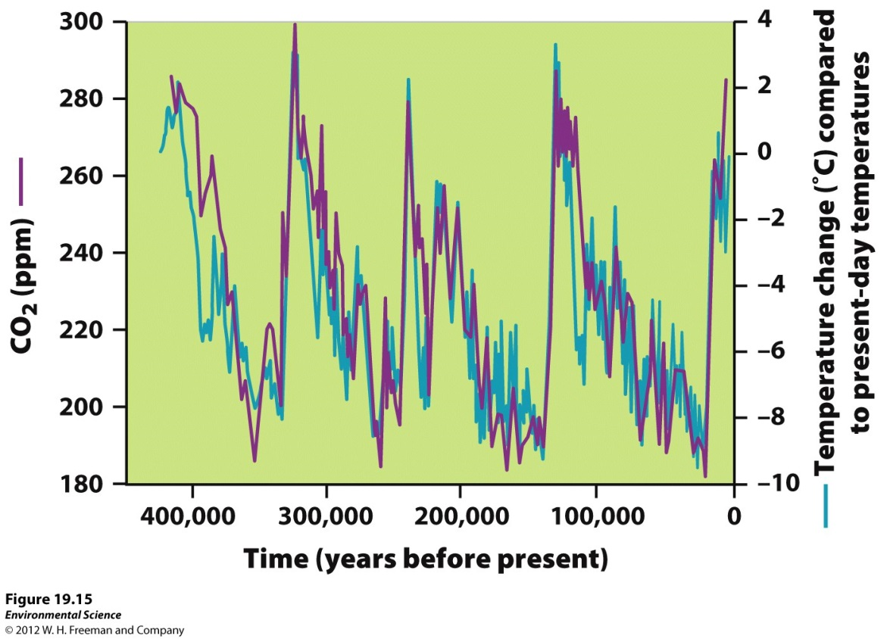
Correlation

Slide 12
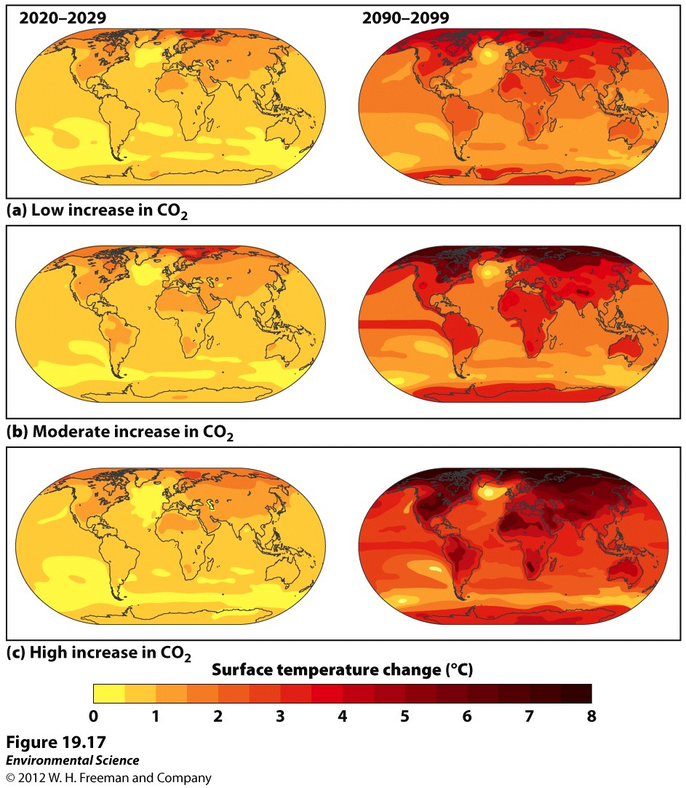
Climate models…

Slide 13
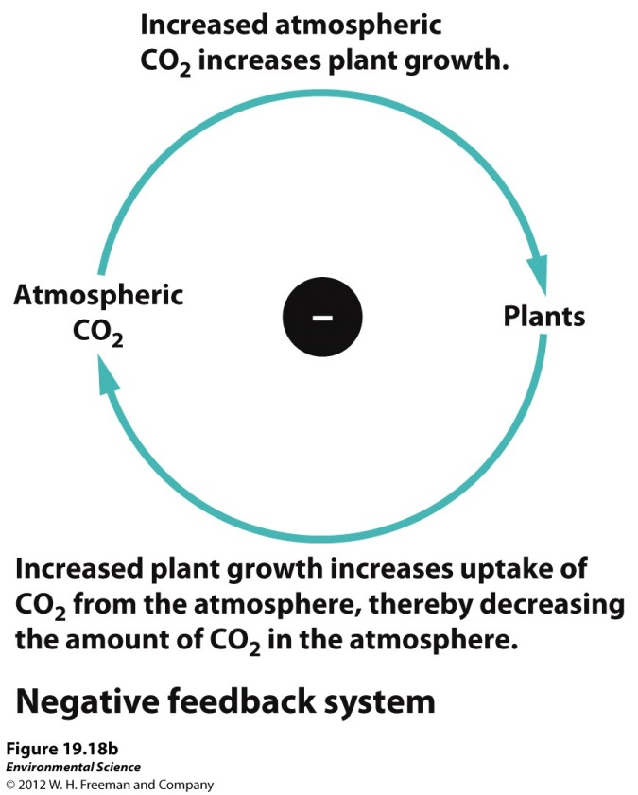
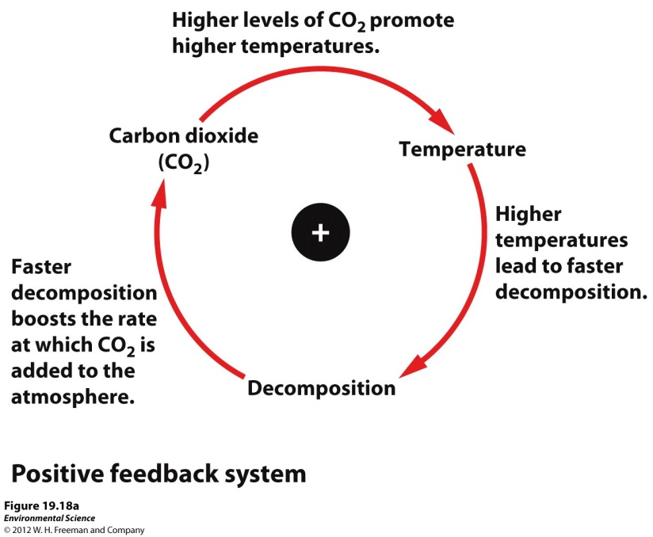
Feedback loops!

Slide 14
Consequences
Melting of polar ice caps, Greenland and Antarctica
Melting of many glaciers around the world
Melting of permafrost
Rising of sea levels due to the melting of glaciers and ice sheets and as water warms it expands
Heat waves
Cold spells
Change in precipitation patterns
Increase in storm intensity
Shift in ocean currents

Slide 15
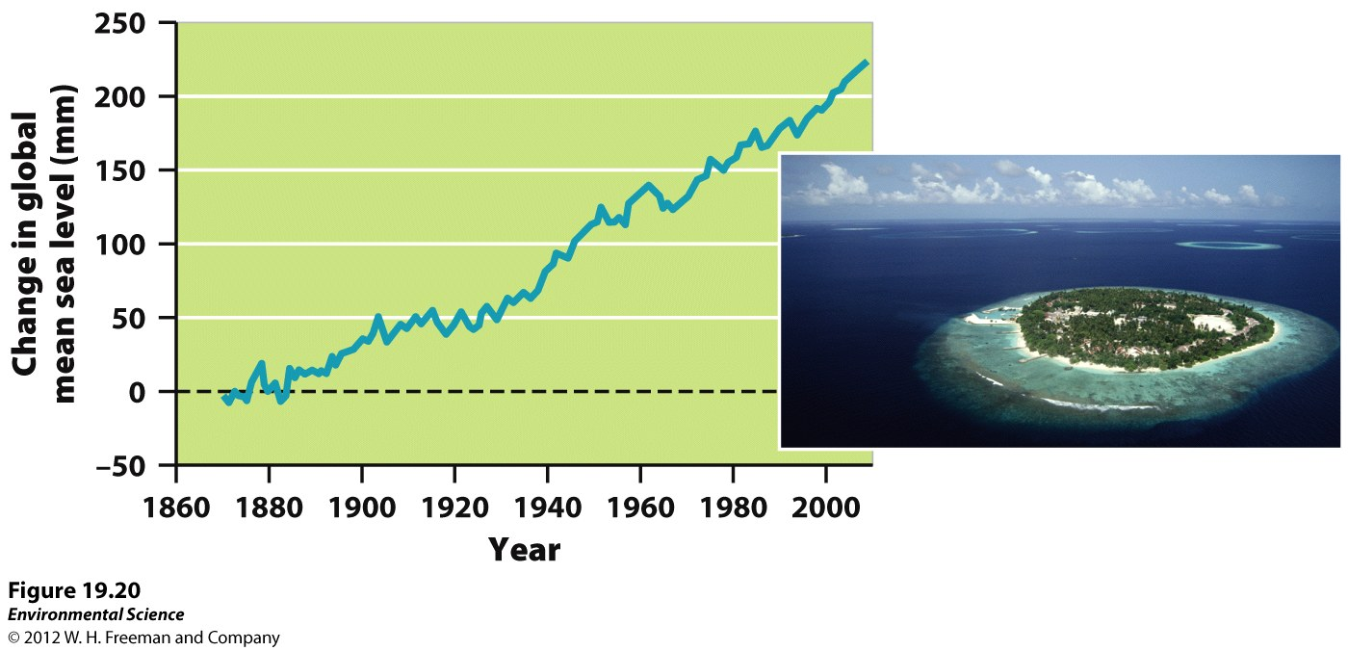
Change in sea level…

Slide 16
