Slide 1
Chapter One
Important Vocabulary

Slide 2
Environment- a sum of all the conditions surrounding us that influence life.
Environmental science- the field that looks at interactions among humans and nature.
System- a set of interacting components that influence one another by exchanging energy or materials.
Ecosystem- the living and non-living components of a particular place on earth.

Slide 3
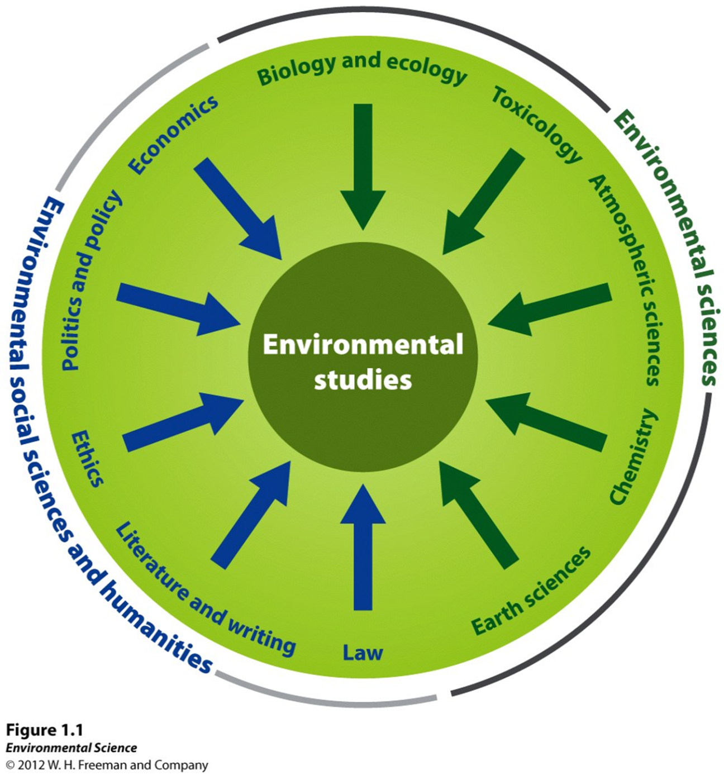

Slide 4
Biotic- the living part of the Earth (animals, plants)
Abiotic- the non-living part of the Earth (soil, air, water)
Environmental studies- includes environmental science, the study of interactions among human systems and those found in nature along with other subjects such as environmental policy, economics, literature and ethics.

Slide 5
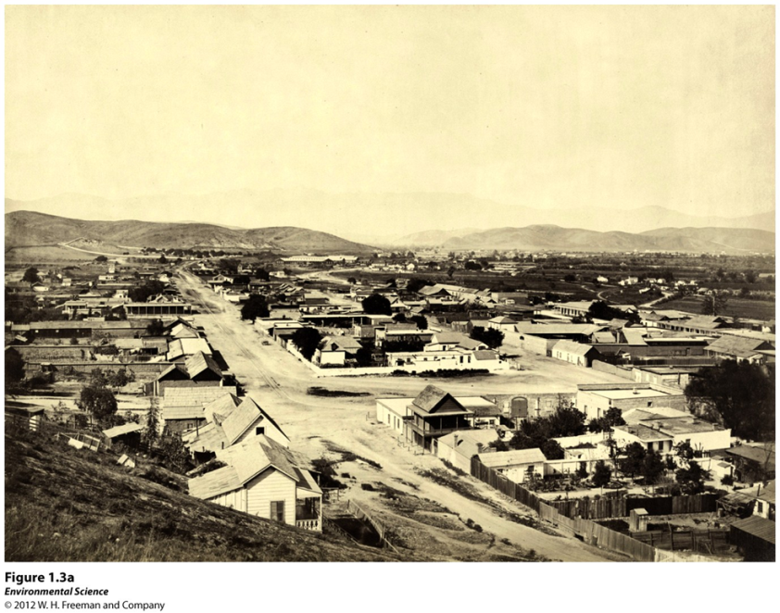
Fact: Humans alter natural systems more than any other species

Slide 6
Ecosystem services- environments provide life supporting services such as clean water, timber, fisheries, crops.
Environmental indicators- describe the current state of the environment.
Sustainability- living on the Earth in a way that allows us to use its resources without depriving future generations of those resources.

Slide 7
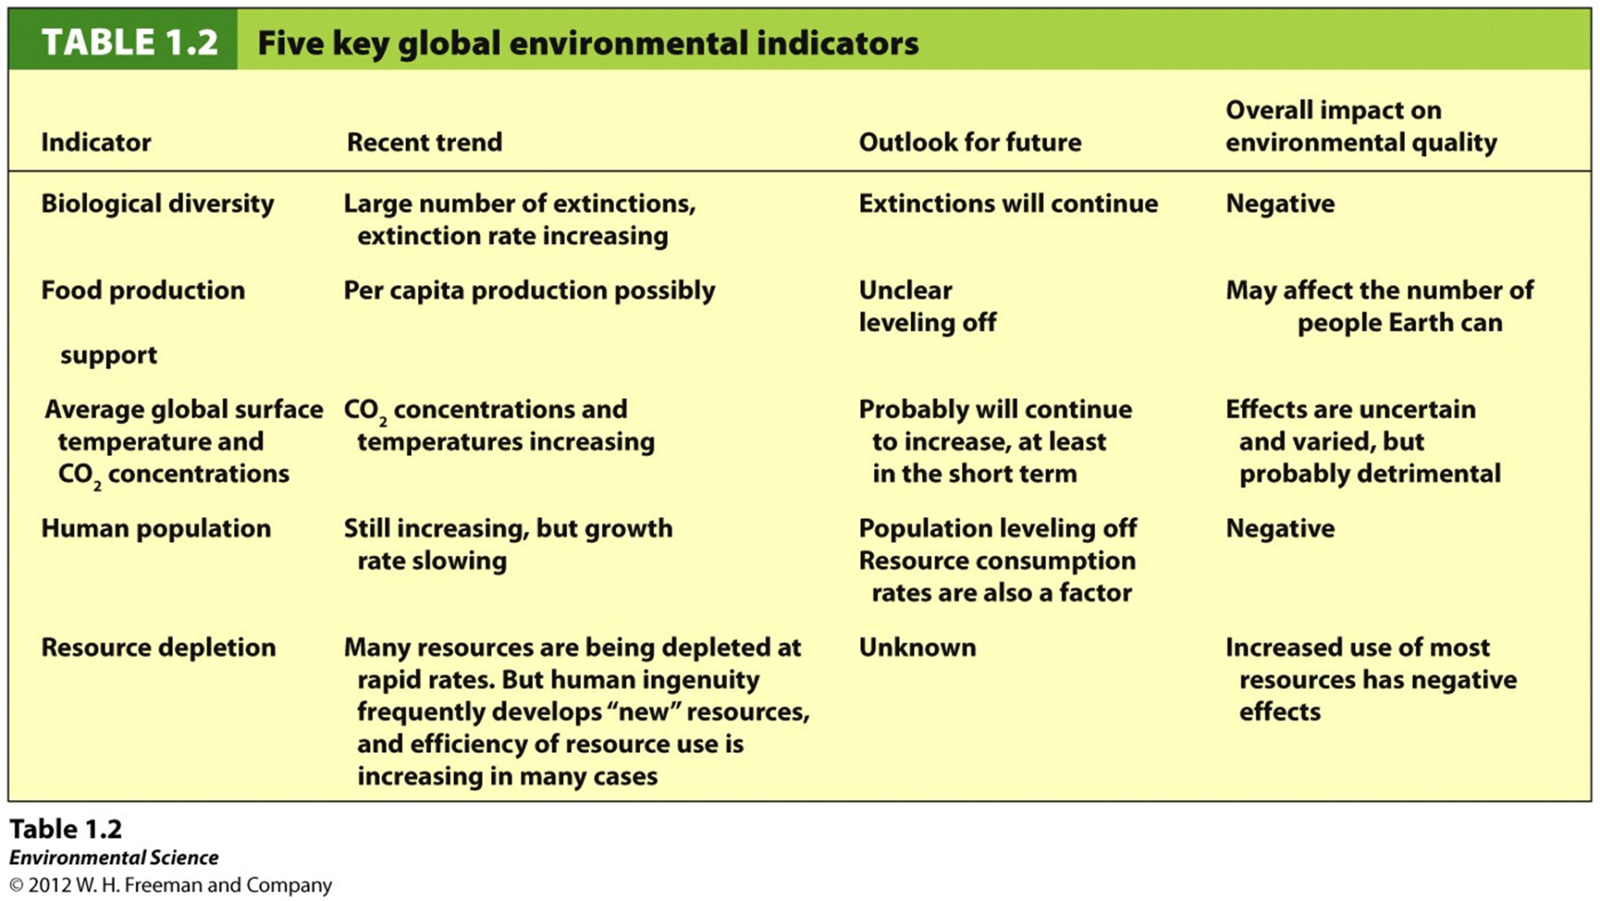
Scientists monitor systems for signs of stress.

Slide 8
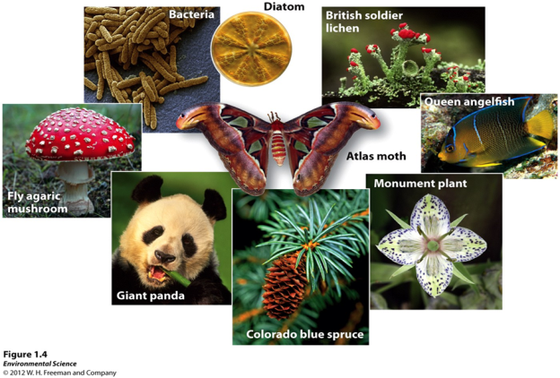
Biological Diversity
Genetic Diversity
Biodiversity- the diversity of life formed in an environment
Biological diversity includes genetic, species and ecosystem diversity.
A measure of the genetic variation among individuals in a population.
Populations with high genetic diversity are better able to respond to environmental change than populations with lower genetic diversity.
Species Diversity
The number of species in a region or in a particular type of habitat.
Species- a group of organisms that is distinct form other groups in form, behavior or biochemical properties. Individuals in a species can breed and produce fertile offspring.
Ecosystem Diversity
A measure of the diversity of ecosystems or habitats that exist in a particular region.

Slide 9
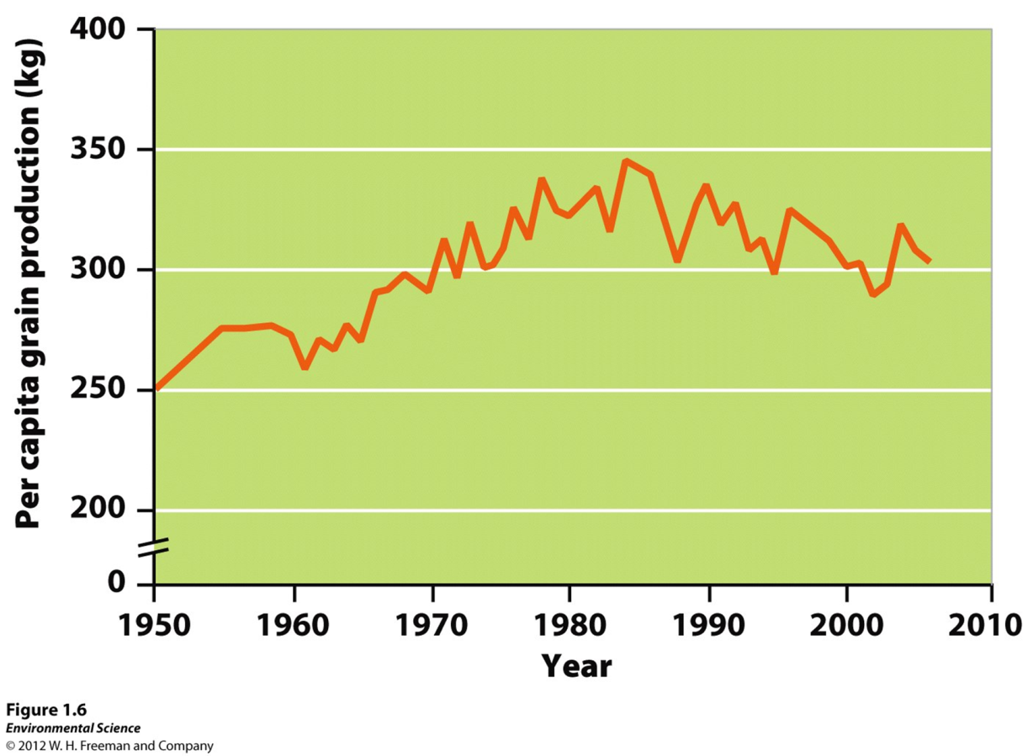
Food production- ability to grow food and nourish the human population
Science and technology increases food/land

Slide 10
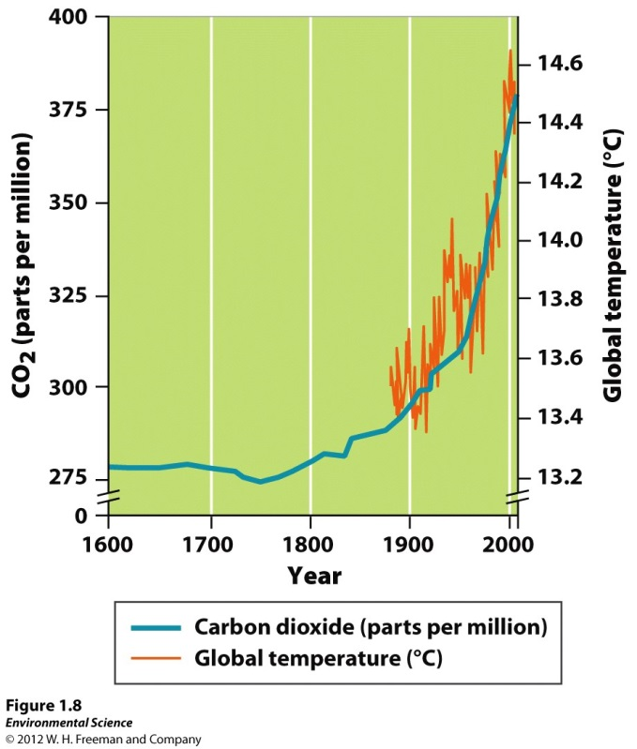
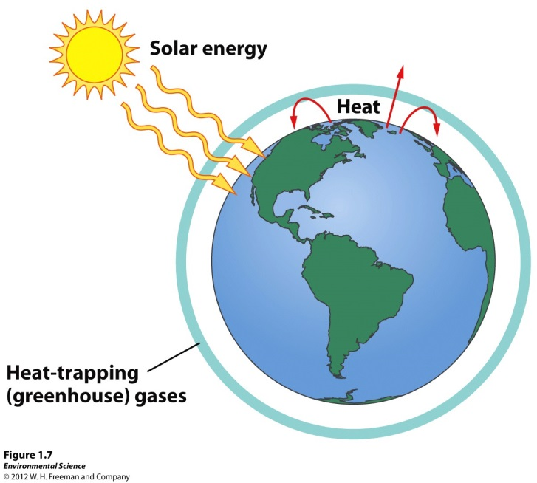
Greenhouse gases- atmospheric gasses that trap heat near Earth’s surface. Relatively constant temperature. Most important CO2.
Anthropogenic- derived from human activities.
Combustion of fossil fuels
Net loss of forests and habitat that would otherwise take up and store CO2

Slide 11
Human population 7.1 billion and growing
About a million extra people every 5 days
Predict 8.1-9.6 billion by 2050
Resource depletion
Pollution & land degradation from mining
Waste from manufactured products
Air pollution from fossil fuel combustion
Development- improvement in human well-being through economic advancement
Human population rising has environmental impact but need to look at economic development and consumption patterns

Slide 12
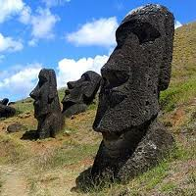
Easter Island- cautionary tale of societal collapse
Harvested trees for houses and canoes (1870’s almost all trees gone)
Overused soil & water resources
No trees to hold soil, no soil not enough food production
Sustainable development- balances current human well-being and economic advancement with resource management for the benefit of future generations.
Environmental systems must not be damaged beyond their ability to recover
Renewable resources must not be damaged beyond their ability to recover
Nonrenewable resources must be used sparingly

Slide 13
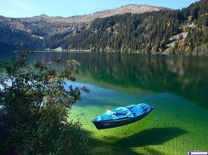
Human Needs
Basic needs- essentials that sustain human life; air, water, food, shelter
Biophilia- Edward O. Wilson, humans exhibit love of life, a need to make “connections that humans subconsciously seek with the rest of life”
Needs for access to nature for beauty and social connections should be considered as vital to our well-being as our basic physical needs and must be considered as part of our long term goal of global sustainability.

Slide 14
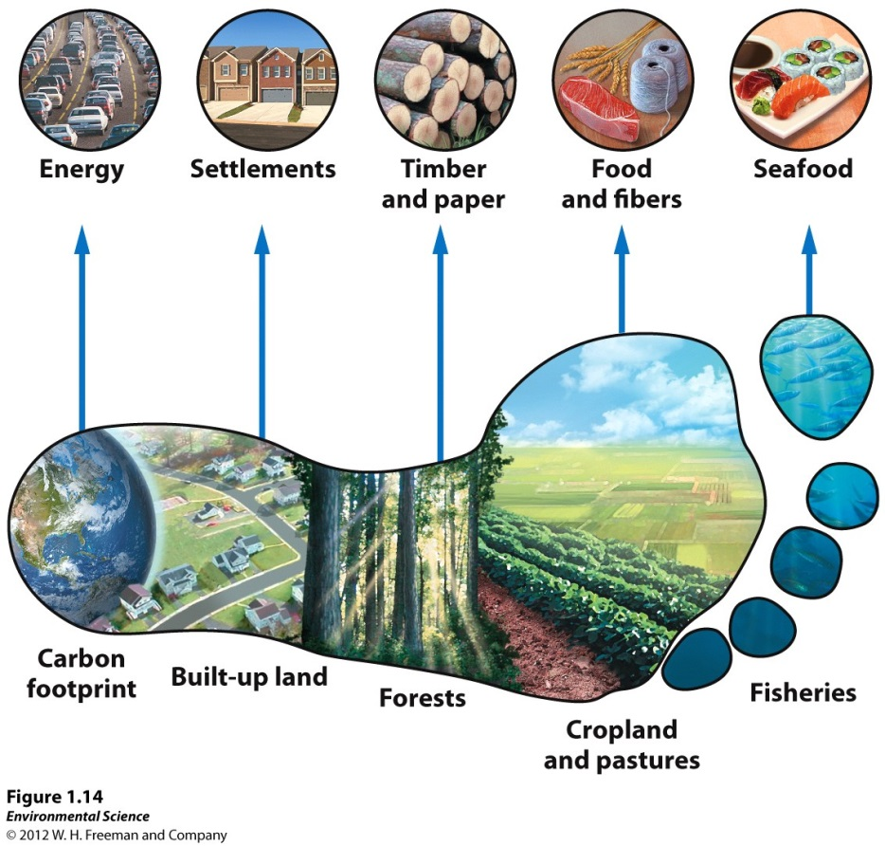
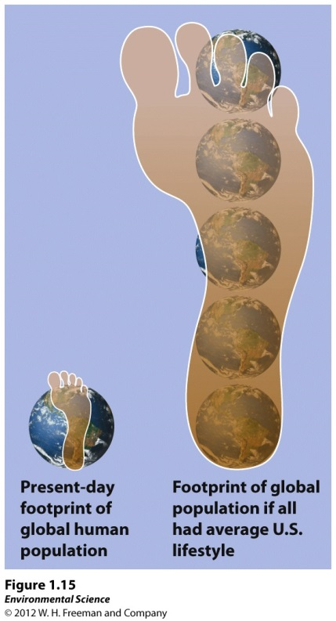
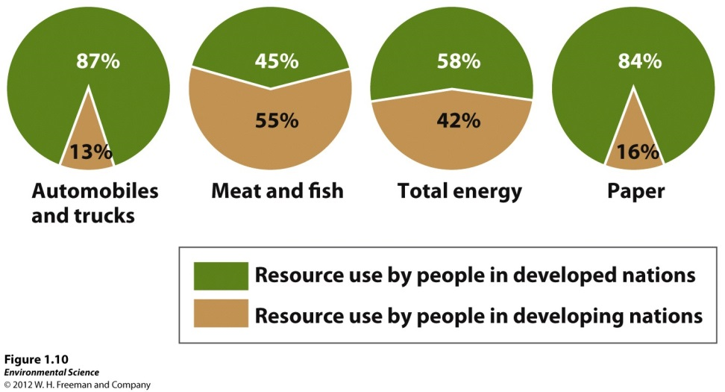
Ecological Footprint

Slide 15
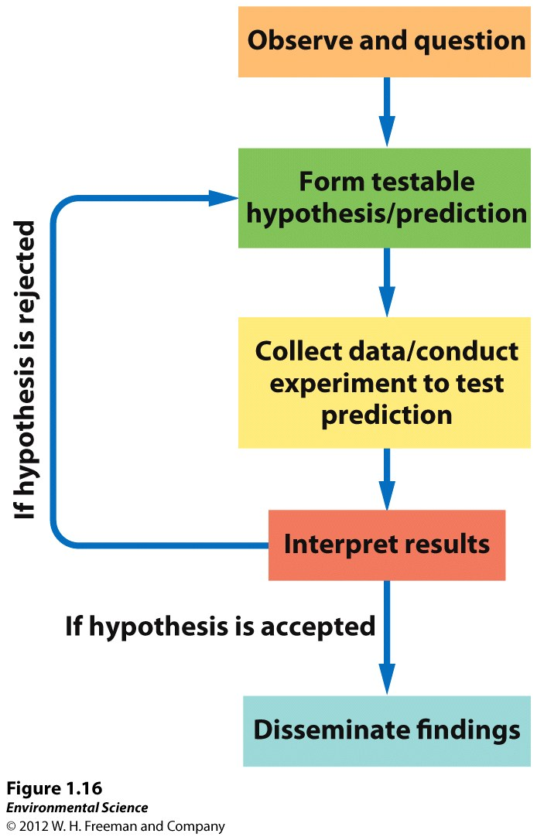
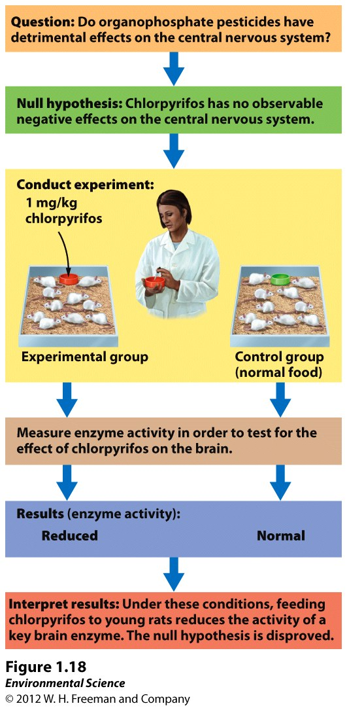
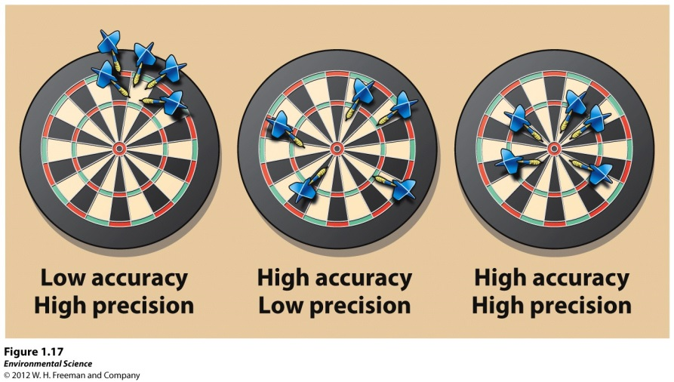

Slide 16
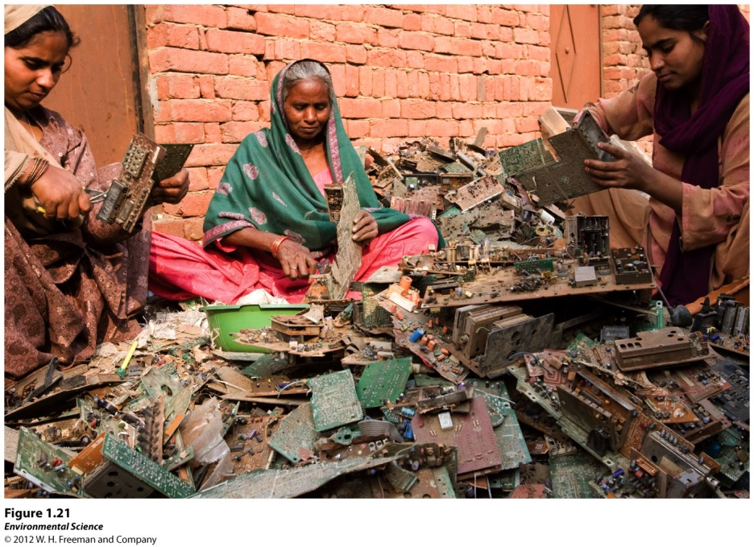
Environmental Justice- social movement and field of study that works towards equal enforcement of environmental laws and the elimination of disparities, whether intended or unintended, in how pollutants and other environmental harms are distributed among the various ethnic and socioeconomic groups within a society.
Complex environmental equity
Carbon footprints
Waste & Pollution
Resource depletion

