Slide 1
Cha. 6
Population and Community Ecology

Slide 2
Nature exists at several levels of complexity…

Slide 3
Population Characteristics
Population size- the total number of individuals within a defined area at a given time.
Population density- the number of individuals per unit area at a given time.
Population distribution- how individuals are distributed with respect to one another.
Population sex ratio- the ratio of males to females
Population age structure- how many individuals fit into particular age categories.

Slide 4
Density Dependent Factors
Density-dependent factors- the size of the population will influence an individual’s probability of survival.
Ex. Available food, water, nest sites
Carrying capacity- limit that food supply can sustain

Slide 5
Density independent Factors
Density-independent factors- the size of the population has no effect on the individual’s probability of survival.
Ex. Natural disasters, hurricanes, floods, fires, climatic events
Bird populations usually regulated by density independent factors

Slide 6
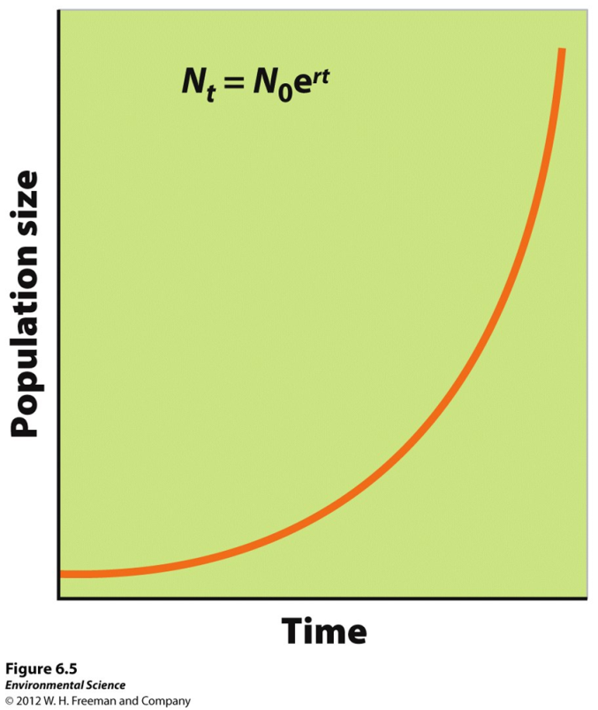
Exponential Growth Model
Growth rate- the number of offspring an individual can produce in a given time period, minus the deaths of the individual or offspring during the same period.
Intrinsic growth rate- under ideal conditions, with unlimited resources, the maximum potential for growth.
J-curve- population not limited by resources (doesn’t happen in nature)

Slide 7
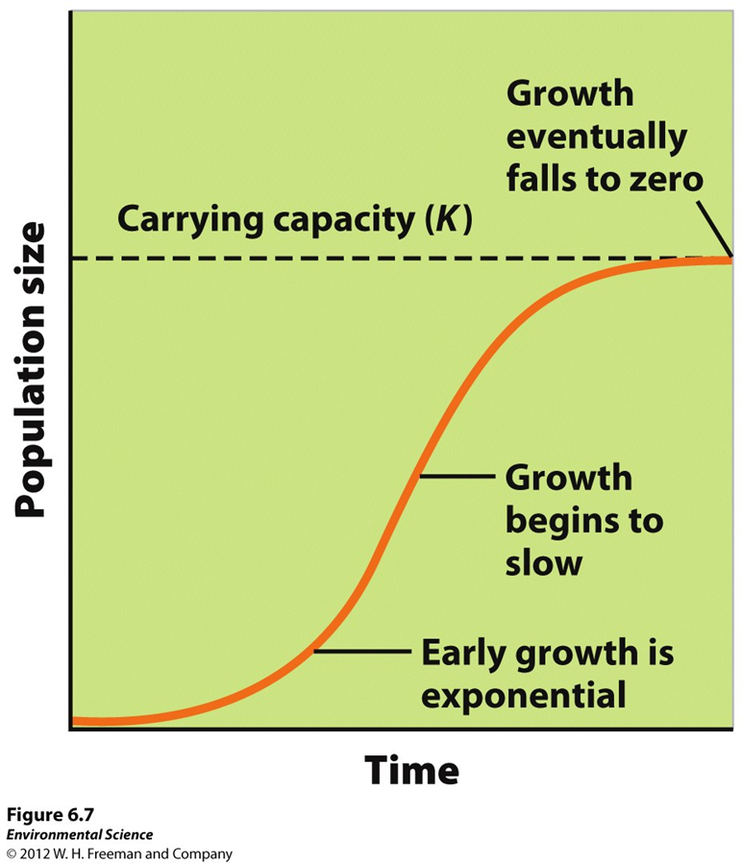
Logistic Growth Model
Logistic growth- when a population whose growth is initially exponential, but slows as the population approaches the carrying capacity.
S-shaped curve- when graphed the logistic growth model produces an “S”.
Subject to density-dependent constraints

Slide 8
Variation of Logistic Model
If food becomes scarce, the population will experience an overshoot by becoming larger than the spring carrying capacity and will result in a die-off, or population crash.

Slide 9
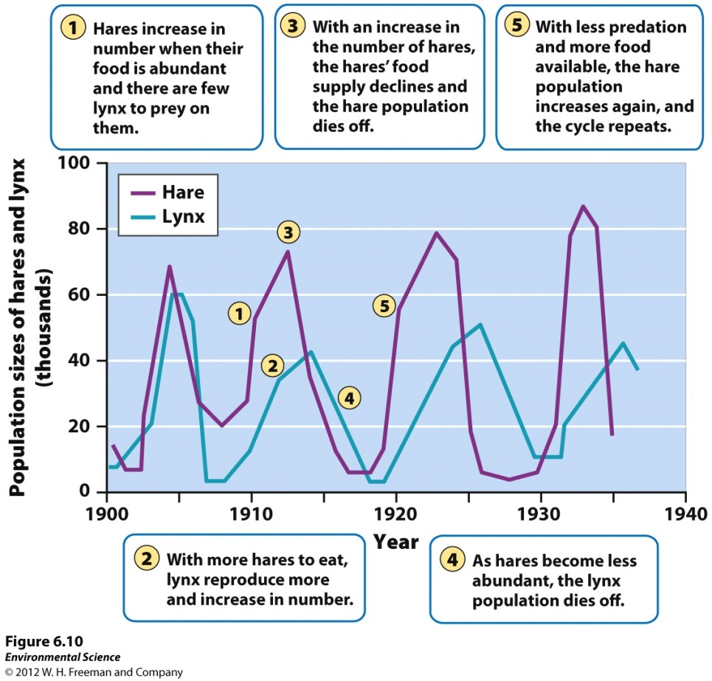
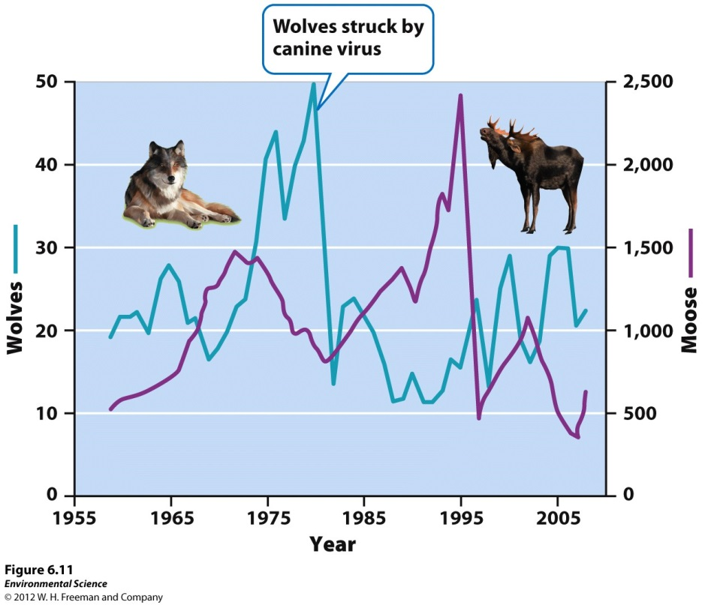
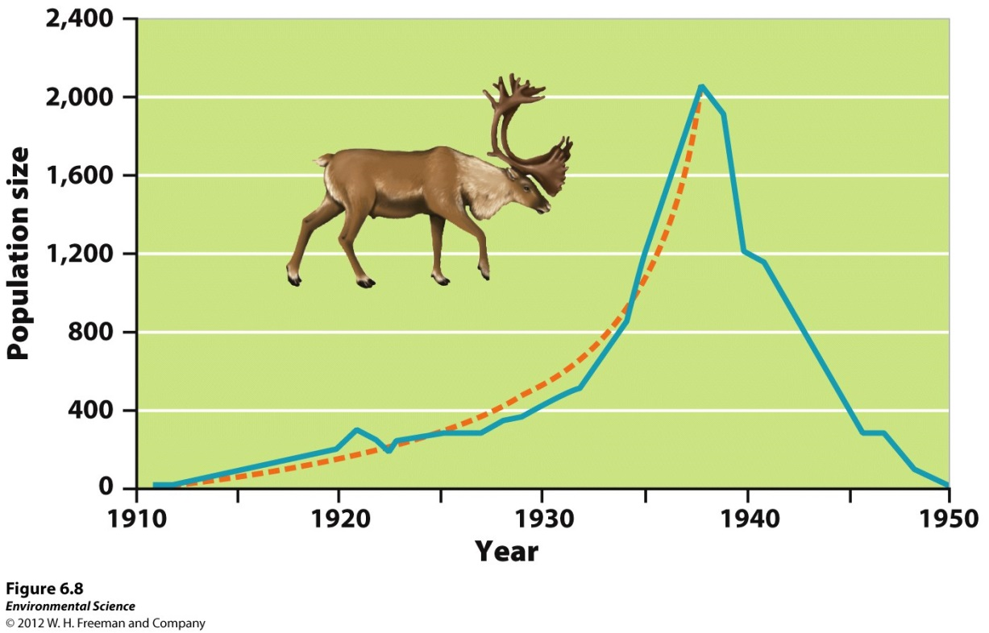

Slide 10
Reproductive Strategies
K-selected species- the population of a species that grows slowly until it reaches the carrying capacity. Ex. elephants, whales, and humans.
R-selected species- the population of a species that grows quickly and is often followed by overshoots and die-offs. Ex. mosquitoes and dandelions

Slide 11
Survivorship Curves
Type I- K-selected species that have high survival rates. As they approach old age, they die in large numbers
Elephants & humans
Type II- Constant decline in survivorship throughout lifetime
Corals & squirrels
Type III- Low survivorship early in life, few individuals reach adulthood
Mosquitos & dandelions

Slide 12
Metapopulations
Metapopulations- a group of spatially distinct populations that are connected by occasional movements of individuals between them.
Help protect species from extinction
# of metapopulations increasing because human activities fragment habitat

