Slide 1
Cha. 10
Land Use Planning

Slide 2
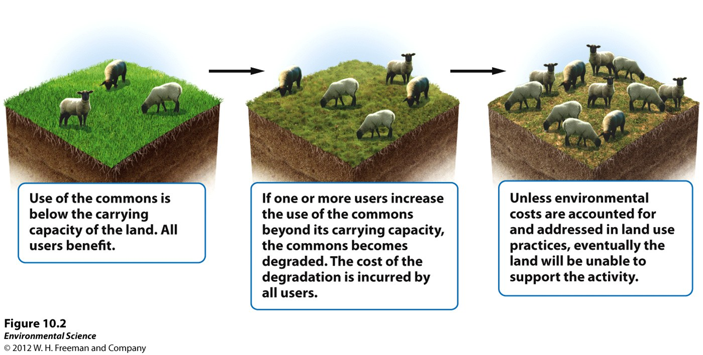
Tragedy of the Commons
1968, Garrett Hardin- tendency of a shared limited resource to become depleted because people act from self interest for short term gain
Commercial fisheries

Slide 3
Externalities
Tragedy of the commons is a result of the economic phenomena called a negative externality
Not included in the purchase price
Concern because can lead to environmental damage that no one is legally or financially responsible for.
Solutions
Private ownership
Regulation
Self-regulation

Slide 4
Maximum sustainable yield
Maximum amount that can be harvested without compromising the future availability of that resource
Amount of harvest that keeps resource population at about half the carrying capacity of the environment
Hard to calculate, in theory this would allow indefinite use without depletion
Example: logging

Slide 5
1/9 of Earth’s land is protected in one way or another

Slide 6
International Categories of Protected Lands
National Parks- managed for scientific, educational, and recreational use, and sometimes for their beauty or unique landforms.
Managed Resource Protected Areas- managed for the sustained use of biological, mineral, and recreational resources.
Habitat/Species Management Areas- actively managed to maintain biological communities.
Strict Nature Reserves and Wilderness Areas- established to protect species and ecosystems.
Protected Landscapes and Seascapes- nondestructive use of natural resources while allowing for tourism and recreation.
National Monuments- set aside to protect unique sites of special natural or cultural interests.

Slide 7
Public Lands in the U.S

Slide 8
Public Land Classifications
Resource conservation ethic- people should maximize resource use based on the greatest good for everyone
Multiple use lands- can be used for recreation, grazing, timber harvesting, and mineral extraction

Slide 9
Land Use and Federal Agencies
Bureau of Land Management (BLM)- grazing, mining, timber harvesting, and recreation
United States Forest Service (USFS)- timber harvesting, grazing, and recreation
National Park Service (NPS)- recreation and conservation
Fish and Wildlife Service (FWS)- wildlife conservation, hunting, and recreation
USFS & NPS are most commonly multiple use lands

Slide 10
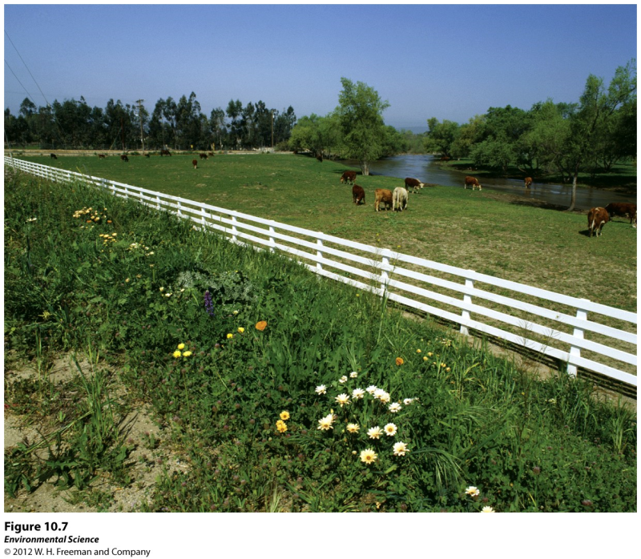
Rangelands
Dry open grasslands used for cattle grazing
Overgrazing can cause rapid soil erosion and makes it difficult for soil to absorb water when it rains
Benefit is that animals can be raised on land too dry to farm, saves fossil fuels from feedlots
Taylor Grazing Act 1934- passed a permit based grazing system
Permits are subsidized because it cost more for federal gov to upkeep the land than permits cost.
BLM set rangeland health guidelines
Not very strict, managers tend to set their own standards
Not consistently successful in preserving rangeland ecosystems

Slide 11
Forests- clear cutting
Clear cutting- cut all trees in an area.
Easiest and most economical
Replant after all new plants the same age
Exposed to a lot of sunlight, ideal for fast growing tree species
Increases wind and water erosion, loss of soil and nutrients
Increased sediment into streams
Increased sunlight to streams, thermal pollution

Slide 12
Forests- selective cutting
Remove small number of trees from among many
Regenerated strand different ages
Optimum growth for shade tolerant trees
Environmental impact less than clear cutting
Construct logging roads, fragmentation and soil compaction

Slide 13
Forests- ecologically sustainable forestry
Goal of maintaining all species as close to natural state as possible
Use animals to pull logs
Hard to compete economically with mechanized logging

Slide 14
Logging, Deforestation, and Reforestation
30% commercial timber produced in US and Canada
Logging often replaces complex forest ecosystems with tree plantations
1982 Federal Regulations provide appropriate habitat for plant and animal communities
Fail to specify how this can be quantified

Slide 15
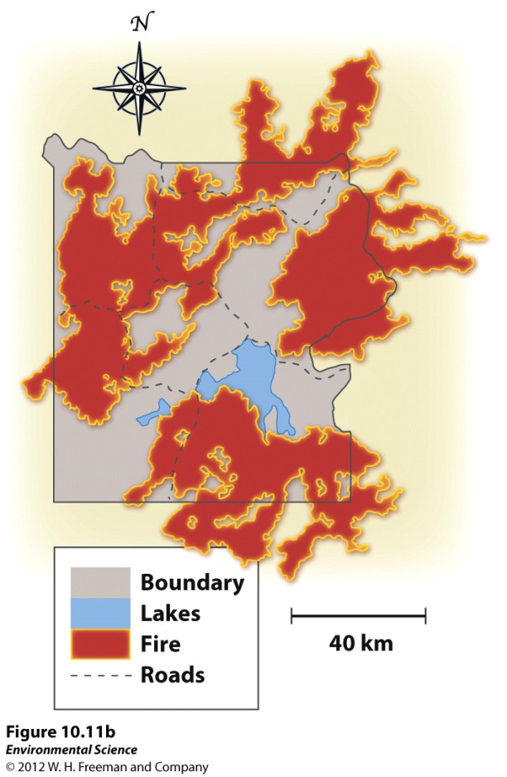
Fire Management
Natural process, releases nutrients tied up in dead biomass
Provides openings for early successional species
Used to try everything to suppress fires, lead to a lot of biomass to fuel large fires
Prescribed Burn- fire set under controlled conditions, help prevent the risk of uncontrolled natural fires
Yellowstone fires of 1988
Burned 1/3 of the trees
Overall now seen as beneficial

Slide 16
National Parks- established to preserve scenic views and unusual landforms.
National wildlife refuges- managed for the purpose of protecting wildlife
National wilderness areas- set aside to preserve large tracts of intact ecosystems or landscapes.

Slide 17
Federal Regulations
National Environmental Policy Act (NEPA)- mandates an environmental assessment of all projects involving federal money or permits.
Environmental impact statement (EIS)- outlines the scope and purpose of the project.
Environmental mitigation plan- outlines how the developer will address concerns raised by the projects impact on the environment.

Slide 18
Residential Land
Suburban- areas surrounding metropolitan centers with low population densities.
Exurban- similar to suburban areas, but are not connected to any central city or densely populated area.

Slide 19
Urban Sprawl
Urban sprawl- the creation of urbanized areas that spread into rural areas.
The four main concerns of urban sprawl in the U.S. are:
automobiles and highway construction
living costs (people can get more land and a larger house in the suburbs for the same amount of money)
urban blight (city revenue shrinks as people move to the suburbs)
government policies

Slide 20
Feedback loops!

Slide 21
Government Policies
Highway Trust Fund- a federal gasoline tax to pay for construction and maintenance of roads and highways.
Zoning- a planning tool to create quieter and safer communities. For example, prohibiting the development of a factory or strip mall in a residential area.
Multi-use zoning- allows retail and high-density residential development to coexist in the same area.
Subsidized mortgages- low interest rates offered to people to purchase a home that would otherwise not be able to do so.

Slide 22
Smart Growth
Mixed land uses
create a range of housing opportunities and choices
create walkable neighborhoods
encourage community and stakeholder collaboration in development decisions
take advantage of compact building design
Foster distinctive, attractive communities with a strong sense of place
Preserve open space, farmland, natural beauty and critical environmental areas
Provide a variety of transportation choices
Strengthen and direct development toward existing communities
Make development decisions predictable, fair and cost-effective

