Slide 1
Cha. 11
Feeding the World

Slide 2
Global Undernutrition

Slide 3
Nutritional Requirements
Undernutrition- not consuming enough calories to be healthy.
Malnourished- a persons diet lacks the correct balance of proteins, carbohydrates, vitamins, and minerals even though they get enough calories.
Overnutrition- too many calories and improper foods that causes a person to become overweight.

Slide 4
Reasons for malnutrition and undernutrition
Reasons for malnutrition and undernutrition
Poverty
Unequal food distribution (rather than absolute scarcity)
Political and economic factors
Agricultural resources being diverted to feed livestock and poultry rather than people (40% of grain grown is to feed livestock)

Slide 5
Annual Meat Consumption

Slide 6
Global Grain Production

Slide 7
Green Revolution
New management techniques and mechanization as well as the triad of fertilization, irrigation, and improved crop varieties. This has increased food production dramatically.

Slide 8
Irrigation Problems
Waterlogging- when the soil remains under water for prolonged periods which impairs root growth because the roots cannot get oxygen.
Salinization- when the small amounts of salts in irrigation water become highly concentrated on the soil surface through evaporation.

Slide 9
Fertilizers
Organic fertilizers- organic matter from plants and animals. Typically made from animal manure that has been allowed to decompose.
Inorganic fertilizers (synthetic)- fertilizers that are produced commercially. This is usually done by combusting natural gas, which allows nitrogen from the atmosphere to be fixed and captured in fertilizer.

Slide 10
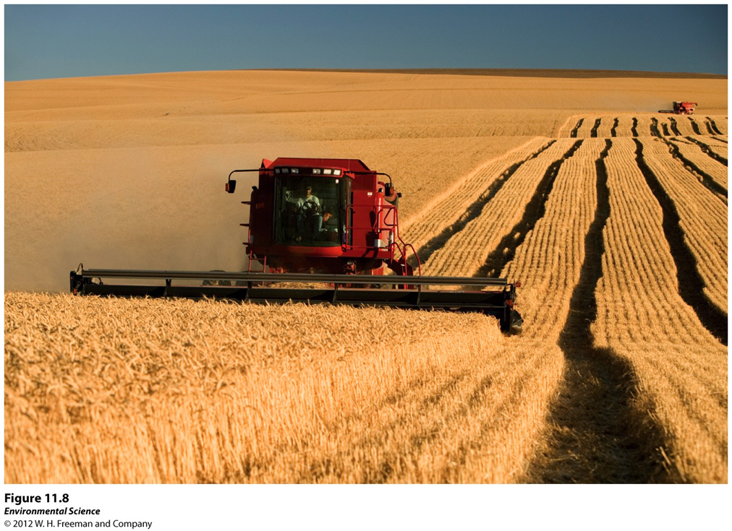
Monocropping
Growing a large amount of a single species of plant.

Slide 11
Pesticides
Pesticide- a substance that kills or controls organisms that people consider pests.
Insecticide- target insects
Herbicides- target plants
Broad-spectrum pesticides- designed to kill many different types of pests.
Selective pesticides- designed to kill a narrower range of organisms.
Persistent- pesticides that remain in the environment a long time.
Non-persistent- pesticide that breaks down relatively rapidly, usually in weeks to months.

Slide 12
Pesticide Harm
Bioaccumulation- some pesticides are found to build up over time in the fatty tissues of predators.
An example was DDT.
When an organism containing the pesticide is eaten, the chemical is transferred to the consumer.
This eventually leads to very high pesticide concentrations at high trophic levels.
https://www.youtube.com/watch?v=9EDZCJMPkEk

Slide 13
Pesticide Resistance
Resistance- pest populations may evolve resistance to a pesticide over time. These are said to be resistant.
Pesticide treadmill- the cycle of pesticide development followed by pest resistance, followed by development of a new pesticide.

Slide 14
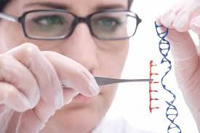
Genetic Engineering
Pros
Cons
Greater yield
Greater food quality
Reductions in pesticide use
Reduction of world hunger by increased food production
Increased profits
Safety for human consumption
Effects on biodiversity
Regulation of genetically modified organisms

