Slide 1
Cha. 12
Non-renewable Energy

Slide 2
Energy Use
Commercial energy sources- those that are bought and sold, such as coal, oil and natural gas.
Subsistence energy sources- those gathered by individuals for their own use such as wood, charcoal and animal waste.

Slide 3
Process of Energy Use

Slide 4
Overall Fuel Efficiency of U.S. Autos

Slide 5
Electricity Generation

Slide 6
Electricity Generation
The burning fuel from coal transfers energy to water, which becomes steam.
The kinetic energy contained within the steam is transferred to the blades of a turbine, a large device that resembles a fan.
As the energy in the steam turns the turbine, the shaft in the center of the turbine turns the generator.
This mechanical motion generates energy.

Slide 7
Electricity Generation

Slide 8
Cogeneration
Cogeneration- using a fuel to generate electricity and to produce heat.
Example- If steam is used for industrial purposes or to heat buildings it is diverted to turn a turbine first.
This improves the efficiency to as high as 90%.

Slide 9
Coal
Coal- a solid fuel formed primarily from the remains of trees, ferns, and other plant materials that were preserved 280-360 million years ago.
Four types of coal ranked from lesser to greater age, exposure to pressure, and energy content.
These four types are: lignite, sub-bituminous, bituminous, and anthracite.
The largest coal reserves are in the United States, Russia, China, and India.

Slide 10
Coal Formation

Slide 11
+/- of Coal

Slide 12
Petroleum
Petroleum- a mixture of hydrocarbons, water, and sulfur that occurs in underground deposits.
Oil and gasoline make this ideal for mobile combustion, such as vehicles.
Formed from the remains of ocean-dwelling phytoplankton that died 50-150 million years ago.
Countries with the most petroleum are Saudi Arabia, Russia, the United States, Iran, China, Canada, and Mexico

Slide 13
+/- of Petroleum

Slide 14
Natural Gas
Natural gas- exists as a component of petroleum in the ground as well as in gaseous deposits separate from petroleum.
Contains 80 to 95 percent methane and 5 to 20 percent ethane, propane, and butane.

Slide 15
+/- Natural Gas

Slide 16
Other Fossil Fuels
Oil sands- slow-flowing, viscous deposits of bitumen mixed with sand, water, and clay.
Bitumen (tar or pitch)- a degraded type of petroleum that forms when a petroleum migrates close to the surface, where bacteria metabolize some of the light hydrocarbons and others evaporate.

Slide 17
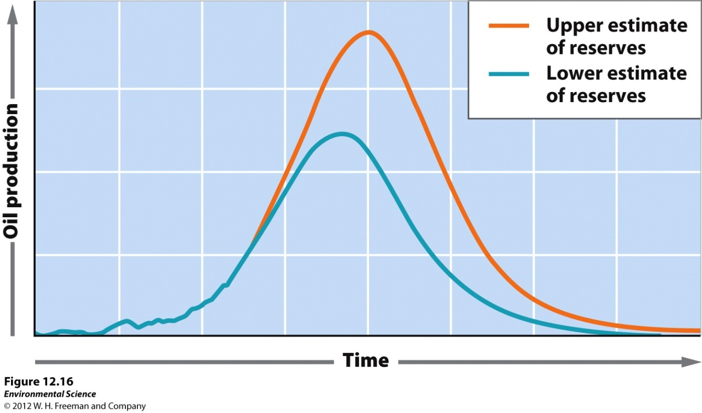
Hubbert Curve
Hubbert curve- a graph that shows the point at which world oil production would reach a maximum and the point at which we would run out of oil.

Slide 18
Future of Fossil Fuel Use
If current global use continues, we will run out of conventional oil in less than 40 years.
Coal supplies will last for at least 200 years, and probably much longer.

Slide 19
Nuclear Energy
Fission- a nuclear reaction in which a neutron strikes a relatively large atomic nucleus, which then splits into two or more parts.

Slide 20
Nuclear Reactors
Fuel rods- the cylindrical tubes that house the nuclear fuel used in a nuclear power plant.
Nuclear power plants work by using heat from nuclear fission to heat water. This water produces the steam to turn the turbine, which turns a generator.
Control rods- cylindrical devices that can be inserted between the fuel rods to absorb excess neutrons, thus slowing or stopping the fission reaction.

Slide 21
+/- of Nuclear Energy

Slide 22
Radioactive Waste
Radioactive waste- once the nuclear fuel can not produce enough heat to be used in a power plant but it continues to emit radioactivity.
This waste must be stored in special, highly secure locations because of the danger to living organisms.
High-level radioactive waste- the form used in fuel rods.
Low-level radioactive waste- the protective clothing, tools, rags, and other items used in routine plant maintenance.
Uranium mine tailings- residue left after uranium is mined and enriched.

Slide 23
Fusion
Nuclear fusion- the reaction that powers the Sun and other stars. This occurs when lighter nuclei are forced together to produce heavier nuclei and heat is released.
Fusion is a promising, unlimited source of energy in the future, but so far scientists have had difficulty containing the heat that is produced.

