Slide 1
Cha.14
Water Pollution

Slide 2
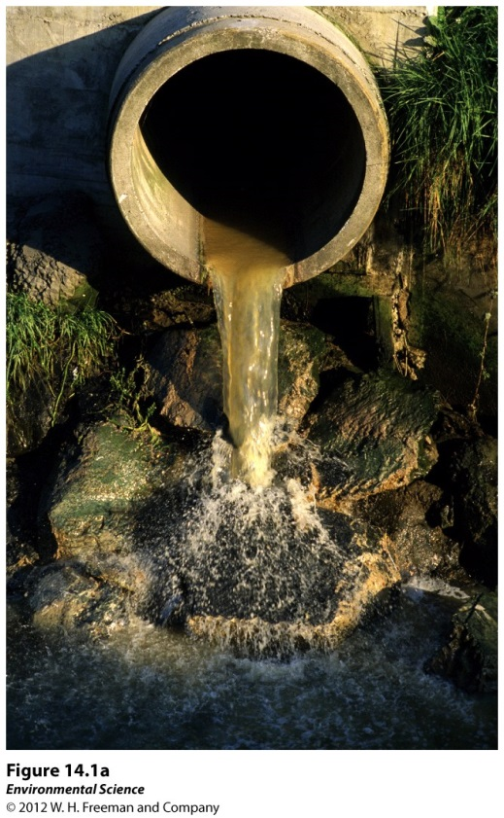
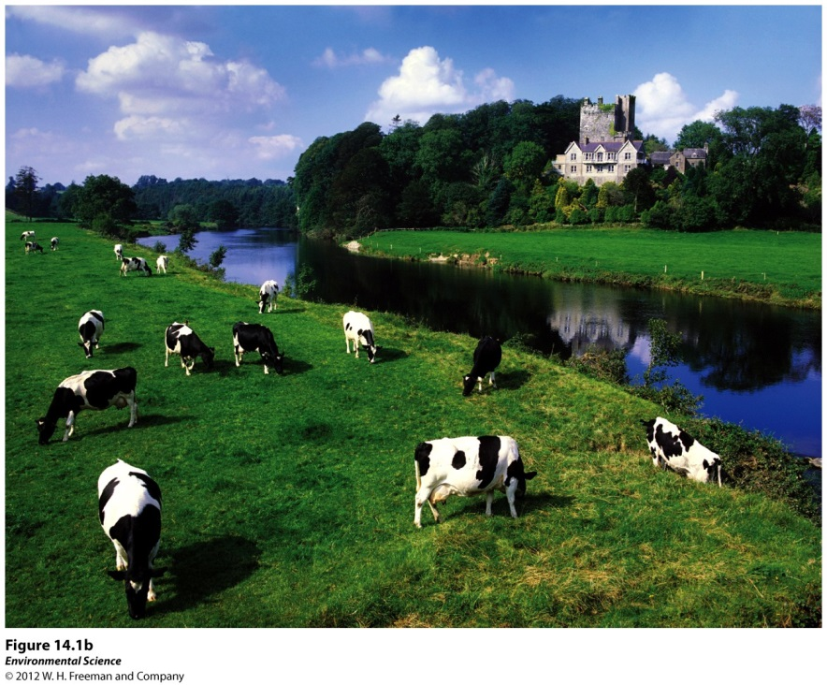
Sources
Point sources- distinct locations that pump waste into a waterway.
Nonpoint sources- diffuse areas such as an entire farming region that pollutes a waterway.

Slide 3
Human Wastewater
Water produced by human activities such as human sewage from toilets and gray water from bathing and washing clothes or dishes.

Slide 4
Human Wastewater Problems
Oxygen-demanding wastes like bacteria that put a large demand for oxygen in the water
Nutrients that are released from wastewater decomposition can make the water more fertile causing eutrophication
Wastewater can carry a wide variety of disease-causing organisms.

Slide 5
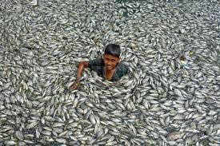
Biochemical Oxygen Demand (BOD)
BOD- the amount of oxygen a quantity of water uses over a period of time at a specific temperature.
Lower BOD values indicate the water is less polluted and higher BOD values indicate it is more polluted by wastewater.

Slide 6
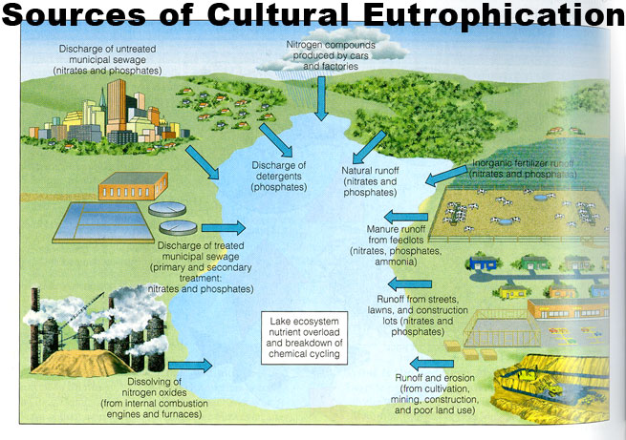
Eutrophication
Eutrophication is an abundance of fertility to a body of water.
Eutrophication is caused by an increase in nutrients, such as fertilizers.
Eutrophication can cause a rapid growth of algae which eventually dies, causing the microbes to increase the BOD.

Slide 7
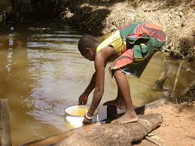
Common Diseases from Wastewater
Cholera
Typhoid fever
Stomach flu
Diarrhea
Hepatitis

Slide 8
Treatments for Human and Animal Wastewater
Septic systems- a large container that receives wastewater from the house.

Slide 9
Treatments Cont…
Sewage Treatment Plants- centralized plants in areas with large populations that receive wastewater via a network of underground pipes.

Slide 10
More treatments…
Manure lagoons- large, human-made ponds line with rubber to prevent the manure from leaking into the groundwater. After the manure is broken down by bacteria, it is spread onto fields as fertilizers.

