Slide 1
Smog, Acid deposition, and Thermal Inversions

Slide 2
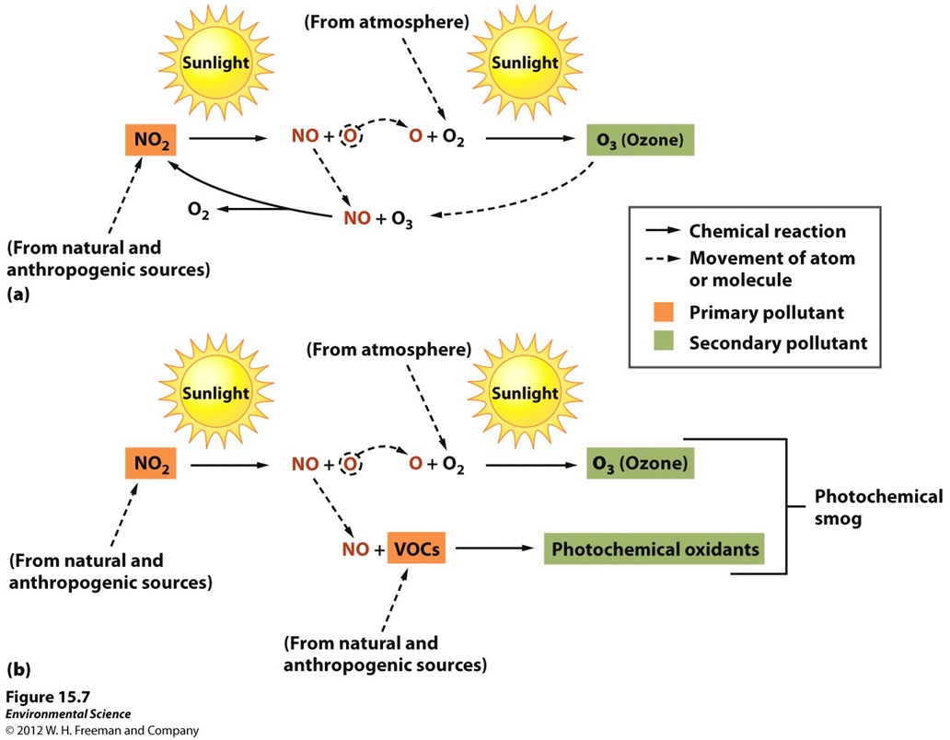
Formation of Smog

Slide 3
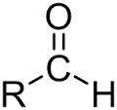
Steps Photochemical
1. Nitrogen and oxygen become nitric oxides under high temps. Emissions from power plants, cars, boilers, coal power plants.
2. NO₂ reacts with water vapor forming nitric acid and nitric oxide
•NO₂ + H₂0 -> 2HNO₃ + NO
3. Remaining NO₂ reacts with sunlight forming NO and O
4. O atoms react with O₂ forming OZONE
5. O and O₃ react with volatile organic compounds (VOCs)
6. Hydrocarbons, oxygen, nitrogen dioxide, react to produce peroxyacyl nitrates (PAN)
•NO₂, O₂, Pans are called photochemical oxidants (Smog)

Slide 4
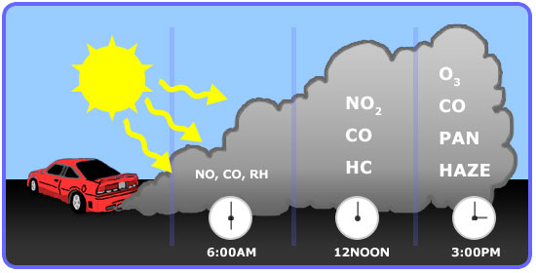
When it forms
Increases during the morning commute as cars release nitrogen
•Increases with sunlight; smog is worst in summer warm cities: Los Angeles, Denver, Salt Lake City, Mexico City, Buenos Aires, Sydney, Sao Paolo

Slide 5
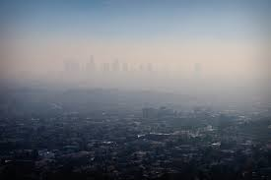
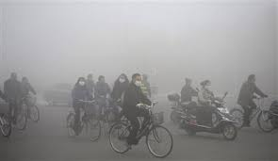
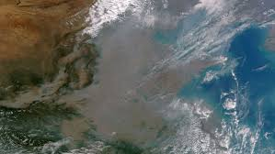
Smoggy cities
Worst/Best smog cities
State of the Air

Slide 6
Thermal Inversions
Thermal Inversion- when a relatively warm layer of air at mid-altitude covers a layer of cold, dense air below.
The warm inversion layer traps emissions that then accumulate beneath it.
Tianjin, China 1998- Cold spell happened after the city shut down its central heating system for the season; many households used coal burning stoves for heat. Temp. inversion trapped CO and PM from the coal; 1000 people suffered from CO poisoning, 11 people died.

Slide 7
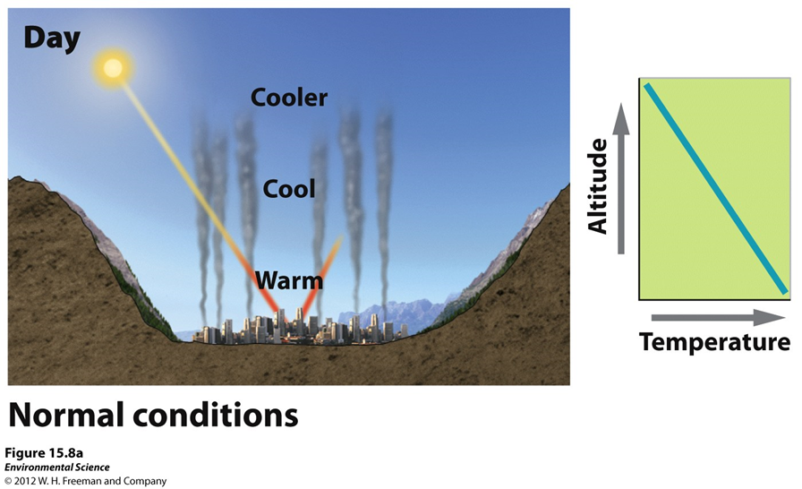
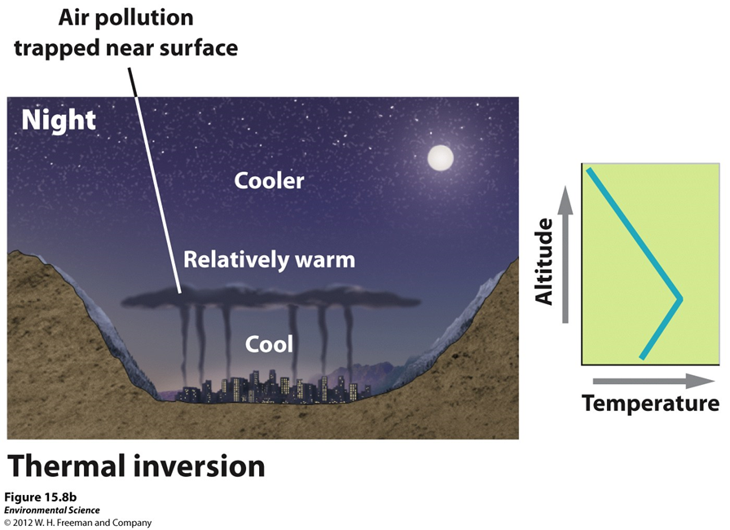

Slide 8
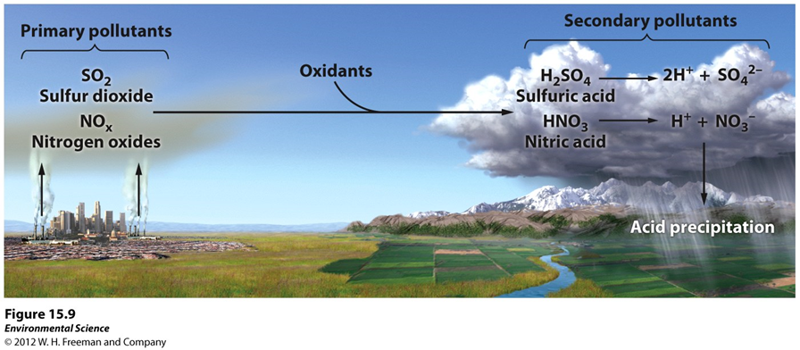
Acid Deposition

Slide 9
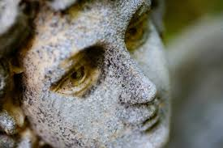
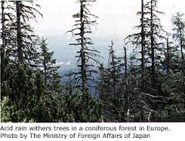
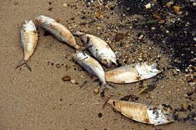
Harmful Acid rain
Surface waters
Aquatic animals
Forests
Auto paint
Building materials (limestone & marble)
Visibility (sulfuric smog)

