Slide 1
Cha.16
Waste Management

Slide 2
Municipal Solid Waste
Refuse collected by municipalities from households, small businesses, and institutions such as schools, prisons, municipal buildings and hospitals.

Slide 4
E-Waste
Electronic waste (E-waste) televisions, computers, cell phones that contain toxic metals.

Slide 5
Reduce, Reuse, Recycle
Reduce- waste minimization or prevention
Reuse- reusing something like a disposable cup more than once
Recycle- materials are collected and converted into raw materials and then used to produce new objects
In order of effectiveness

Slide 6
Loops

Slide 7
Composting
Compost- organic material that has decomposed under controlled conditions to produce an organic-rich material.

Slide 9
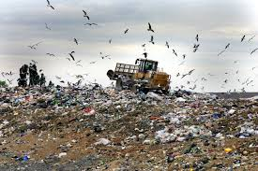
Landfills
Sanitary landfills- engineered ground facilities designed to hold MSW with as little contamination of the surrounding environment as possible.
Leachate- the water that leaches through the solid waste and removes various chemical compounds with which it comes into contact.

Slide 11
Incineration
Incineration- the process of burning waste materials to reduce its volume and mass and sometimes to generate electricity and heat.

Slide 12
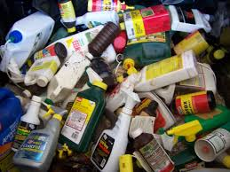
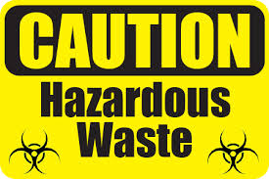
Hazardous Waste
Hazardous waste- liquid, solid, gaseous, or sludge waste material that is harmful to humans or ecosystems.
Collection sites for hazardous waste must be staffed with specially trained personnel.
Hazardous waste must be treated before disposal.

Slide 13
Laws
Comprehensive Environmental Response, Compensation, and Liability Act (CERCLA)- also know as “Superfund”.
Puts a tax on the chemical and petroleum industries. This revenue is used to cleanup abandoned and nonoperating hazardous waste sites where a responsible party cannot be found.
Requires the federal government to respond directly to the release of substance that may pose a threat to human health or the environment
Resource Conservation and Recovery Act (RCRA)- designed to reduce or eliminate hazardous waste. Also know as “cradle-to-grave” tracking.
RCRA ensures that hazardous waste is tracked and properly disposed of.

Slide 14
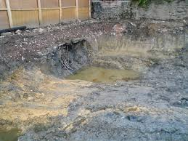
Brownfields
Contaminated industrial or commercial sites that may require environmental cleanup before they can be redeveloped or expanded.
Old factories, industrial areas and waterfronts, dry cleaners, gas stations, landfills, and rail yards are some examples.

Slide 15
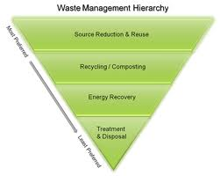
Integrated Waste Management
A method that seeks to develop as many options as possible, to reduce environmental harm and cost.
Reduction, recycling, composting, landfills, and incineration are some ways IWM is utilized.

