Slide 1
Cha. 5
Evolution of Biodiversity

Slide 2
Biodiversity
Ecosystem diversity- variety of ecosystems in a given region
Species diversity- Number of species in an ecosystem
Genetic diversity- Variety of genes within a species

Slide 3
How many species live on Earth?
Species- group of organisms that is distinct from other organisms in terms of size, shape, behavior, or biochemical properties, and can interbreed with other organisms to produce viable offspring.
# of species is the most common measure of biodiversity
Scientists have named 2 million species
Current estimates for total # of species range between 5 million and 100 million
Most estimate 10 million

Slide 4
Looking at insect species as a measure…
Insect group contains more species than most other groups
Estimate # of insect species get a better sense of total species
Fumigated tree species in tropical forest
Multiply # of beetle species that fed on that tree by total tree species
Est. 8 million species of beetle in tropical forest
Beetles ~40% insect species,
Twice as numerous in the canopy as forest floor
Reasonable estimate for total tropical species might be 30 million (many think this is too high)

Slide 5
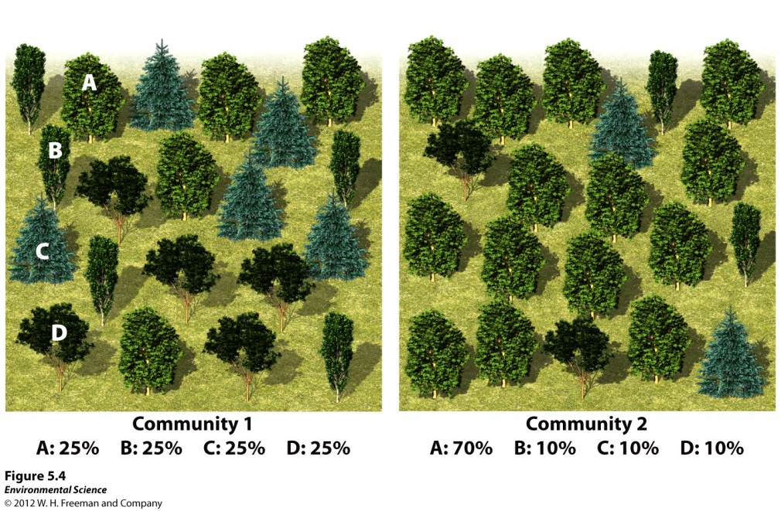
Species Evenness vs. Species Richness
Species richness- # of species in a given area.
Used to approximate biodiversity
Species evenness- tells whether an ecosystem is dominated by one species or if they have similar abundances.
Knowing both gives scientists a baseline to determine how much ecosystem has changed.

Slide 6
Evolutionary relationships
Phylogenies- branching patterns of evolutionary relationships
Based on similarity of traits; morphology, behavior, & genetic similarity

Slide 7
**Evolution is the mechanism underlying biodiversity**
Evolution- change in genetic composition of a population over time
Microevolution- below species level, varieties of apples or potatoes
Macroevolution- genetic changes give rise to a new species
Speciation- evolution of new species

Slide 8
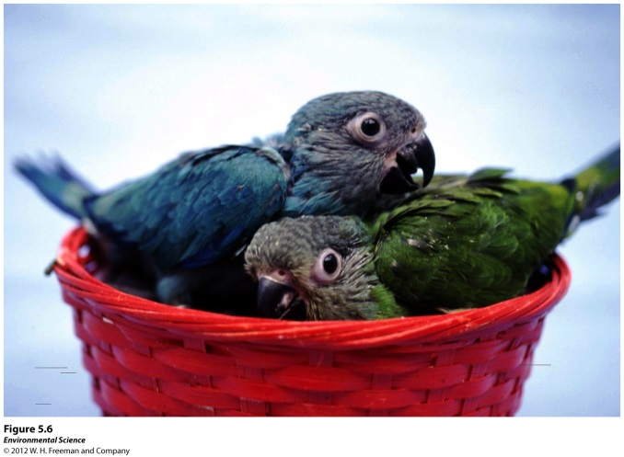
Genetic Diversity
Genes- physical locations on chromosomes within each cell of an organism
Determine range of possible traits (physical or behavioral) that can be passed to offspring
Genotype- Complete set of genes in an organism
Processes that create diversity
Mutation-mistake in copying process, random change, environmental factors
When they occur in sex cells, can be passed on to next generation
Can be good or bad for organism
Recombination- as chromosomes are duplicated piece breaks off and attaches to another chromosome.
Important for immune defenses

Slide 9
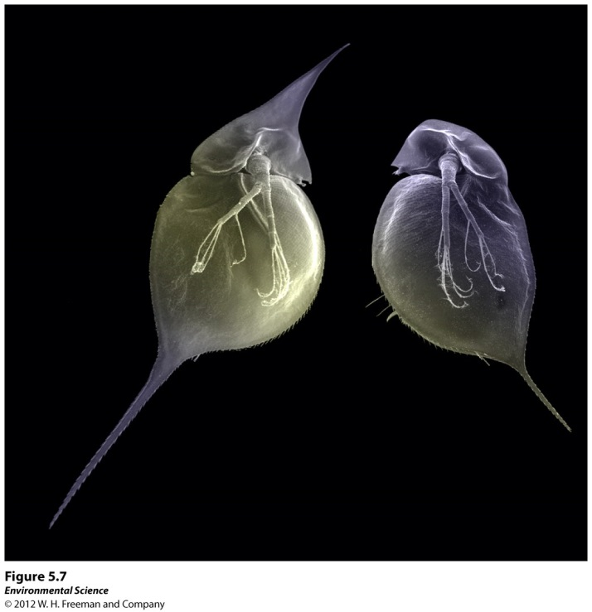
Genotype vs. Phenotype
Genotype- blueprint for traits that organism can eventually possess
Phenotype- actual set of traits expressed in that individual
Can also be product of environment
Turtle & crocs temp. of eggs during incubation determines sex of offspring
Body shape of water fly determined on sense of predators in enviromnment

Slide 10
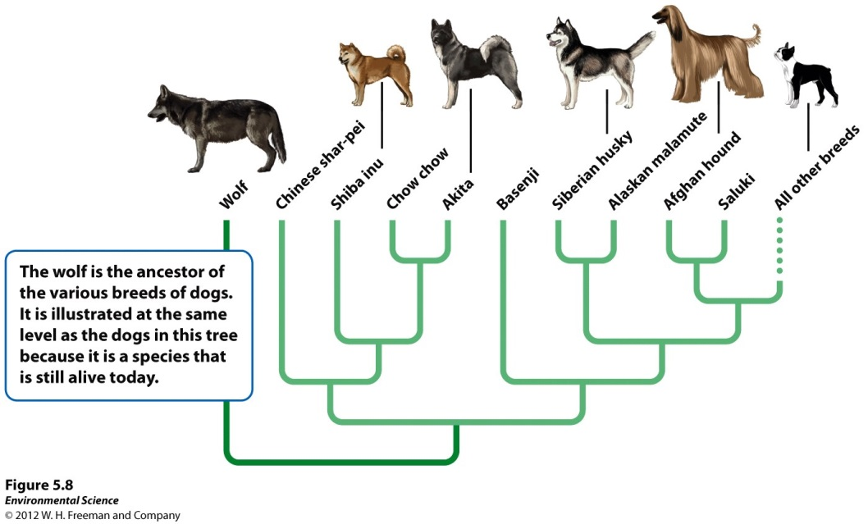
Evolution by artificial selection
Humans breed plants and animals for desirable traits
*Dangers can be herbicide resistance, or antibiotic resistance*

Slide 11
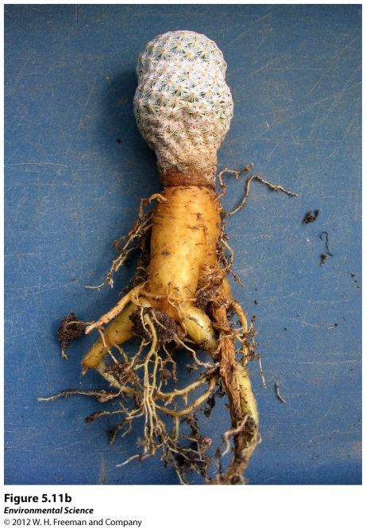
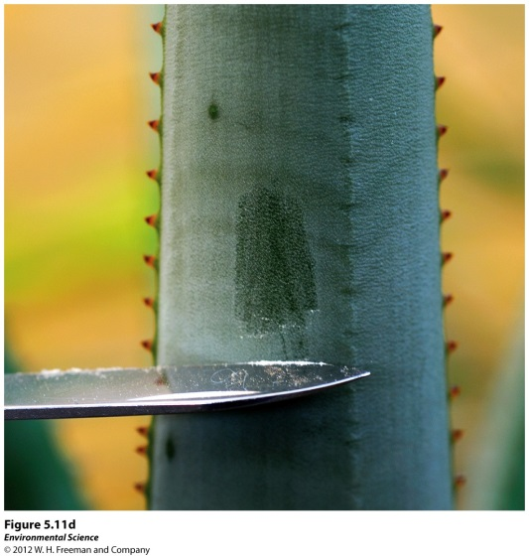
Evolution by natural selection
Environment determines which organisms survive and reproduce.
Fitness- ability to survive and reproduce
Adaptations- traits that improve fitness
Darwin & Wallace
Darwin’s theory of evolution key ideas:
Individuals produce excess of offspring
Not all offspring can survive
Individuals differ in traits
Differences in traits can be passed from parents to offspring
Differences in traits are associated with ability to survive and reproduce

Slide 13
Allopatric Speciation
Geographic isolation
River changing course, large lake into 2 small lakes, mountain range rising
Leads to reproductive isolation: become so different that even if barrier is removed they can’t interbreed.
*Darwin’s finches
*Most common way evolution generates new species

Slide 14
Sympatric Speciation
Evolution of 1 species into 2 species in absence of geographic isolation
Usually happens through polyploidy- increases in # of sets of chromosomes.
Occur during division of reproductive cells
Once it occurs can’t reproduce with diploid ancestors, instant speciation
Ex. Snails, salamanders, 15 % flowering plants, agricultural crops

Slide 15
Pace of Evolution
Can take anywhere from 100s to millions of years.
Avg. rate is 1 species every 3 million years
Over 200 species of cichlids evolved from common ancestor over several million years

Slide 16
Factors determining pace of evolution
Rate of environmental change- Species need time to adapt to environmental change
Genetic variation- more variation= more phenotypes, more likely that some individuals can survive in new environmental conditions
Population size- a beneficial mutation can spread more quickly in a small population rather than large
Generation time- shorter generation time allows species to adapt faster to change

Slide 17
Human driven evolution…
Genetic engineering- copy genes from an organism with desired traits, such as rapid growth or disease resistance.
Genetically modified organisms- genes of desired traits inserted into species or plants, animals, or microbes. Traits passed onto offspring.
Example- Soil bacterium (Bacillus thuringiensis) that naturally produces an insecticide to defend from being consumed by insects in soil
Breeders have identified gene and insert them into genomes of crop plants
Bt Corn and Bt Cotton

Slide 18
Niches and species distribution
Range of tolerance- limits to tolerance of abiotic factors (temp, humidity, salinity, pH)
Fundamental niche- ideal conditions
Realized niche- includes biotic factors (competition, predators, diseases)

Slide 19
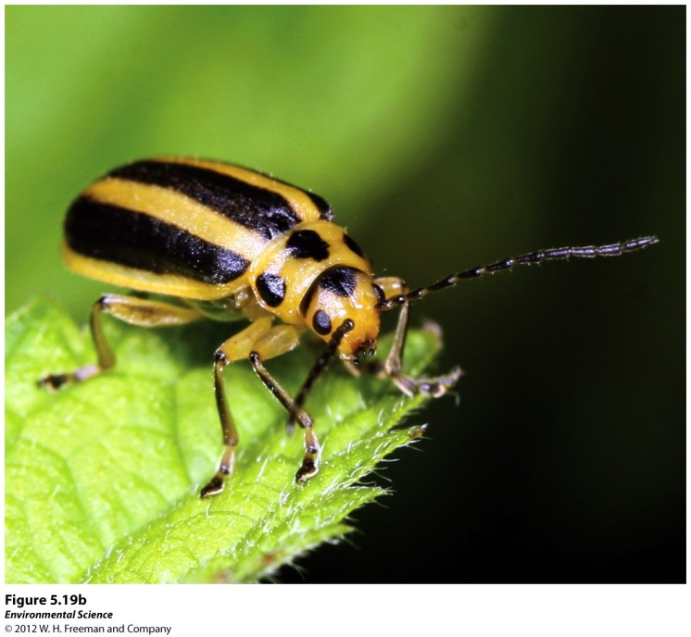
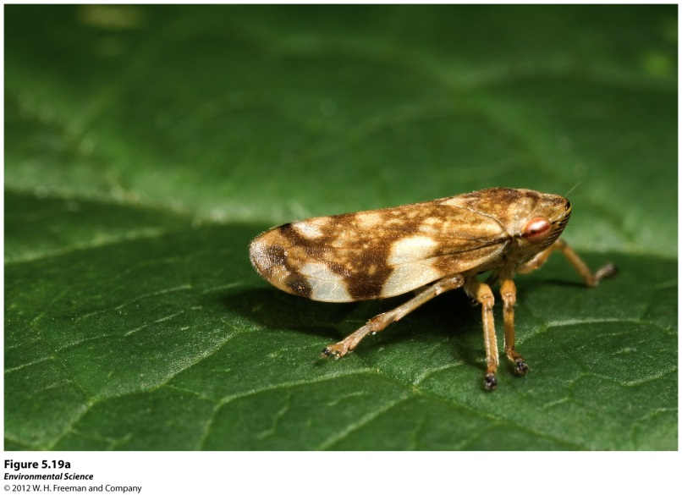
Niche generalists vs. niche specialists
Generalists- can live in a variety of habitats and feed on a variety of species
Specialists- specific habitat, feed on small group of species

Slide 20
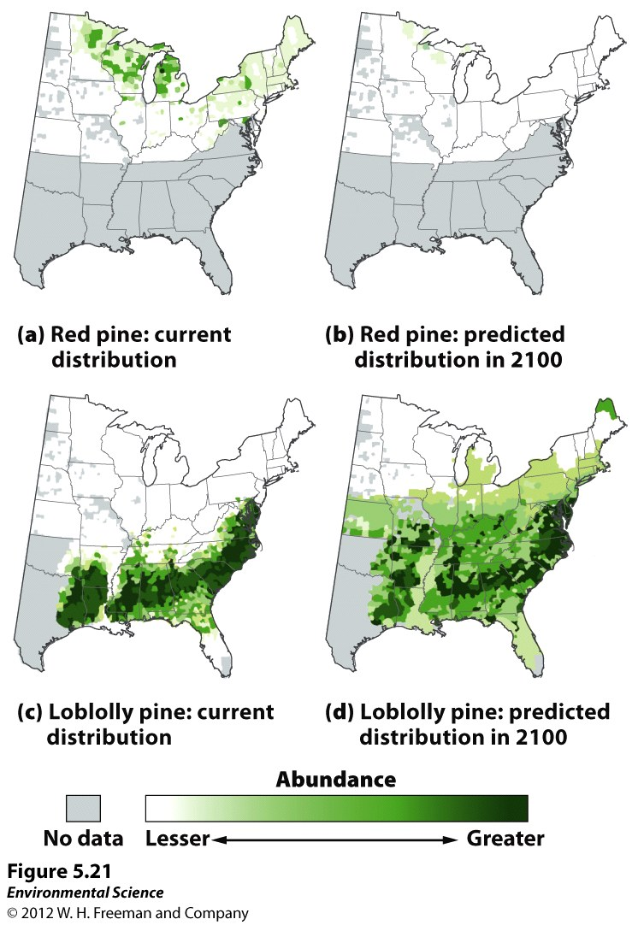
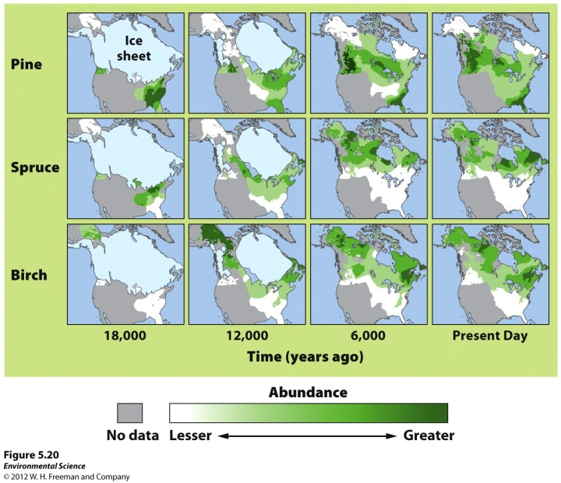
Environmental change and species distribution
Changes in conditions affect species distribution
Ex. Tree species, pollen from lake sediments indicates that plant species moved north as temps warmed following retreat of glaciers 12,000 years ago.
Predictions

Slide 21
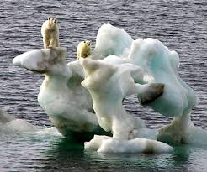
Environmental Change and Species Extinctions
Avg. lifespan of species 1 million- 10 million years
99% of species that ever lived are now extinct
Reasons
No favorable environment close enough to move to.
Ex. Polar bears. Sea ice melts 3 weeks earlier, affects hunting, bears avg. 150 lbs less than they were 30 years ago!
May be occupied by species that can’t be competed against
Too rapid of a change to evolve new adaptations

Slide 22
Fossil Record
Most of what we know about the evolution of life is based on fossils.
Most organisms decompose rapidly, incomplete fossil record.
Use to determine when different species existed on Earth

Slide 23
5 global mass extinctions
Greatest one 251 million years ago
90% of marine species and 70% of land vertebrates went extinct
Cause unknown
Better know Cretaceous period (65 million years ago)
50% of Earth’s species, and dinosaurs
Large meteorite hit and dust blocked solar radiation
Photosynthesis stopped and knocked out bottom of food chain
Small squirrel-sized primate survived and is an ancestor to humans

Slide 24
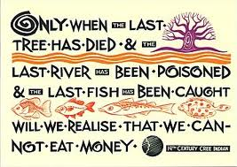
Sixth Mass Extinction
Past 2 decades scientists realized we are currently experiencing a mass extinction of a magnitude within the range of previous extinctions.
Estimates vary between 2% and 25% of species going extinct by 2020.
Agreement that this is caused by humans.
Habitat destruction, overharvesting, introductions of invasive species, climate change, emerging diseases
Recovery from past extinctions took 10 million years
Debate about true magnitude of crisis and the costs of reducing human impact on extinction rates.

