Slide 1
Cha. 9
Water Resources

Slide 2
Water Distribution

Slide 3
Water Distribution Globally

Slide 4
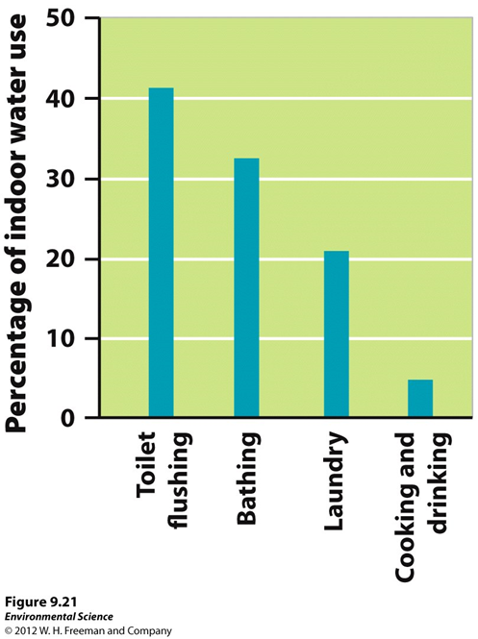

Slide 5
Groundwater
Confined aquifer- surrounded by a layer of impermeable rock or clay (not easily recharged, not easily contaminated)
Artesian well- under pressure from confining layer, drill hole and release pressure and it will naturally flow up
Unconfined aquifer- porous rock covered by soils (easily recharged, contaminated)
Well- pump water out against gravity
Water table-uppermost level where water fully saturates rock or soil

Slide 6
Ogallala Aquifer

Slide 7
Groundwater Overuse
Cone of depression- Well is drawing out water faster than recharge rate so it makes an area where there is no longer water

Slide 8
Saltwater Intrusion
Saltwater intrusion- groundwater naturally puts pressure on sea water to keep it out, however if too much water is drawn out the pressure is released and salt water contaminates the freshwater

Slide 9
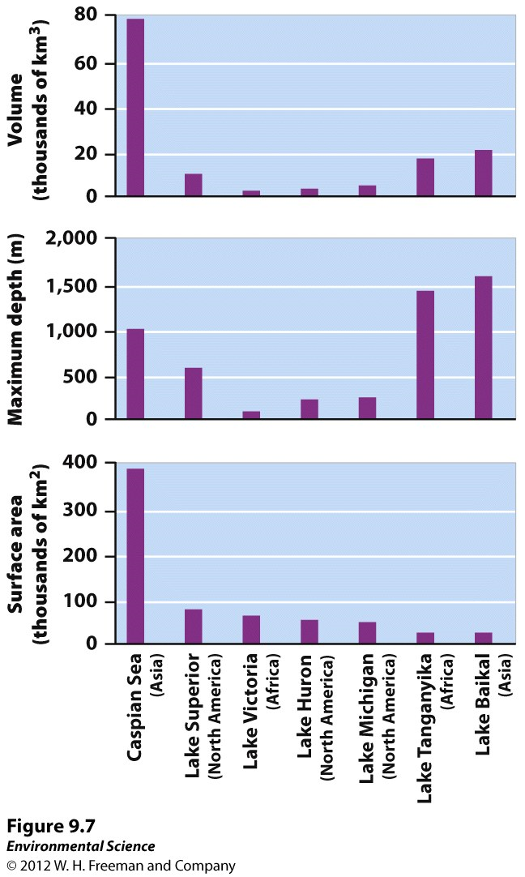
Largest Lakes
Can be formed by tectonic activity and glaciation
Caspian Sea- tectonic uplift
Lake Victoria, Lake Tanganyika, and Lake Baikal formed from rifts
Great Lakes- formed from glaciers
Oligotrophic- low productivity & low nutrients
Mesotrophic- medium level
Eutrophic- high level

Slide 10
Atmospheric Water
Essential to global water distribution
Droughts cause long term damage to soil. Loss of water halts nutrient cycling and wind can blow away fertile topsoil
Soil then hardens and becomes impermeable and water runs off it and erodes the topsoil (Positive feedback loop!)
1920s-30s dust bowl, too much conversion of native grass to wheat fields. Wheat erodes easier. 30s drought caused a decade of crop failures. Less plants to hold soil in place caused dust storms.
Many drought prone areas are likely to flood because impermeable soil

Slide 11
Flooding
Levees-enlarged bank on the side of the river
Mississippi river has largest levee system
Challenges-
Natural floodwaters can’t add fertility to floodplains by adding sediment
Sediments end up deposited where river meets ocean
Prevent floods at one location, but push flood water further downstream
Encourages development in floodplains, which still occasionally flood
Levees can collapse (Hurricane Katrina)
Dikes- similar to levees, but used to prevent ocean water from flooding.
Common in Europe

Slide 12
Dams
Barrier that runs across river or stream to control the flow of water
Reservoir- water behind dam
2009-845,000 dams, 82,642 in the US
3% hydroelectric, 18% flood control, 38% recreation
Worlds largest in China on the Yangtze River- 3 Gorges Dam
Benefits
Cleaner energy than fossil fuels

Slide 13
Dam’s effect ecosystems
Interruption of natural flow of water
Obstacle to migrating fish such as salmon.
Fish ladders- allow salmon to travel through
Experimenting with releasing large amounts of water to simulate flooding
Areas where dams are no longer needed they are being removed.

Slide 14
Aqueducts
Canals or ditches used to carry water to another location
Usually from a lake or river
Older aqueducts made of limestone can lose as much as 55% of the water they transport
NY and LA rely on aqueducts for water
Environmental consequences- construction requires money and resources, fragments natural habitats, diverts water from where it naturally flows

Slide 15
Aral Sea
1950s Soviet Union diverted 2 rivers that fed the Aral Sea.
Decreased freshwater and made sea too salty, killed fish
Used to be the 4th largest in terms of surface water, diversion decreased S.A. by 60%
Caused it to split into 2 parts
Dust storms releasing pesticides, climate affected (less regulating of temps.)
South Sea is expected to dry in 10 years, efforts are to restore the North Sea

Slide 16
Desalination
Removing salt from seawater
Middle East produces 50% of the world’s desalinated water
Distillation- takes a lot of energy
Reverse Osmosis- more efficient
Both produce brine (super salty water) which can cause harm to organisms when put back into the ocean

Slide 17
Irrigation

Slide 18
Irrigation cont…

Slide 19
Hydroponic
Cultivation of crop plants under greenhouse conditions but with roots immersed in nutrient-rich solutions, no soil
Water not taken up by plants can be reused, uses 95% less water than traditional irrigation techniques
Can produce more crops/ hectare than traditional farms
Can grow under ideal conditions, grow the crops any season of the year, little or no use of pesticides.
More expensive than traditional farming, but is gaining popularity

Slide 20
Industry
Water used for generating electricity, cooling machinery, and refining metals and paper.
Difference between water withdrawn and returned to source (dams) and water that gets consumed
Thermoelectric consumes a lot of water using heat to turn water into steam to turn turbines. Use massive cooling towers to try and return water, but a lot is released into the atmosphere (coal or nuclear reactors)
Takes many gallons of water to make paper, steel, aluminum, copper, and many other goods

Slide 21
Water Ownership
Multiple interest groups can claim a right to use and consume the water
Right to use is not the same as owning
Regional and national governments set priorities for water distribution, but no control over knowing how much water there will be available.
Issues of water ownership has created many conflicts. Especially in the Middle East
Economists think parties interested should compete and let market forces determine its price

Slide 22
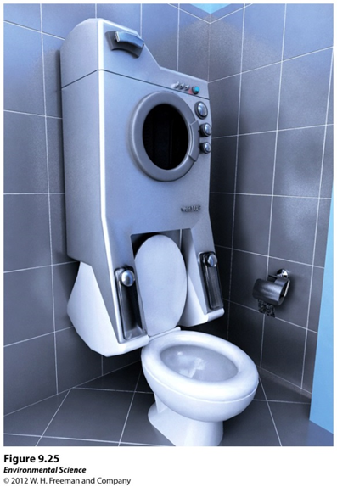
Water Conservation
Federal standards for water efficient toilets, toilet made before 1994 used 7 gallons/flush, now must use 1.6 gallons or less/flush
Dual flush toilets
Front loading washing machines
Plant vegetation for the local habitat (can save 520 gallons/ 10 square feet of lawn per year!)

Slide 23
Water Withdrawals in the US

