Slide 1
Cha. 2
Important Terms

Slide 2
Environmental Systems
Environmental Scientist must understand interactions of energy and matter across systems.
System is defined by the point of view

Slide 3
Chemistry Review

Slide 4
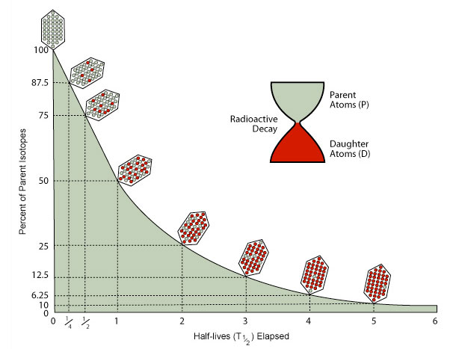
Radioactivity
Radioactive decay of one element into another releases a lot of energy
Half-life- time it takes for one-half of the original parent isotopes to decay
Helps scientists know how long a radioactive element is dangerous
Long-term storage of nuclear waste
Living things take carbon into their tissue at the known atmospheric ratio, overtime carbon-14 decays into nitrogen-14, compare ratio carbon dating

Slide 5
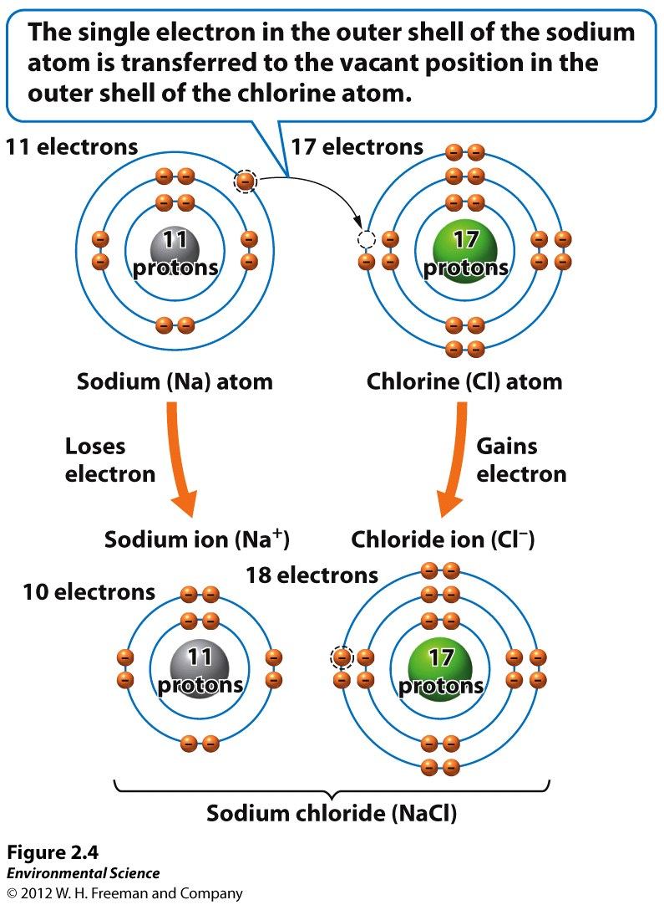
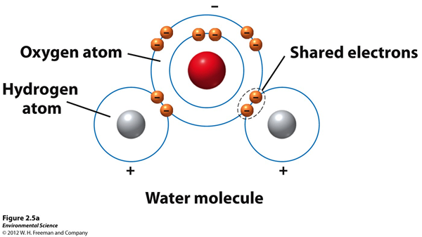
Chemical Bonds
Covalent- share electrons, generally strongest (Methane)
Ionic- Involves transfer of electrons. One becomes + one becomes -. (NaCl)
Hydrogen Bond- typically weakest. Water polar molecule

Slide 6
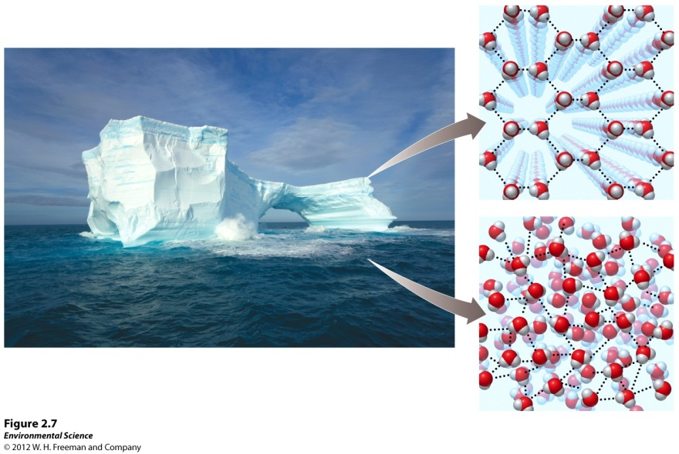
Properties of Water
Support conditions necessary for life on Earth
Surface tension- skin on water. Smooth water droplets
Capillary action- important in plants, trees, soil, groundwater, pollutants
Boiling & Freezing- cohesion allows water to be solid, liquid, and gas at surface temperatures. Ice floats, important for aquatic organisms.
High Heat Capacity- A lot of energy needed to change temperature. Moderates land temps.
Solvent- dissolves things easily, good and bad, bad because toxins dissolve

Slide 7
Acids, Bases, & pH
Acid- contributes H+ ions to a solution (nitric acid & sulfuric acid)
Base-contributes OH- ions to a solution (sodium hydroxide & calcium hydroxide)
Logarithmic- factor of 10 difference between each number
*Water in equilibrium with Earth’s atmosphere typically has a pH of 5.65 because carbon dioxide from the atmosphere dissolves in water, making it weakly acidic

Slide 8
Conservation of Matter
Matter cannot be created or destroyed, can only change form
Exception: nuclear energy small amounts of matter turn into energy
This law tells us we can’t easily dispose of hazardous materials
<- Forest matter seems to be disappearing as it burns, matter is conserved in the form of water vapor, carbon dioxide, and solid particles

Slide 9
Biological Molecules
Organic- carbon-carbon and carbon- hydrogen bonds. Glucose & fossil fuels
Inorganic- either do not contain carbon or has carbon bonded to elements other than hydrogen. Ammonia, sodium chloride, water, and carbon dioxide
Carbohydrates- energy composed of carbon, hydrogen, and oxygen atoms C₆H₁₂O₆
Proteins- made of amino acids. Provide support, energy storage, internal transport, and defense against foreign substances
Lipids- do not mix with water, membranes
Nucleic Acids- DNA & RNA

Slide 10
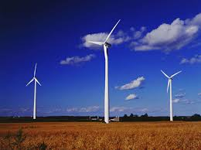
Energy vs. Power
Energy- ability to do work
Power- rate at which work gets done
Energy = power x time
Power= energy/time
kW unit of power (capacity of turbine)
kWh unit of energy (electricity bill)

Slide 11
Potential and Kinetic Energy
Potential- energy stored, not yet released. Water behind a dam.
Kinetic- energy of motion. Moving water captured and transferred to turbine and generator
Chemical- P.E stored in chemical bonds (food energy, fuel combustion)

Slide 12
Energy Efficiency

Slide 13
Energy Quality
Ease at which energy can be used for work
Gas- high quality b/c energy concentrated
Wood- lower. Less than half the energy concentration of gasoline

Slide 14
Entropy
Second law of thermodynamics
All systems move toward randomness rather than toward order
Always increasing unless energy is added to create order
Energy flows from hot to cold- global circulation patterns
All living things work against entropy by using energy to maintain order

Slide 15
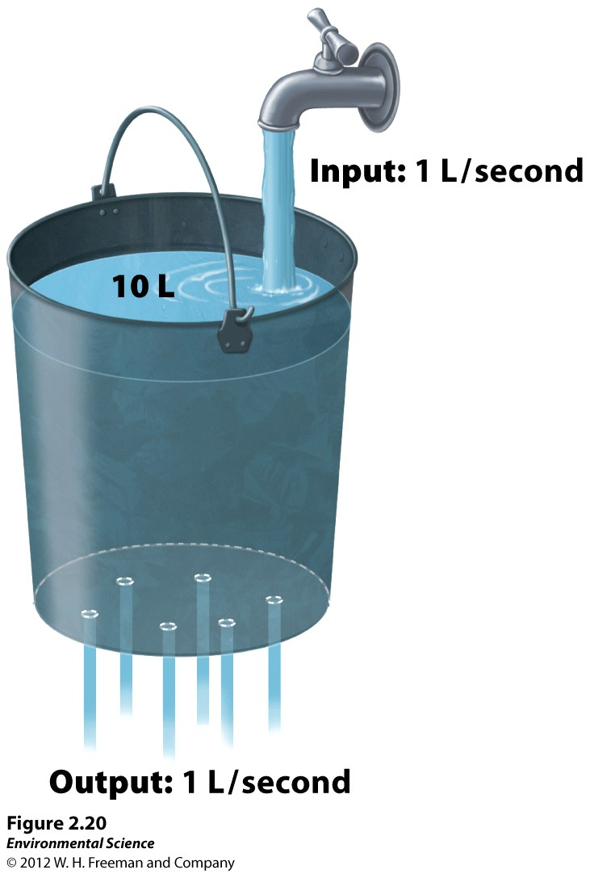
Systems analysis
Steady state ->

Slide 16
Feedback Loops

