Slide 1
Weather vs. Climate
Weather- short-term conditions of atmosphere in local area. (Temperature, humidity, clouds, precipitation, wind speed, & atmospheric pressure.
Climate- average weather that occurs in a given region over a long period (several decades) Mainly characterized by temperature and precipitation

Slide 2
Processes that effect heat distribution…
Unequal heating of Earth by the Sun
Atmospheric convection currents
Rotation of the Earth
Earth’s orbit on tilted axis
Ocean currents

Slide 3
Earth’s Atmosphere
Gravity on gas molecules keeps them in place. Weaker gravity far from Earth spreads them out, closer keeps them together
Troposphere- (10 miles) Most dense.
Nitrogen, oxygen, and water vapor
Circulation and mixing
Weather
Stratosphere- (10-31 miles)
UV rays warm higher altitudes
Ozone layer (O₃) absorbs UV-B and all UV-C radiation
Protects from DNA damage & cancer
Mesosphere, Thermosphere, and Exosphere
Thermosphere protects from X-ray & UV. Charged gas molecules Northern & Southern lights

Slide 4
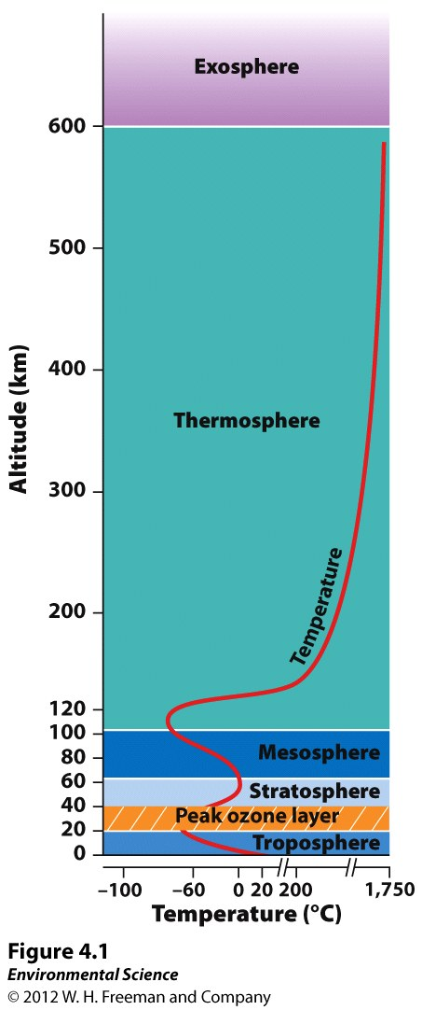
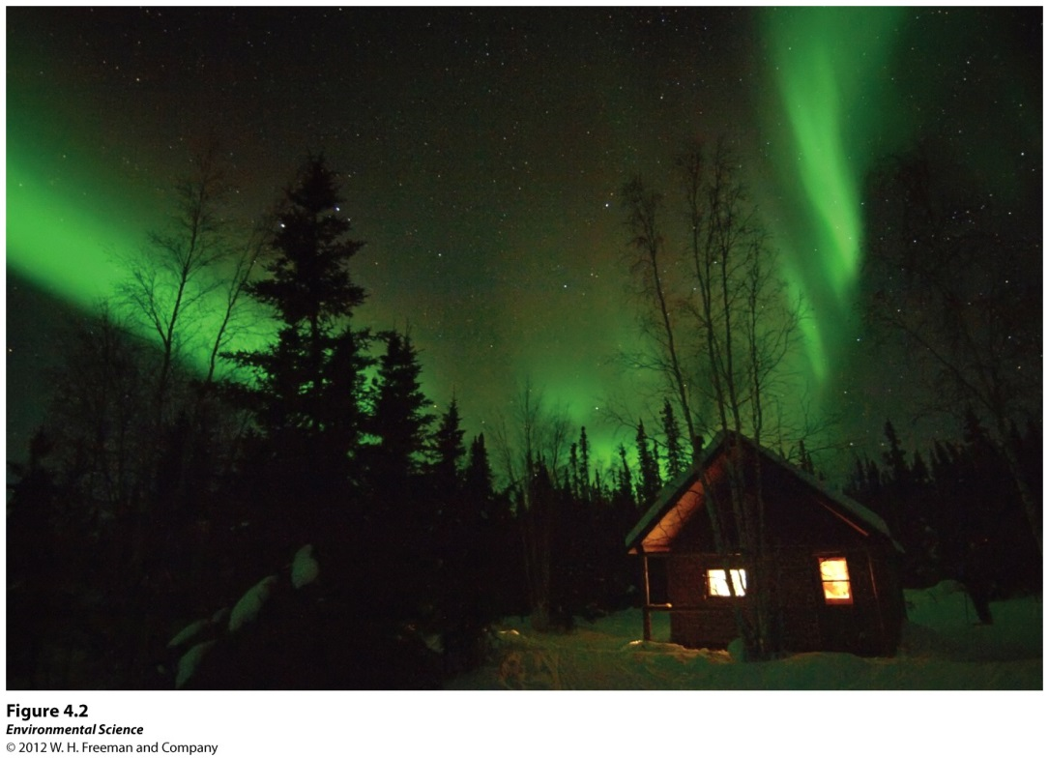
Layers of Earth’s Atmosphere
Figure 4.1
Figure 4.2

Slide 5
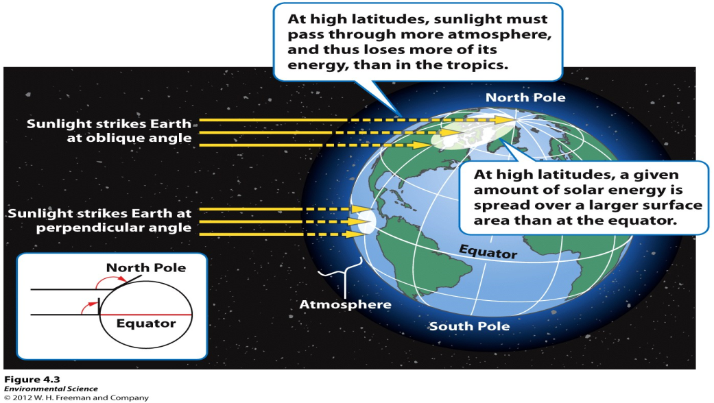
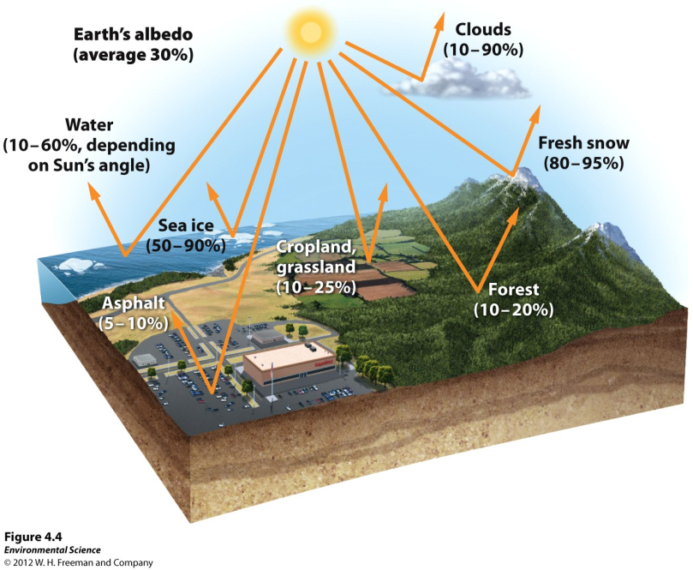
Unequal Heating of Earth
Variation in the angle Sun’s rays strike Earth
Variation in surface area the Sun’s rays are distributed
Albedo- some areas reflect more solar energy than others
Figure 4.3
Figure 4.4

Slide 6
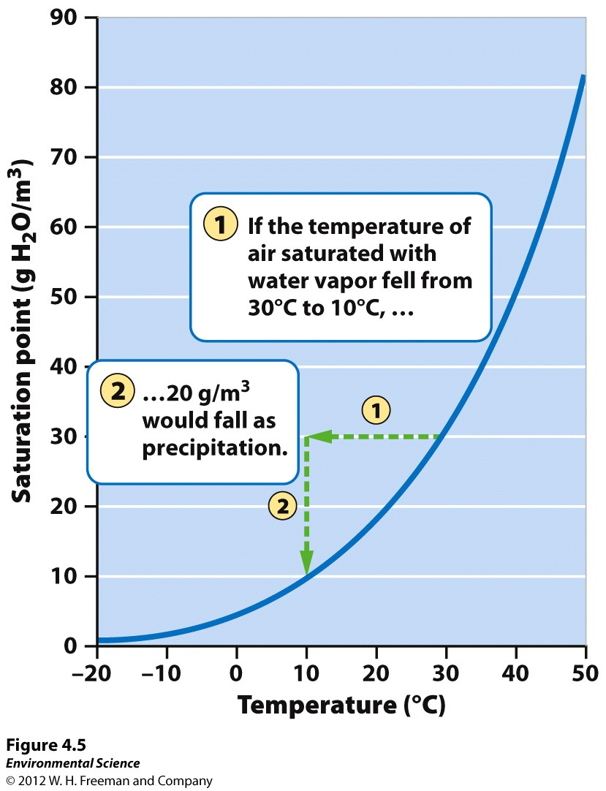
Properties of Air
Density
Warm, less dense, rises
Cold, more dense, sinks
Water vapor capacity
Warm air can hold more water
Adiabatic heating or cooling
Response to change in pressure
Air rises, low pressure expands, lowers the temp.
Air sinks, pressure increases, increases temp.
Latent heat release
Water vapor in atmos. condenses into liquid water energy is released
Figure 4.5

Slide 7
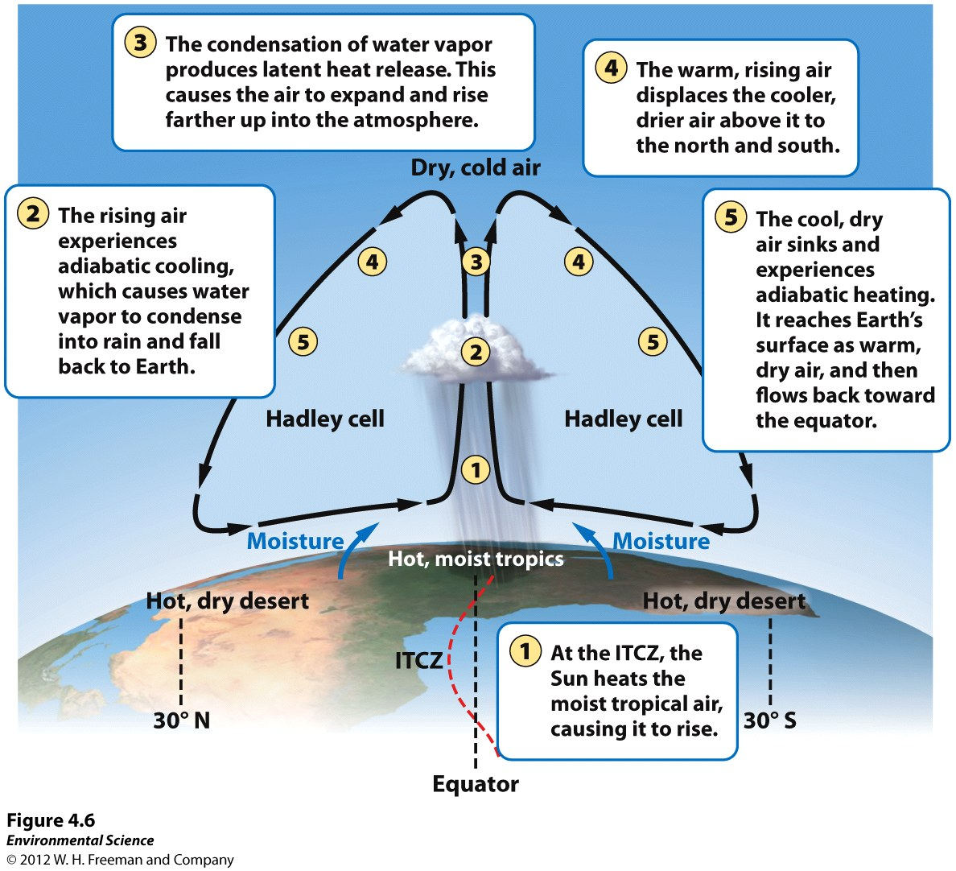
Convection Currents are initiated by the uneven heating of the Earth
Hadley cells- convection currents between equator and 30⁰ N & S.
Warm air at the equator rises
Displaces air at the top of troposphere, displaced air sinks to approx. 30⁰ N & S of the equator
Air is hot and dry (deserts)
Polar cells- Air rises at 60⁰ N & S and sinks at the poles
Figure 4.6

Slide 8
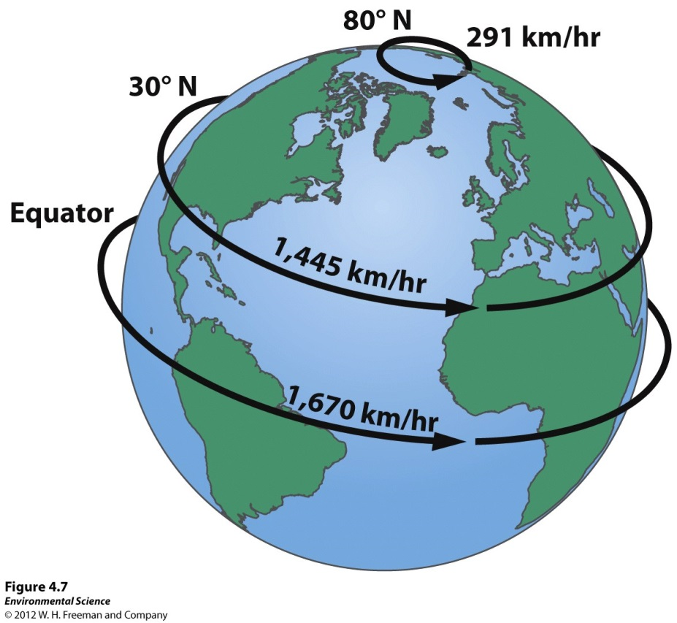
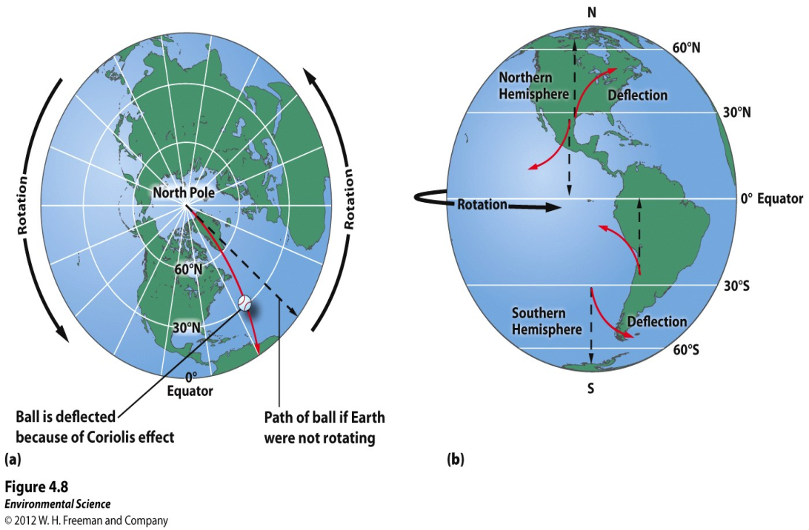
Earth’s Rotation & Coriolis Effect
Wind systems of the world are produced by atmospheric convection currents and Coriolis effect. If no rotation air would move directly N & S
Figure 4.7
Figure 4.8

Slide 9
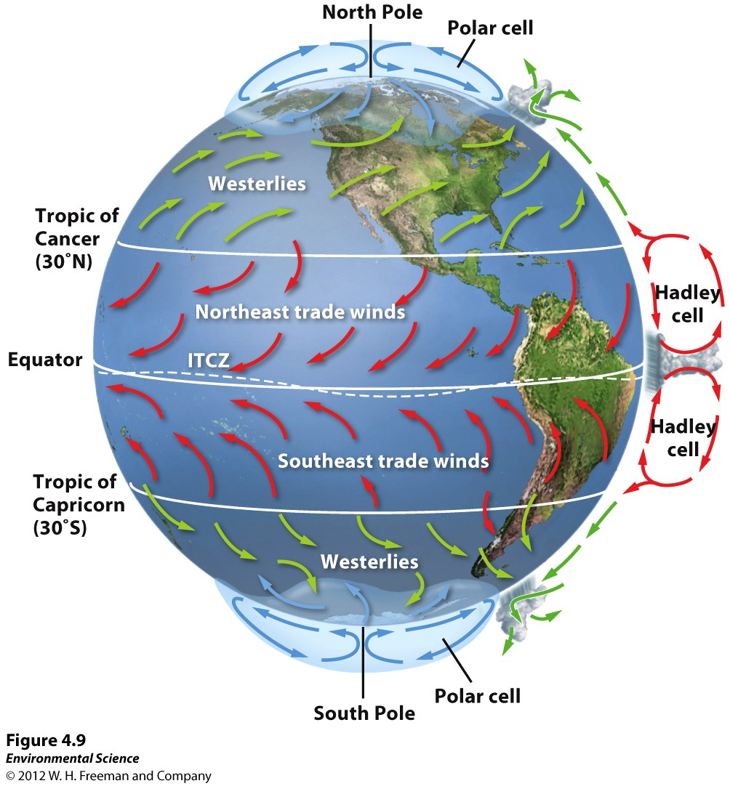
Prevailing Wind Patterns
Northeast trade winds- move from NE to SW between 0⁰ & 30⁰ N
Southeast trade winds- move from SE to NW between 0⁰ & 30⁰ S
Westerlies- move from SW to NE bw 30⁰ & 60⁰ N and NW to SE bw 30⁰ & 60⁰ S
Easterlies- move E to W from 60⁰ & 90⁰ N & S
Figure 4.9

