Slide 1
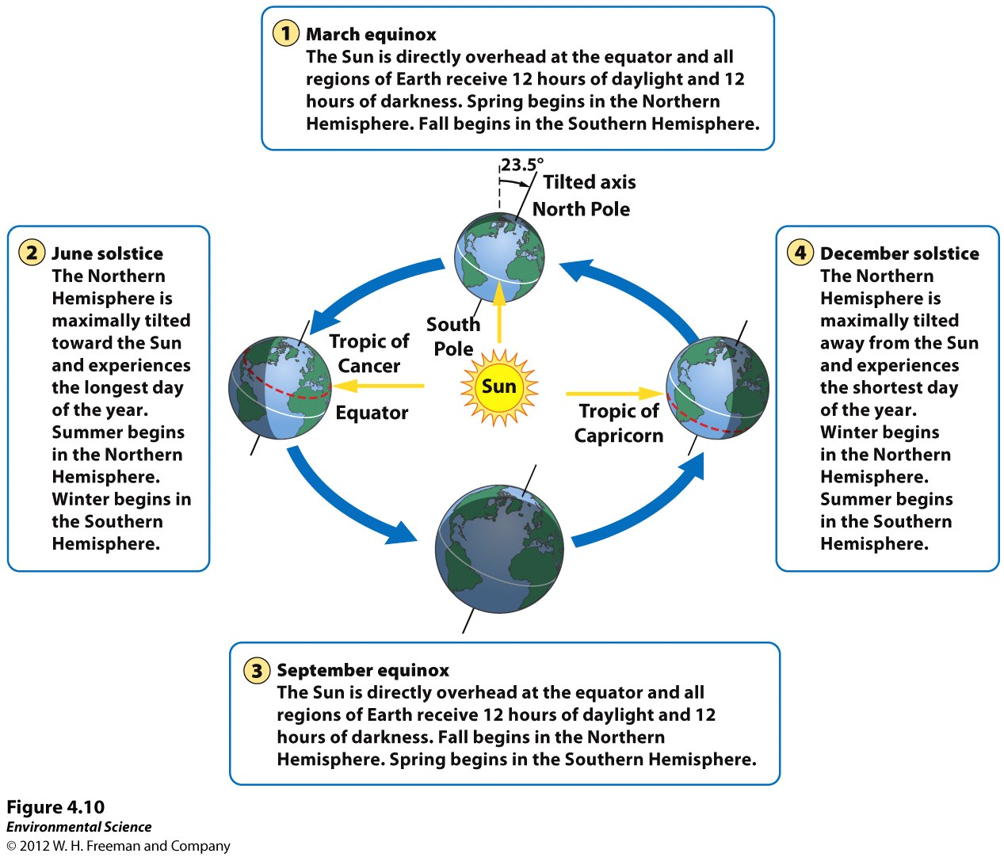
Earth’s Tilt and the Seasons
Figure 4.10

Slide 2
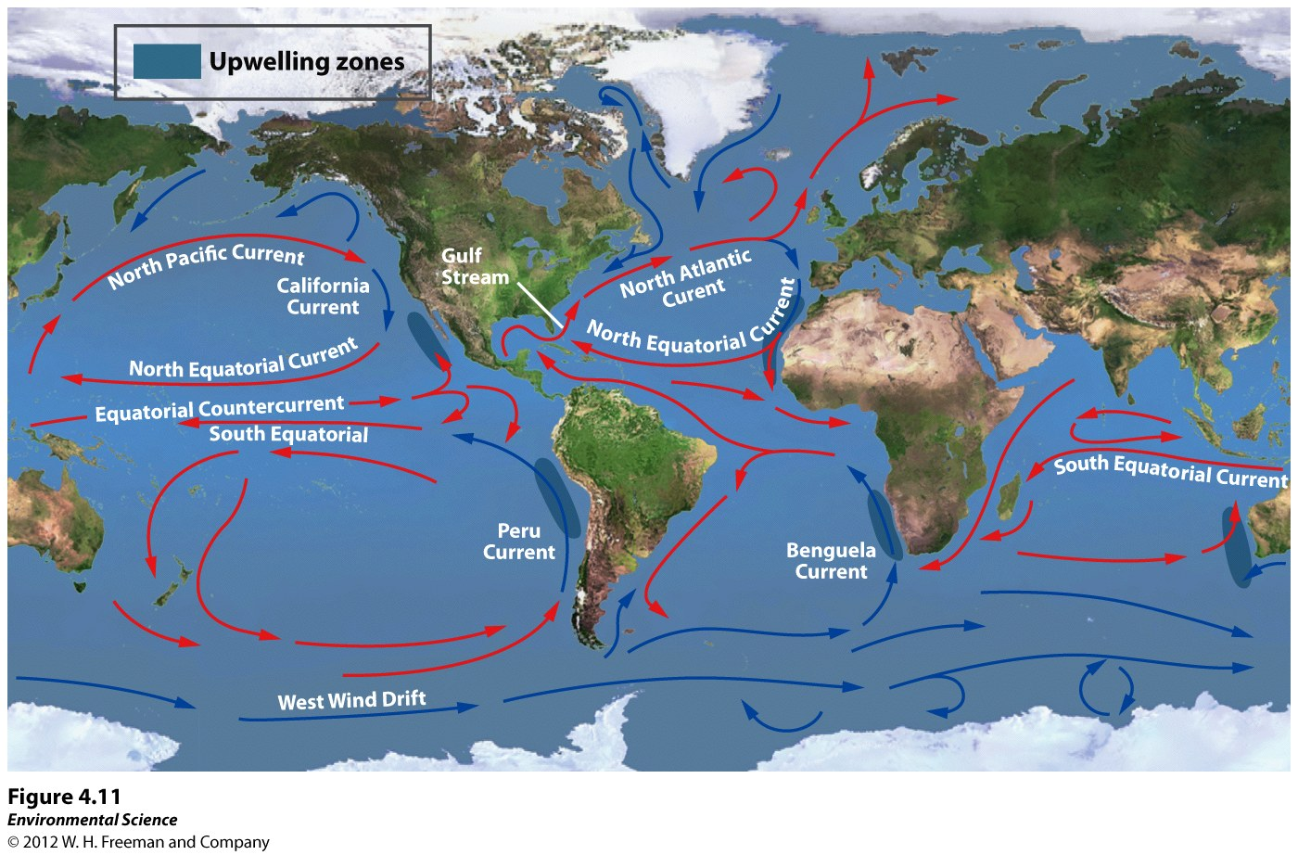
Ocean Currents
Driven by temperature, gravity, prevailing winds, Coriolis effect, and locations of continents
Temp. – warm rises, cool sinks
Gravity- warm expands causing it to be 3 in. higher than mid-latitude water, slope moves water away from equator
Gyres- Ocean surface currents clockwise in N.hemisphere and counterclockwise in S.hemisphere
Figure 4.11

Slide 3
Upwelling
Heat Transport
Along west coasts of most continents, surface currents separate, deep cold nutrient rich water rises.
Nutrients from the deep support productive ecosystems (Fisheries)
Ocean currents affect temp. of nearby land masses
Gulf stream brings heat energy moderating temps in England (36⁰ warmer than Newfoundland, Canada at the same latitude)

Slide 4
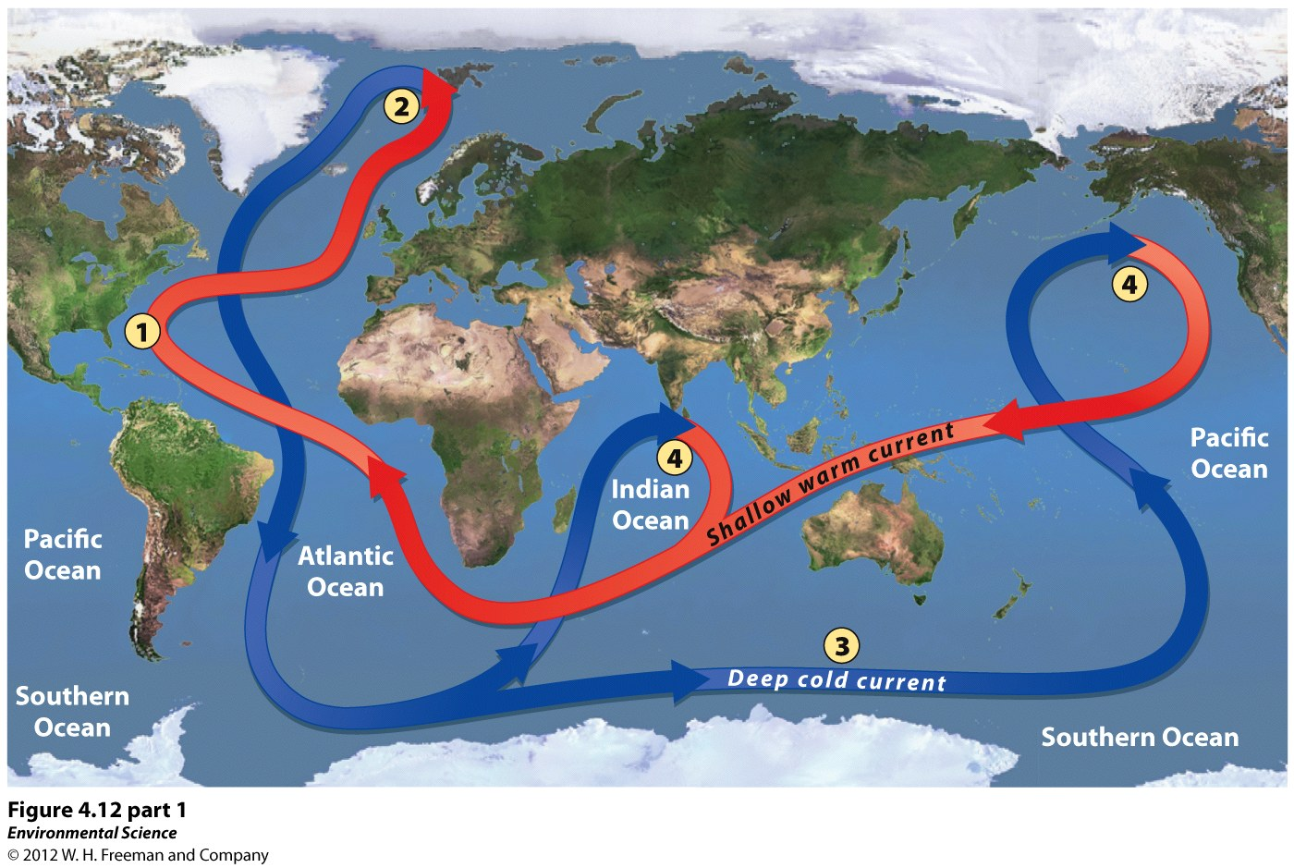
Thermohaline Circulation
Mixing of surface water and deep water. Crucial for moving nutrients and heat around the world.
Driven by surface waters that have unusually high salt. Warm water freezes or evaporates salt is left behind making it more dense.
Sinking of cold at poles and rising of warm at equator drive deep cold current.
Figure 4.12

Slide 5
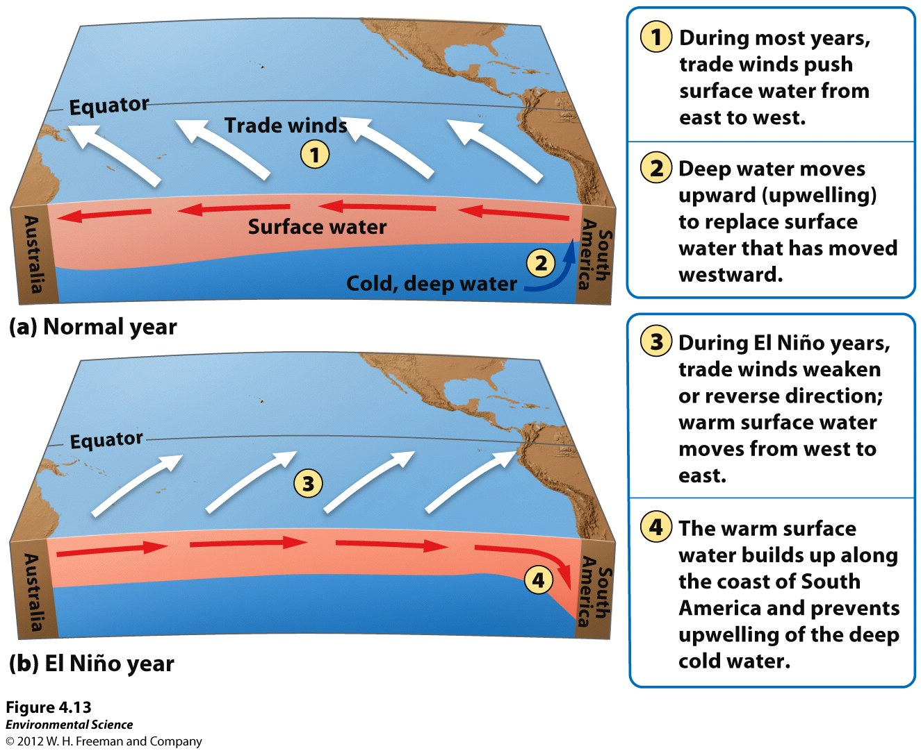
El Nino- Southern Oscillation
Approx. Every 3-7 years atmosphere and ocean interactions cause surface currents in the tropical Pacific ocean to reverse directions
Trade winds near S. America weaken, warm water from pacific moves towards W. coast S.America, movement of warm air and water supresses upwelling off the coast of Peru
Lack of productivity reducing fish population
Often begins around Christmas
Can last weeks to years
Globally cooler/wetter conditions in SE US, unusually dry weather in S.Africa and SE Asia
Figure 4.13

Slide 6
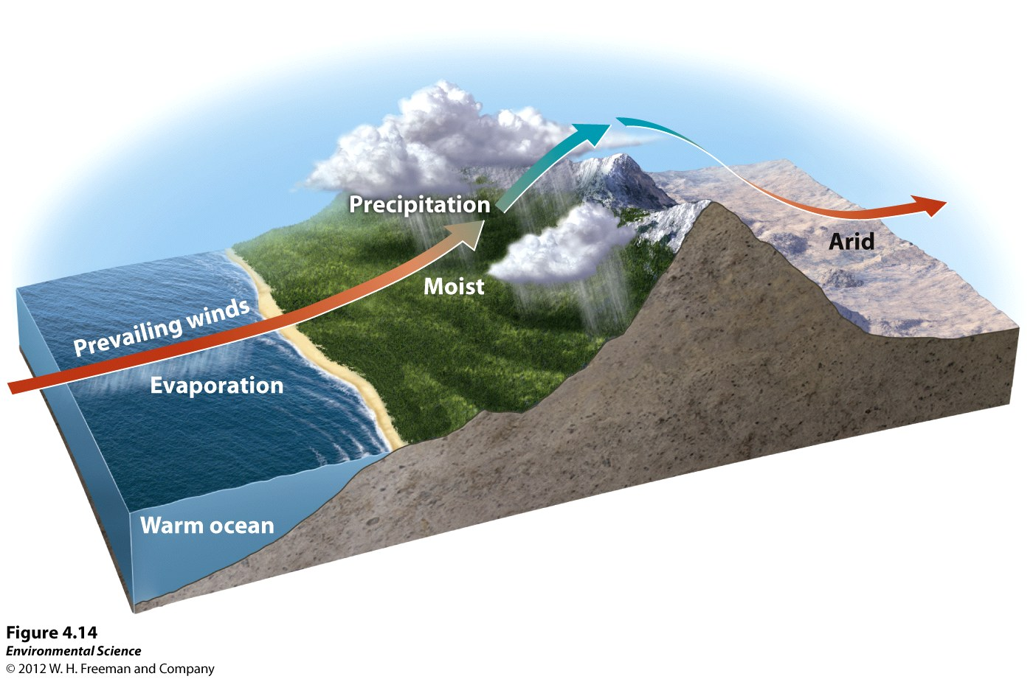
Rain Shadows
Air moving inland from ocean contains a lot of water
Windward side- side facing the wind, rises, cools, and precipitates. Lots of vegetation
Leeward side- cold dry air falls forming a rain shadow. Dry and desert conditions.
Figure 4.14

