Slide 1
Cha. 7
Human Population

Slide 2
Population Growth

Slide 3
Scientists disagree on Earth’s carrying capacity…
A) Food surplus followed by a food deficit.
Malthus believed in a fixed carrying capacity
B) Technology allows food production to continually increase
Increase in population = increase in intellect and innovation
Creativity sets humans apart from most other species

Slide 4
Factors that drive human population growth…
Demography- the study of human populations and population trends.
Changes in Population Size
Fertility
Life Expectancy
Age Structure
Migration

Slide 5
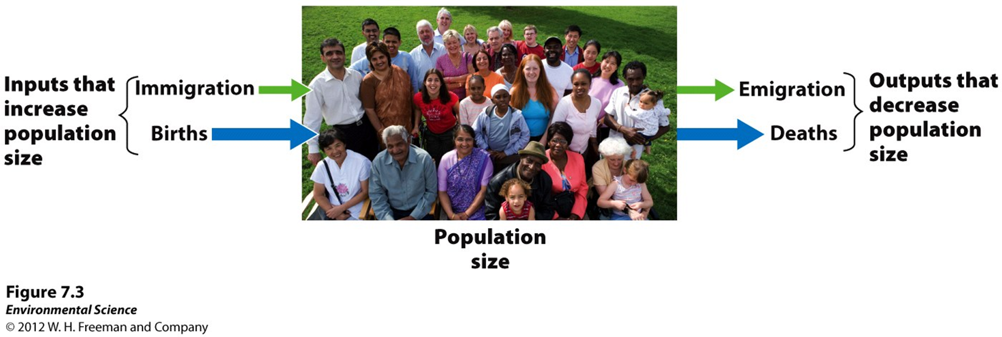
Changes in Population size
Immigration- the movement of people into a country
Emigration- the movement of people out of a country.
Net migration rate- the difference between immigration and emigration in a give year per 1,000 people in the country.

Slide 6
Changes in Population Size
Crude birth rate (CBR)= the number of births per 1,000 individuals per year.
Crude death rate (CDR)= the number of deaths per 1,000 individuals per year.
Global population growth rate =
(CBR- CDR)/ 10
National population growth rate =
(CBR+ immigration) - (CDR + emigration)/ 10
Doubling time (in years)- 70/growth rate

Slide 7
Fertility
Total fertility rate- an estimate of the average number of children that each woman in a population will bear.
Replacement level fertility- the total fertility rate required to offset the average number of deaths in a population and for the current population size to remain stable.

Slide 8
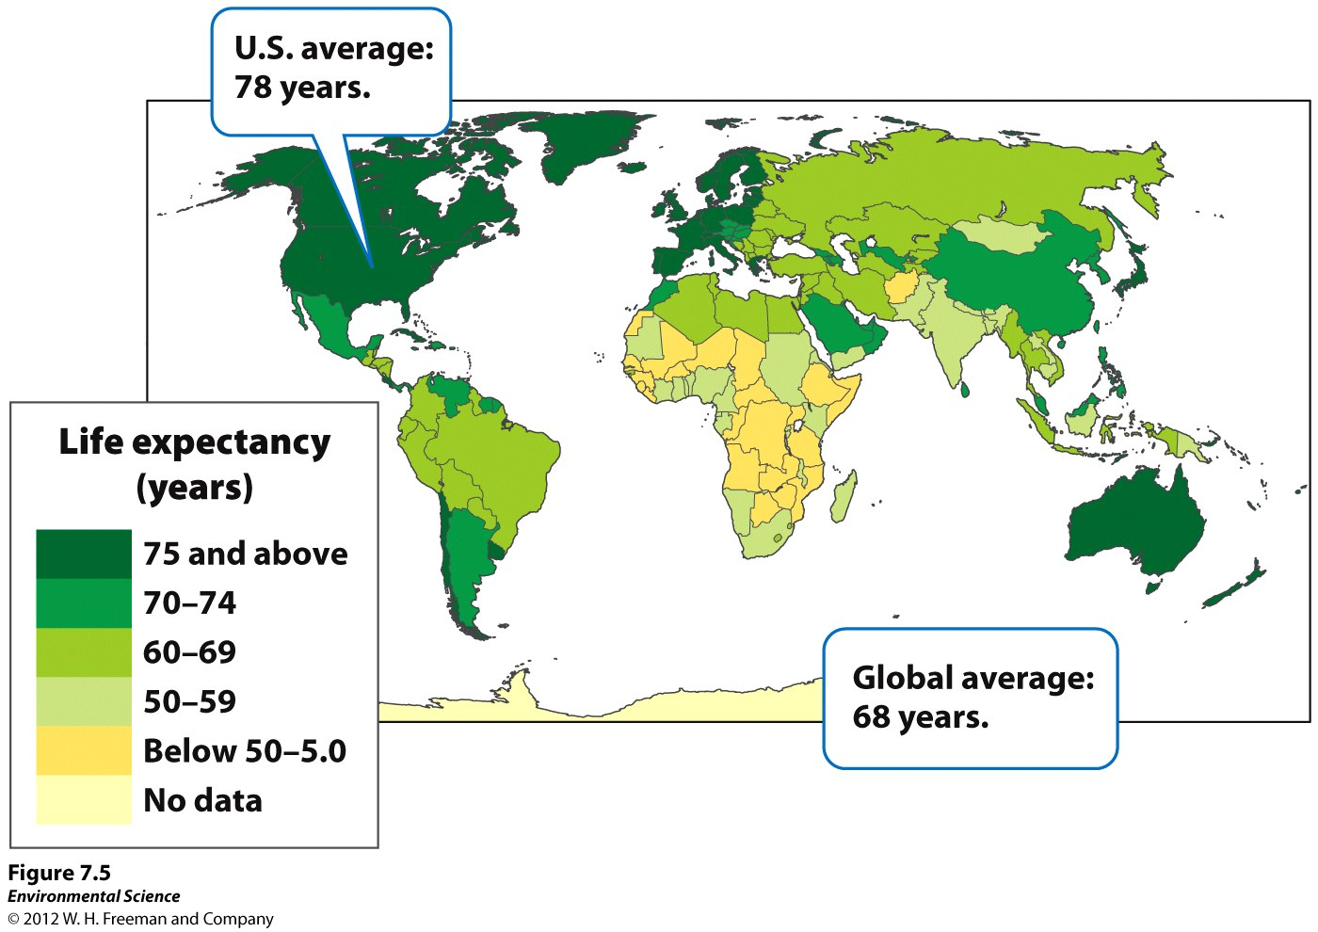
Life Expectancy
Life expectancy- the average number of years that an infant born in a particular year in a particular country can be expected to live, given the current average life span and death rate of that country.

Slide 9
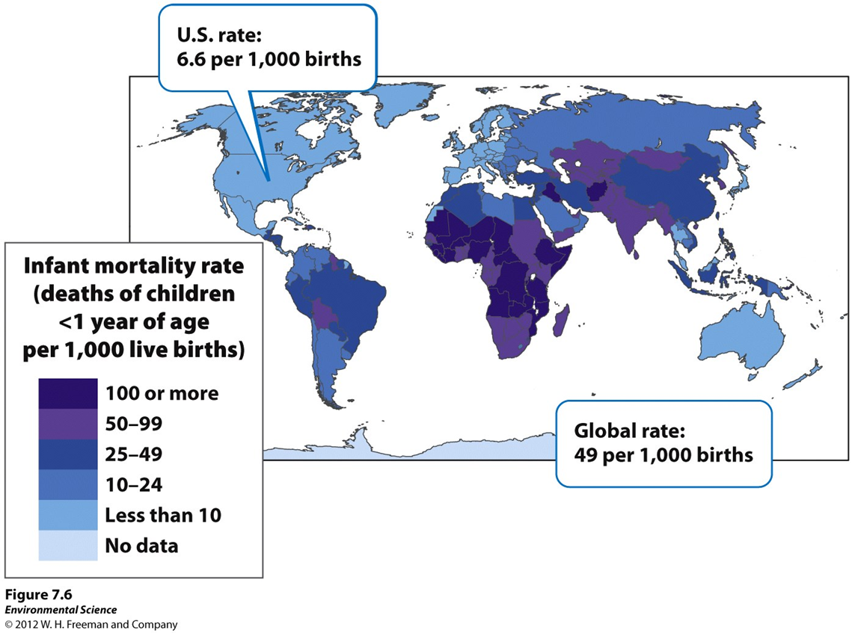
Life Expectancy
Infant mortality rate- the number of deaths of children under 1 year of age per 1,000 live births.
Child mortality rate- the number of deaths of children under age 5 per 1,000 live births.

Slide 10
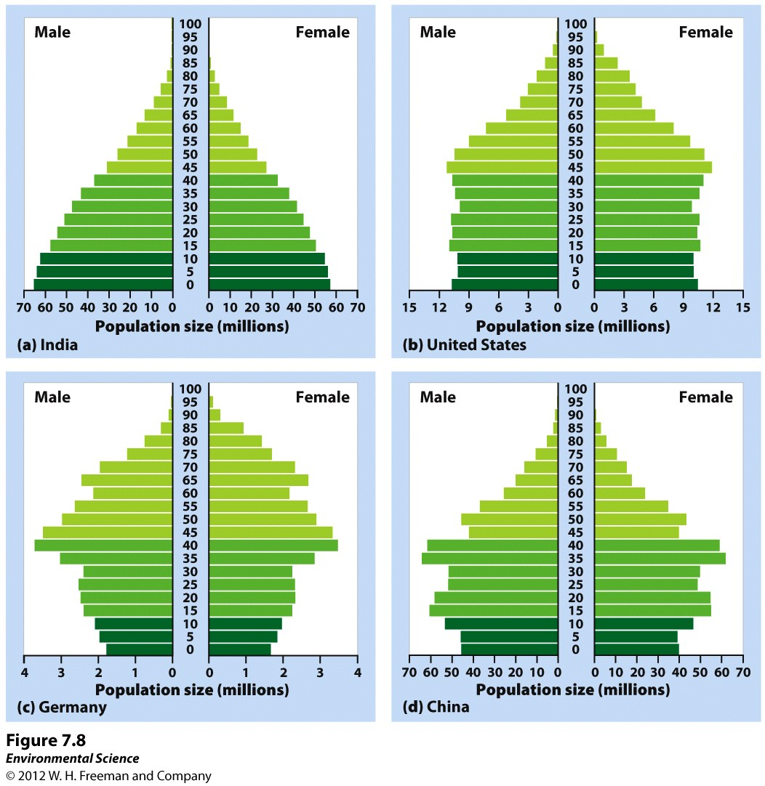

Slide 11
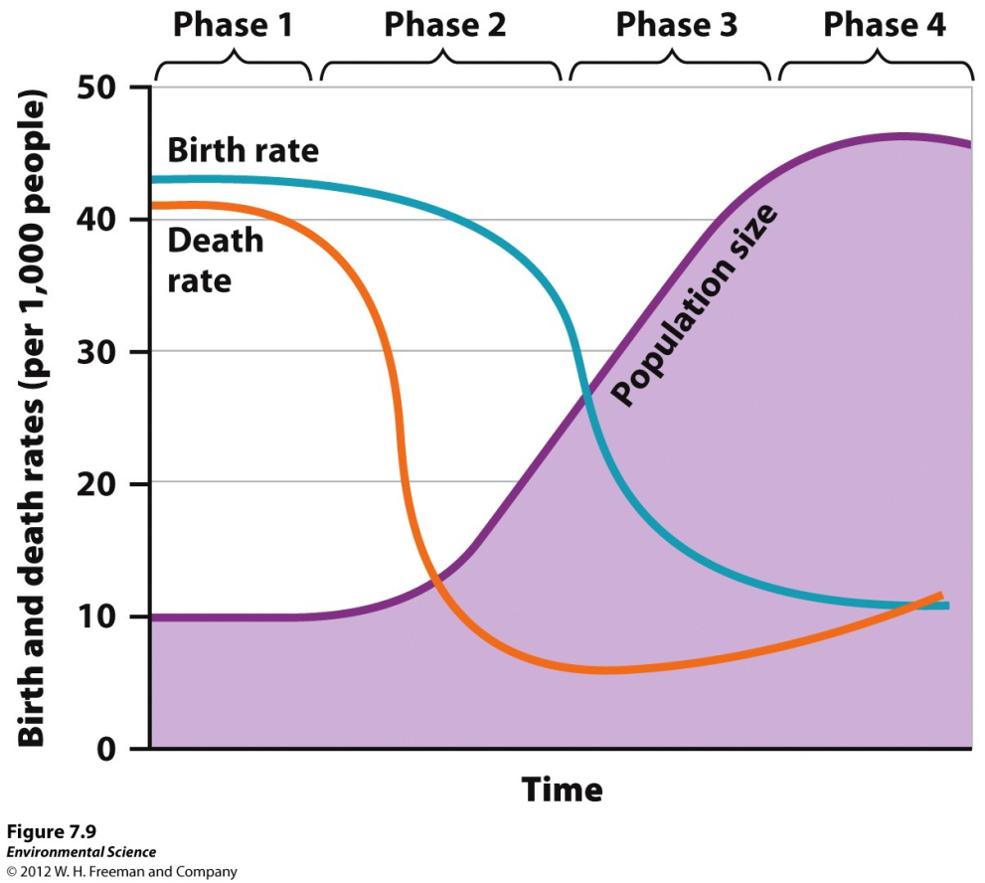
The Theory of Demographic Transition
The theory of the demographic transition is the theory that as a country moves from a subsistence economy to industrialization and increased affluence, it undergoes a predictable shift in population growth.

Slide 13
Phases of demographic transition…
Phase 1: Slow population growth because there are high birth rates and high death rates which offset each other.
Most countries have moved past phase 1
Phase 2: Rapid population growth because birth rates remain high but death rates decline due to better sanitation, clean drinking water, increased access to food and goods, and access to health care.
Africa and India
Phase 3: Stable population growth as the economy and educational system improves and people have fewer children.
United States and Canada
Phase 4: Declining population growth because the relatively high level of affluence and economic development encourage women to delay having children.
Japan, UK, Germany, Russia, and Italy

Slide 14
Family Planning
Family planning- the regulation of the number or spacing of offspring through the use of birth control.

Slide 15
Top 12 most populous countries

Slide 16
The relationship between economic development and population growth rate for developing nations.

Slide 17
Ecological Footprints
Affluence - having a lot of wealth such as money, goods, or property.

Slide 18
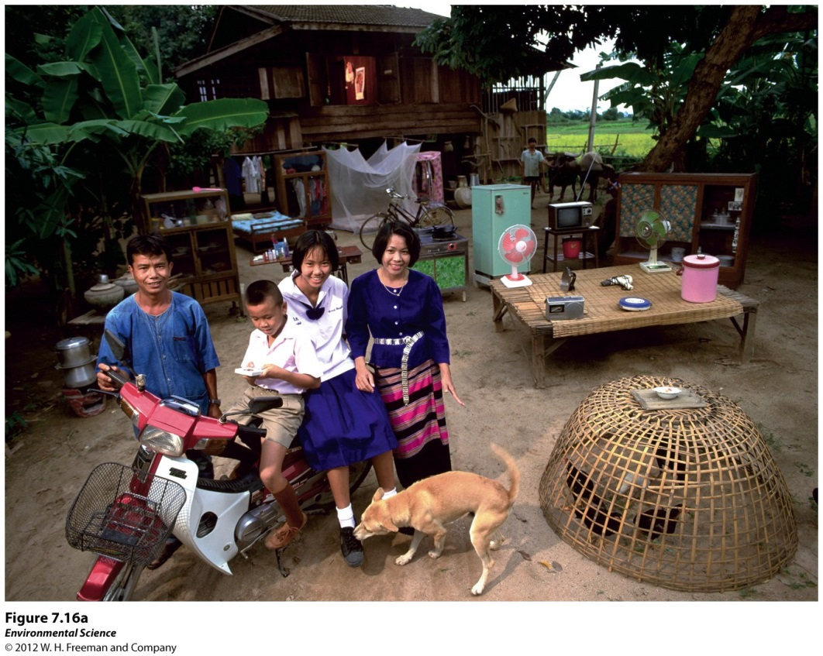
IPAT equation
To estimate the impact of human lifestyles on Earth we can use the IPAT equation:
Impact= Population X Affluence X Technology

Slide 19
Urbanization

Slide 20
Urbanization

Slide 21
The impact of affluence…
Gross domestic product (GDP)- the value of all products and services produced in a year in that country.
GDP is made up of consumer spending, investments, government spending, and exports minus imports.
A countries GDP often correlates with its pollution levels.

