Slide 1
Farming Methods
Conventional agriculture- industrial agriculture where labor is reduced and machinery is used.
Traditional farming- still used in the developing world where human labor is used and not machinery.
Shifting agriculture- used in areas with nutrient poor soils. It involves planting an area for a few years until the land is depleted of nutrients and then moving to another area and repeating the process.
Nomadic grazing- moving herds of animals to find productive feeding grounds.

Slide 2
Desertification
Desertification- When soil is degraded by agriculture to the point at which they are not longer productive.

Slide 3
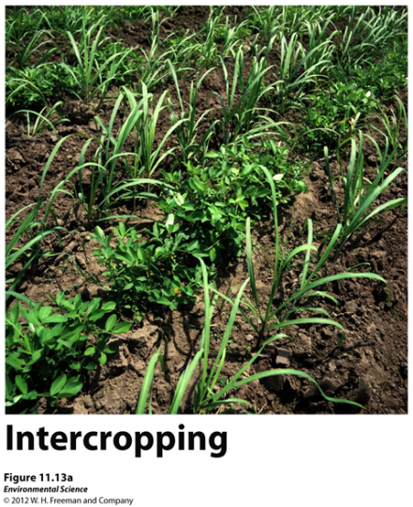
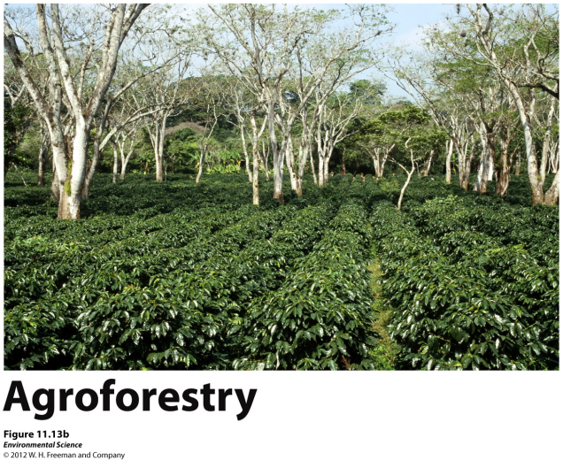
Sustainable Agriculture
Sustainable agriculture- producing enough food to feed the world’s population without destroying the land, polluting the environment, or reducing biodiversity.
Intercropping- two or more crop species are planted in the same field at the same time.
Crop rotation- rotating crops species from season to season.
Agroforestry- intercropping trees with vegetables.
Contour plowing- plowing and harvesting parallel to the land to prevent erosion.

Slide 4
No-till Agriculture
No-till agriculture- helps to stop soil degradation by leaving crop residues in the fields and not tilling the land after each harvest.

Slide 5
Integrated Pest Management
Integrated pest management- using a variety of techniques designed to minimize pesticide inputs.
Crop rotation
Intercropping
Planting pest resistant crop varieties
Creating habitats for predators
Limited use of pesticides

Slide 6
Organic Agriculture
Organic agriculture- production of crops without the use of synthetic pesticides or fertilizers.

Slide 7
High Density Animal Farming
CAFOs (concentrated animal feeding operations)- large structures where animals are being raised in high density numbers.

Slide 8
Harvesting of Fish and Shellfish
Fishery- a commercially harvestable population of fish within a particular ecological region.
Fishery collapse- the decline of a fish population by 90% or more.
Bycatch- unintentional catch of non-target species.

Slide 10
Aquaculture
Aquaculture- the farming of aquatic organisms such as fish, shellfish, and seaweeds.

