Slide 1
Deforestation in Haiti -In 1923 more than 60% of the country covered in forest -2006, less than 2% forested

Slide 2
Ecosystem Ecology Examines Interactions Between the Living and Non-Living World
Ecosystem- A particular location on Earth distinguished by its particular mix of interacting biotic and abiotic components.
Ecosystem Boundaries
Some ecosystems, such as a caves and lakes have very distinctive boundaries. However, in most ecosystems it is difficult to determine where one ecosystems stops and the next begins.

Slide 3
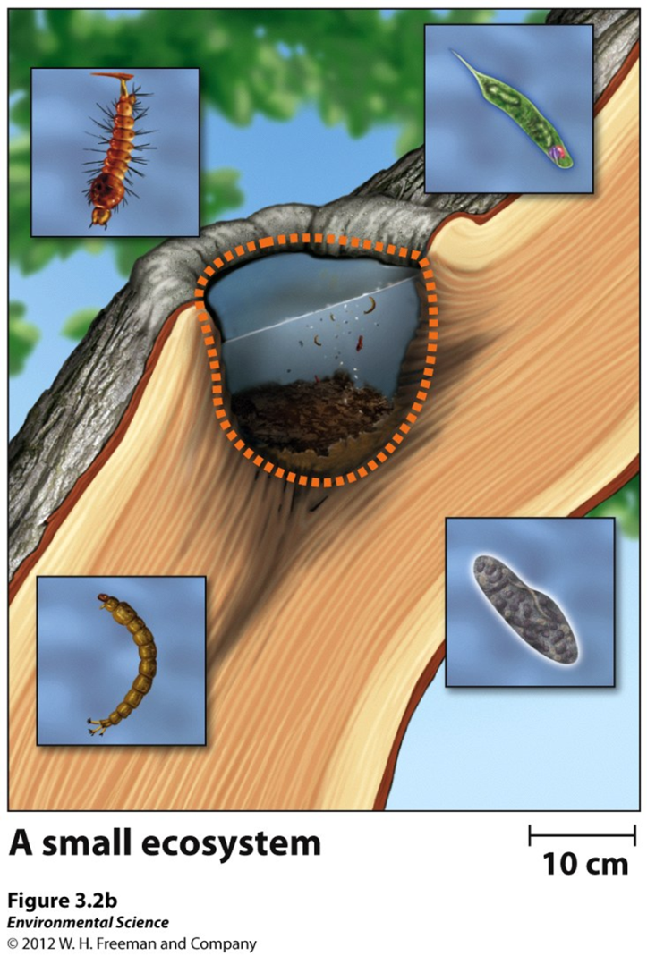
Boundaries are all about the perception of the ecosystem

Slide 4
Systems Interact
Ecosystems can be considered separate, but many ecosystems can interact between each other

Slide 5
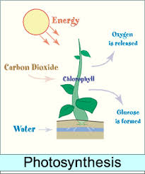
Photosynthesis
Producers/autotrophs
Use the Sun’s energy to produce usable forms of energy

Slide 6
Cellular Respiration
A process that unlocks the chemical energy stored in the cells of organisms
All organisms carry out respirations, including producers, to fuel their own metabolism and growth

Slide 7
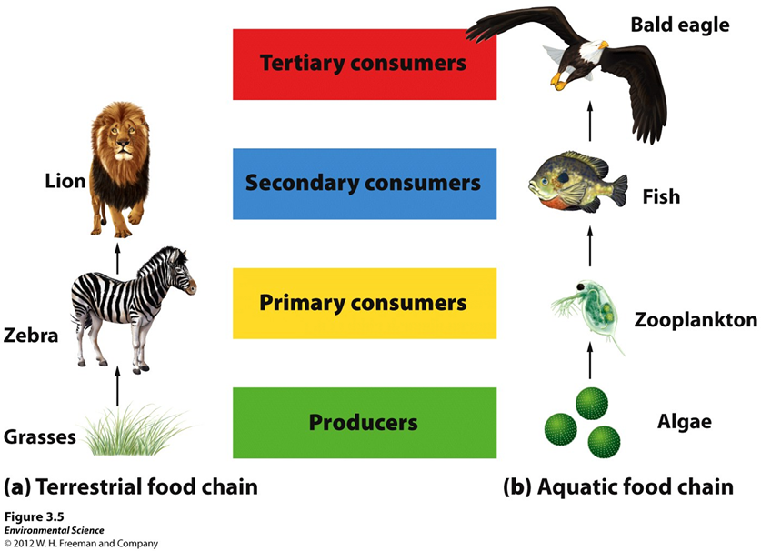
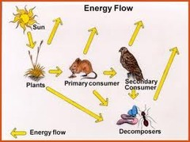
Energy flows through ecosystems

Slide 8
Trophic Levels, Food Chains, and Food Webs
Consumers (heterotrophs)- obtain energy by consuming other organisms.
Primary Consumers (herbivores)- consume producers.
Secondary Consumers (carnivores)- obtain their energy by eating primary consumers.
Tertiary Consumers (carnivores)- eat secondary consumers.

Slide 9
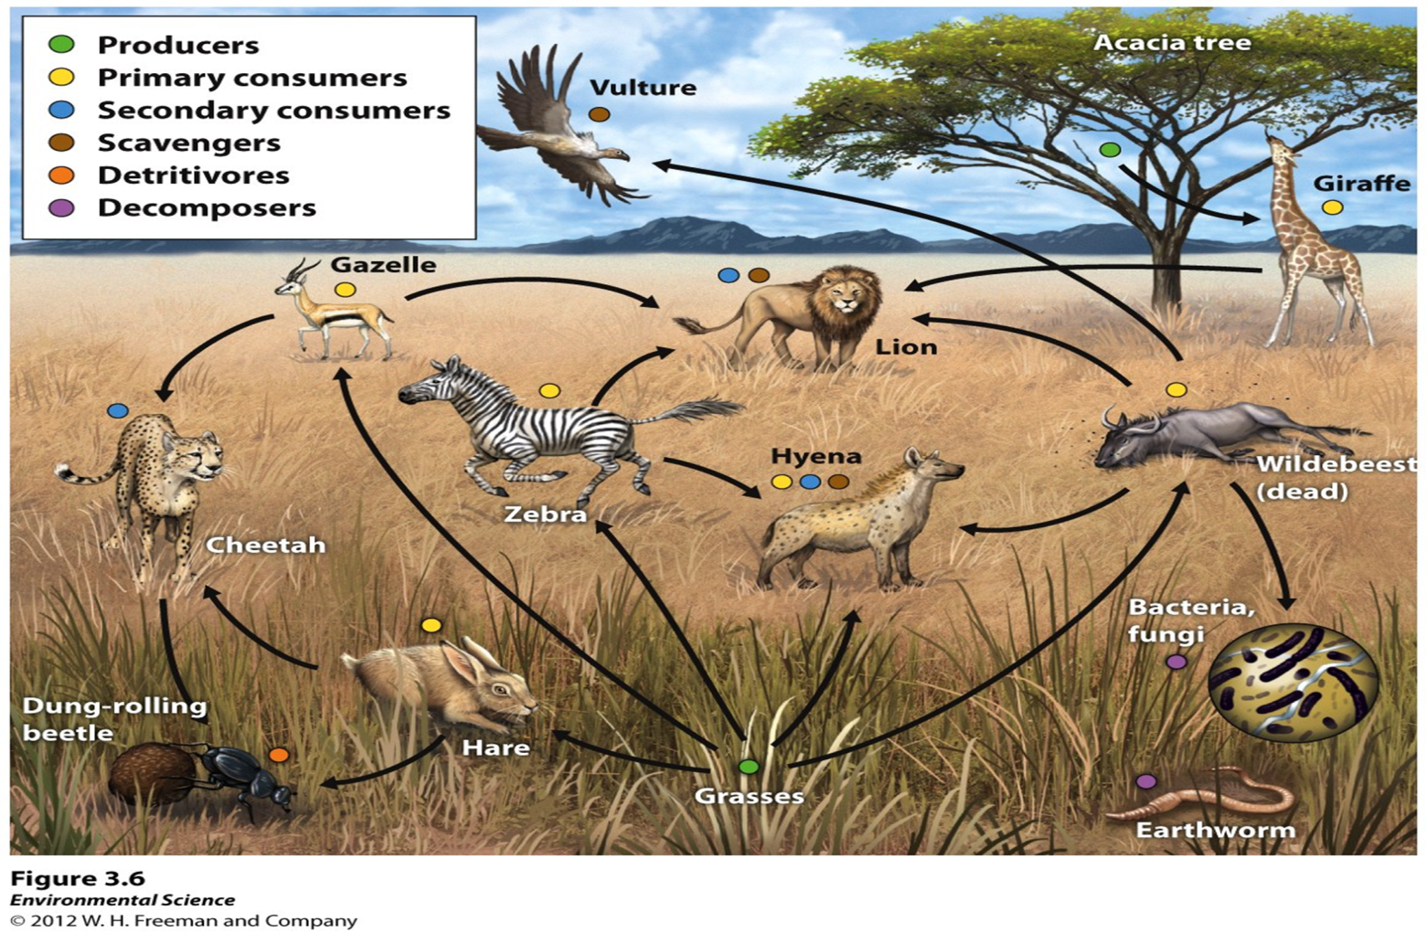
Food Chain- The sequence of consumption from producers through tertiary consumers.
Food Web- A more realistic type of food chain that takes into account the complexity of nature.

Slide 10
Ecosystem Productivity
Gross primary productivity (GPP)- The total amount of solar energy that the producers in an ecosystem capture via photosynthesis over a given amount of time.
Net primary productivity (NPP)- The energy captured (GPP) minus the energy respired by producers.

