Slide 1
Energy Transfer Efficiency and Trophic Pyramids
Biomass- The energy in an ecosystem is measured in terms of biomass.
Standing crop- The amount of biomass present in an ecosystem at a particular time.
Ecological efficiency- The proportion of consumed energy that can be passed from one trophic level to another.
Trophic pyramid- The representation of the distribution of biomass among trophic levels.

Slide 2
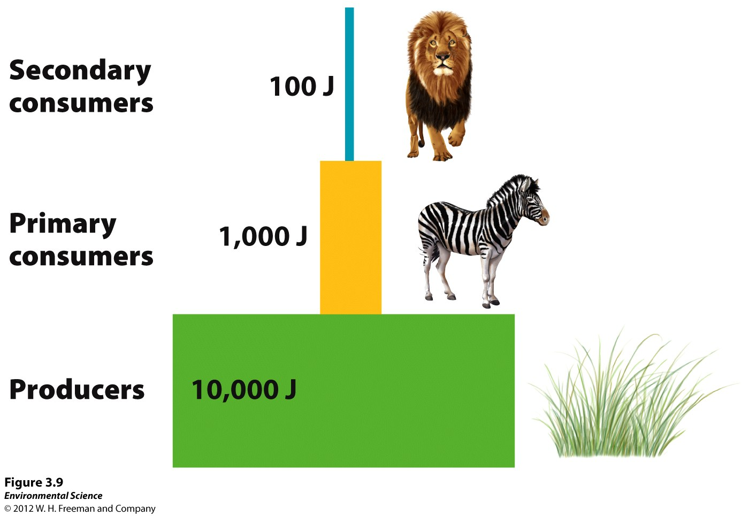
Trophic Pyramid for Serengeti

Slide 3
Matter cycles through the biosphere
Biosphere- The combination of all ecosystems on Earth.
Biogeochemical cycles- The movement of matter within and between ecosystems involving biological, geologic and chemical processes.

Slide 4
Hydrologic Cycle (Water Cycle)

Slide 5
Hydrologic Cycle
Transpiration- The process where plants release water from their leaves into the atmosphere.
Evapotranspiration- The combined amount of evaporation and transpiration.
Runoff- When water moves across the land surface into streams and rivers, eventually reaching the ocean.

Slide 6
Carbon Cycle

Slide 7
Nitrogen Cycle

Slide 8
Phosphorus Cycle

