Slide 1
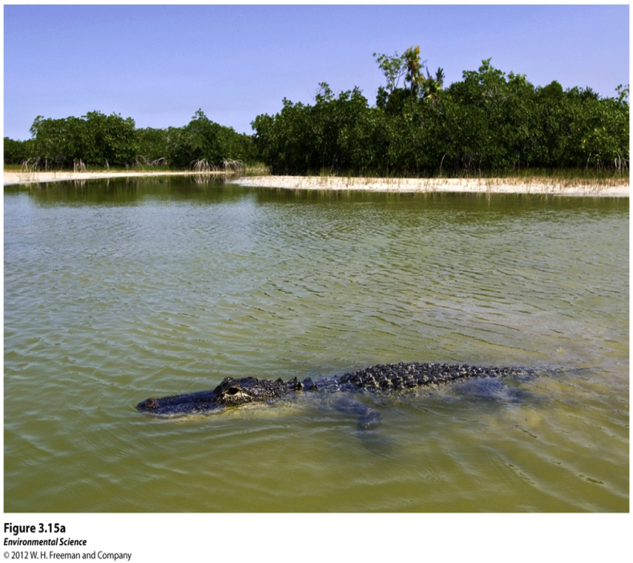
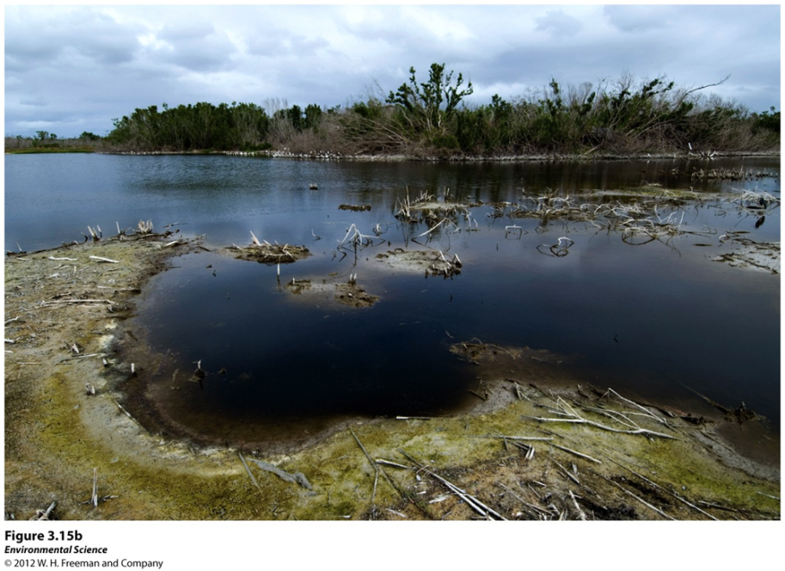
Disturbance- An event caused by physical, chemical or biological agents that results in changes in population size or community composition.
Chandeleur Islands in Lousiana before and after Katrina

Slide 2
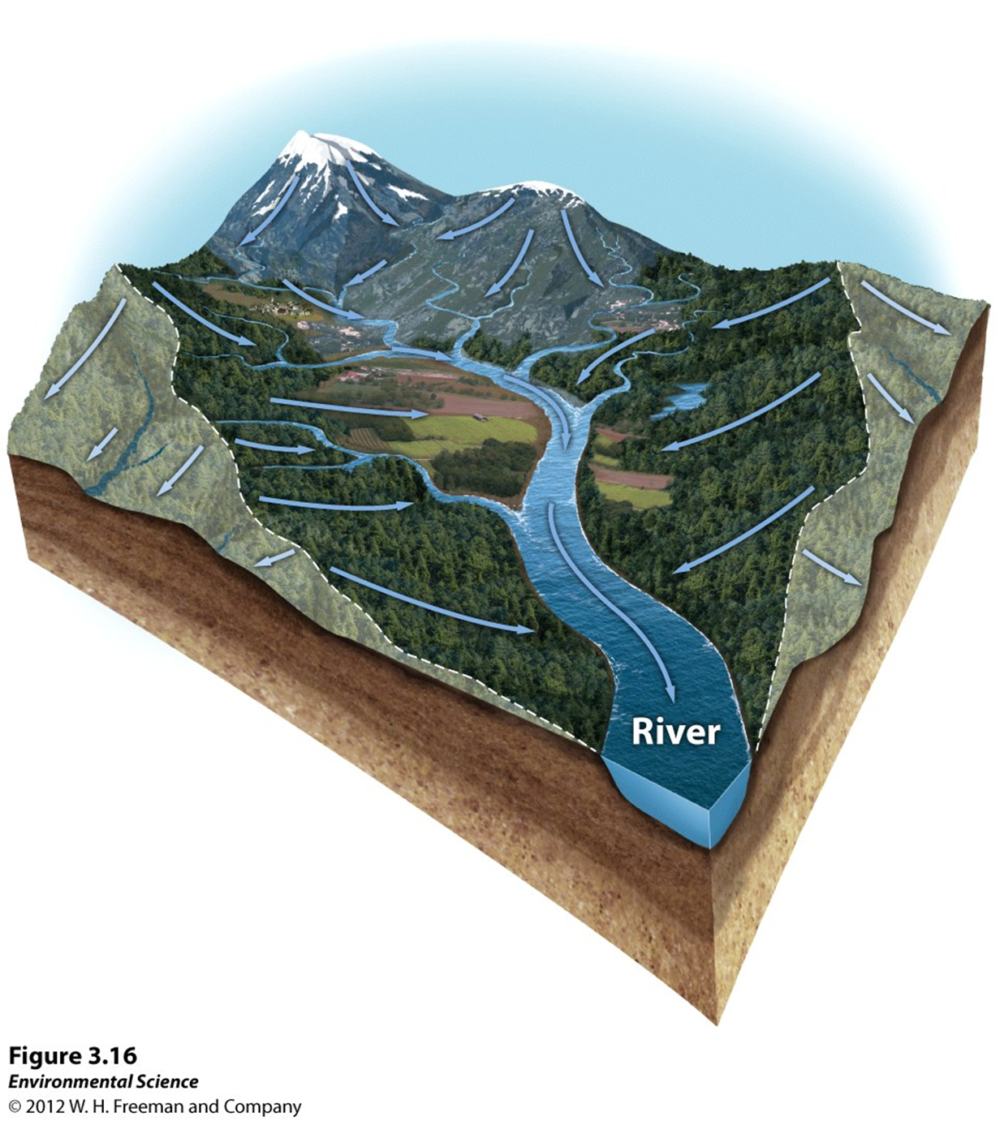
Watershed- All of the land in a given landscape that drains into a particular stream, river, lake or wetland.

Slide 3
Resistance vs. Resilience
Resistance- A measure of how much a disturbance can affect its flows of energy and matter.
Resilience- The rate at which an ecosystem returns to its original state after a disturbance.
Restoration ecology- A new scientific discipline that is interested in restoring damaged ecosystems.

Slide 4
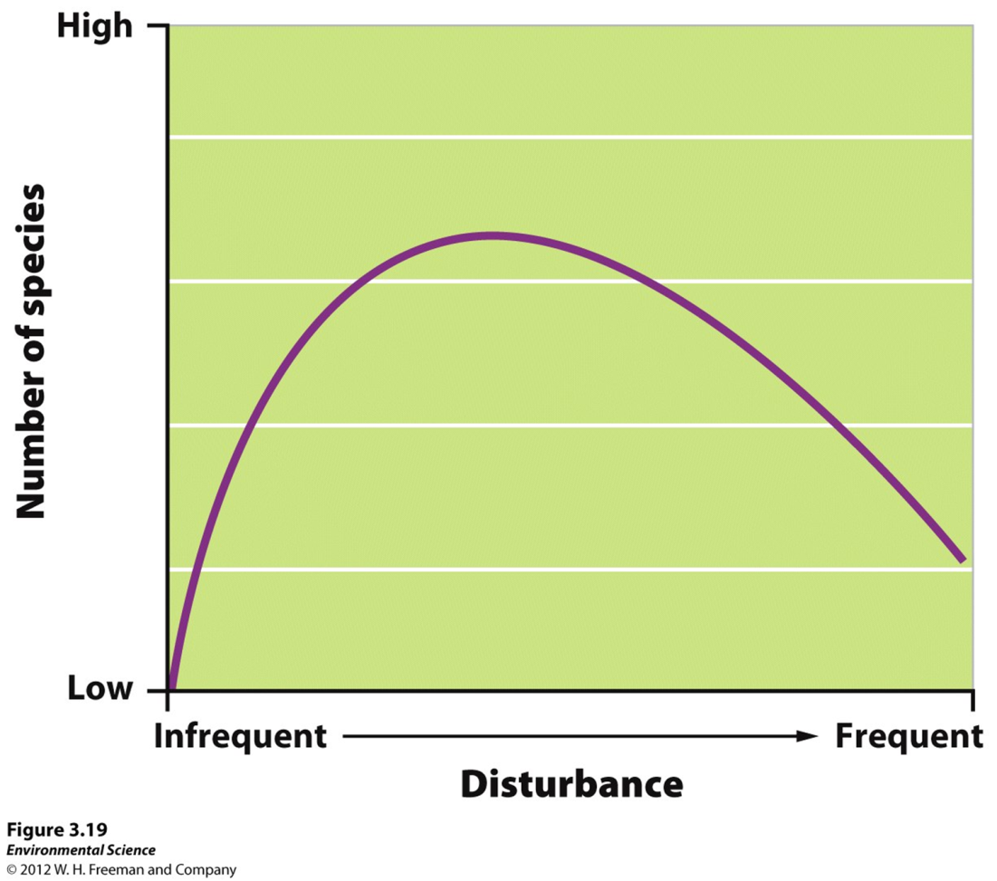
The intermediate disturbance hypothesis- states that ecosystems experiencing intermediate levels of disturbance are more diverse than those with high or low disturbance levels.

Slide 5
Instrumental Values of Ecosystems
Provisions- Goods that humans can use directly.
Regulating services- The service provided by natural systems that helps regulate environmental conditions.
Support systems- The support services that natural ecosystems provide such as pollination, natural filters and pest control.
Resilience- Resilience of an ecosystem ensures that it will continue to provide benefits to humans. This greatly depends on species diversity.
Cultural services- Ecosystems provide cultural or aesthetic benefits to many people.

