Slide 1
Competiton
Competition- the struggle of individuals to obtain a limiting resource.
Competitive exclusion principle- two species competing for the same resource can’t co-exist

Slide 2
Resource Partitioning
2 species divide a resource based on differences in the species behavior or morphology

Slide 3
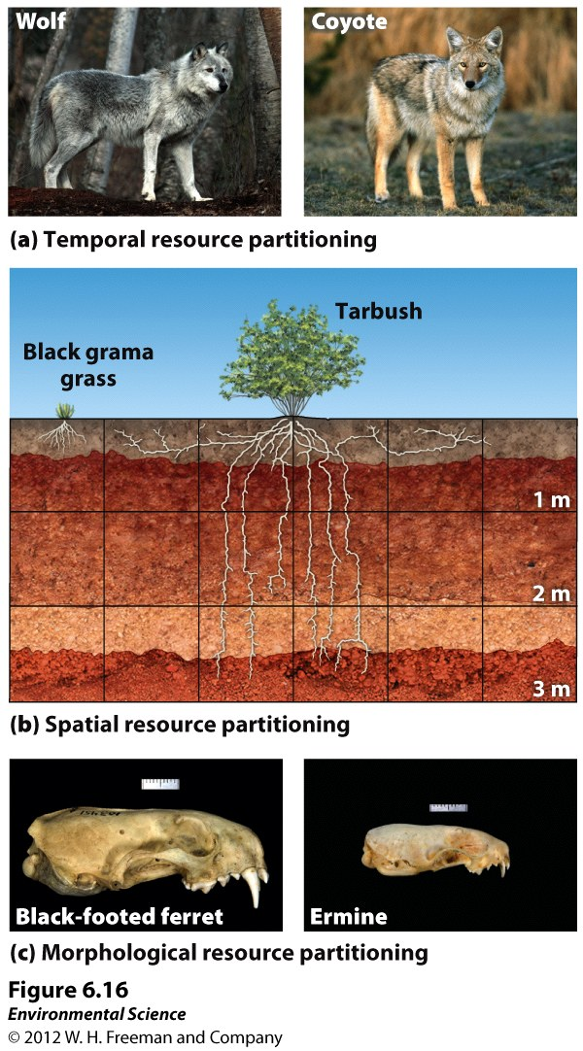

Slide 4
Predation
Predation- the use of one species as a resource by another species.
True predators- kill their prey.
Herbivores- consume plants as prey.
Parasites- live on or in the organism they consume.
Parasitoids- lay eggs inside other organisms.

Slide 5
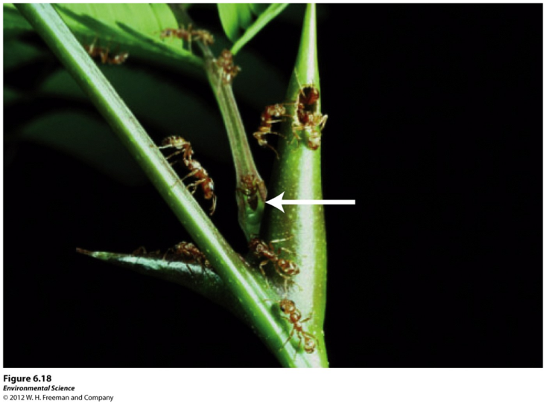
Mutualism
Mutualism- A type of interspecific interaction where both species benefit.

Slide 6
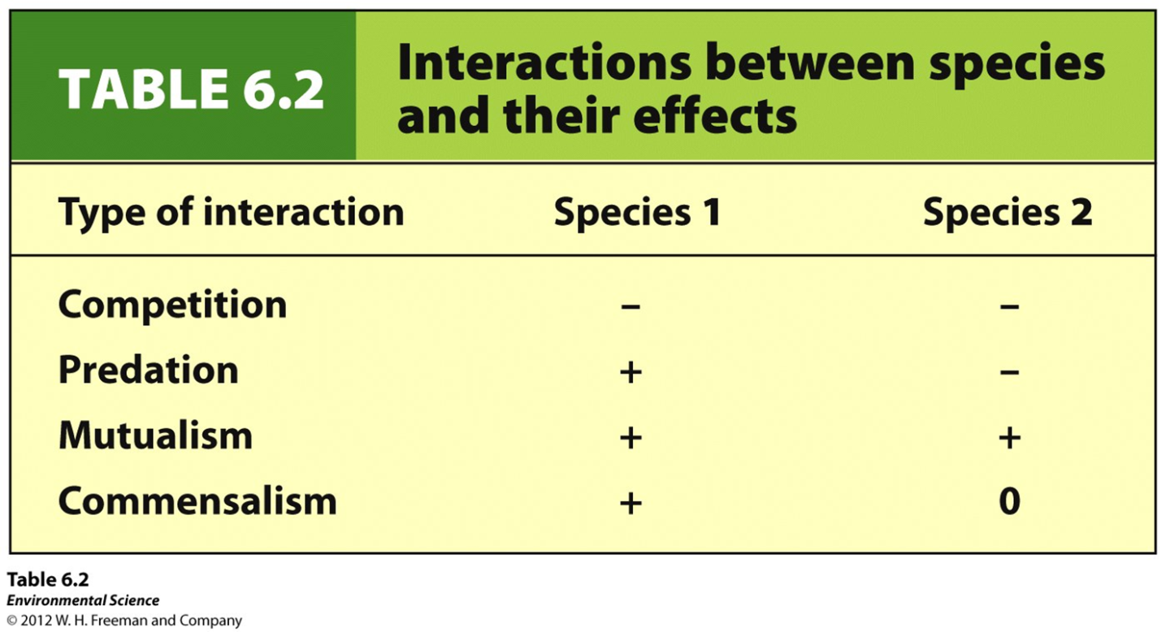
Commensalism
Commensalism- a type of relationship in which one species benefits but the other is neither harmed nor helped.

Slide 7
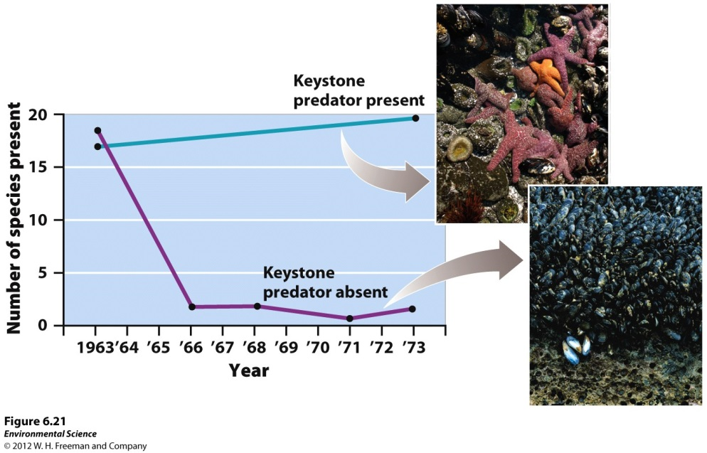
Keystone Species
Keystone species- a species that plays a role in its community that is far more important than its relative abundance might suggest.
Typically exist in low numbers
Predators (starfish), mutualistic relationships (mycorrhiza) , ecosystem engineers (beaver)

Slide 8
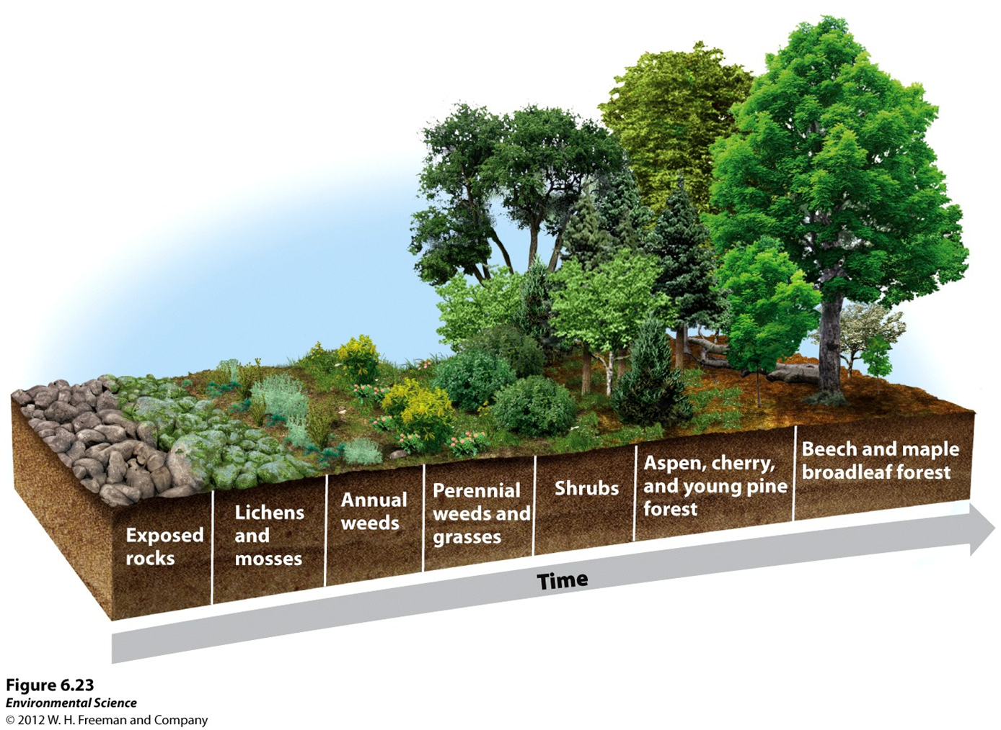
Primary Succession
Primary succession- occurs on surfaces that are initially devoid of soil. (Parking lot, new exposed rock, newly cooled lava)

Slide 9
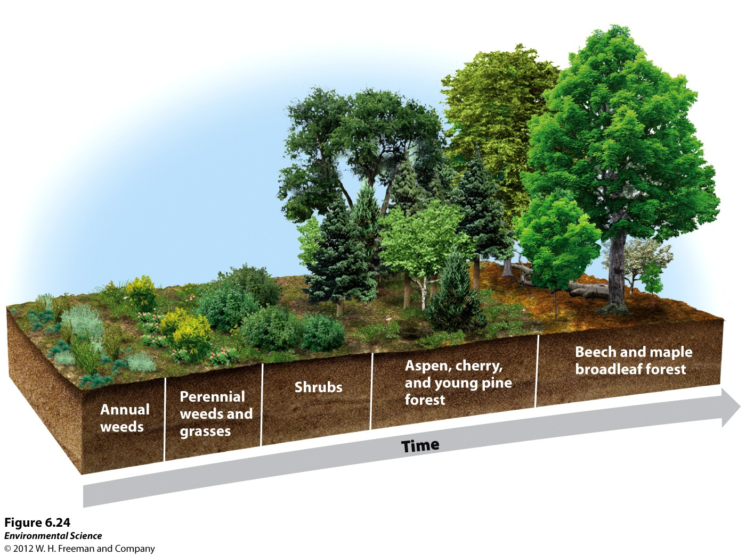
Secondary Succession
Secondary succession- occurs in areas that have been disturbed but have not lost their soil. (forest fire, hurricane)

Slide 10
Aquatic Succession

Slide 11
Factors that determine species richness:
Latitude- move from equator to poles # of species declines
Time- Longer a habitat exists more colonization, speciation, and extinction can occur
Habitat size- richness increases with size
Theory of Island biogeography
Size and distance from source of colonizing species

