Slide 1
Infectious Disease

Slide 2
Epidemic and pandemic
Epidemic- when a pathogen causes a rapid increase in disease
Pandemic- When an epidemic occurs over a large geographic region

Slide 3
Malaria
Life cycle in a human host video
TED Ed mosquito video
350-500 million people get the disease each year, about 1 million die from it.
Common in sub-saharan Africa, Asia, Middle East, Central and South America
Has been eradicated from US by eradication program

Slide 4
Swine Flu H1N1
Similar to normal flu virus, but usually contracted by birds
Related virus H5N1 jumped from birds to humans in Asia
No natural defense against it. In 2009 400 people contracted it and about half died.
Currently transmission is not easily passed among people, but it is predicted that a mutation that makes transmission easier could kill 150 million people
H1N1 Clip

Slide 5
Tuberculosis
Highly contagious disease caused by a bacterium that primarily infects the lungs.
Tuberculosis (TB) is second only to HIV/AIDS as the greatest killer worldwide due to a single infectious agent.
In 2012, 8.6 million people fell ill with TB and 1.3 million died from TB.
Over 95% of TB deaths occur in low- and middle-income countries, and it is among the top three causes of death for women aged 15 to 44.
In 2012, an estimated 530 000 children became ill with TB and 74 000 HIV-negative children died of TB.
TB is a leading killer of people living with HIV causing one quarter of all deaths.
Multi-drug resistant TB (MDR-TB) is present in virtually all countries surveyed.
The estimated number of people falling ill with tuberculosis each year is declining, although very slowly, which means that the world is on track to achieve the Millennium Development Goal to reverse the spread of TB by 2015.
The TB death rate dropped 45% between 1990 and 2012.
Source: http://www.who.int/mediacentre/factsheets/fs104/en/

Slide 6
Ebola
Uganda outbreak
Viral hemorrhagic fever outbreaks have a case fatality rate of up to 90%.
Ebola hemorrhagic fever outbreaks occur primarily in remote villages in Central and West Africa, near tropical rainforests.
The virus is transmitted to people from wild animals and spreads in the human population through human-to-human transmission.
Fruit bats of the Pteropodidae family are considered to be the natural host of the Ebola virus.
There is no treatment or vaccine available for either people or animals.
2014 Outbreak

Slide 7
West Nile
Transmitted among birds by mosquitoes
First human case in 1937 in the West Nile region of Uganda
Virus causes an inflammation of the brain leading to illness and sometimes death
Clip

Slide 8
Mad Cow Disease
Pathogen slowly damages a cow’s nervous system
Prions in brains of cattle can mutate into deadly proteins that act as pathogens
Transmission requires an uninfected cow to consume the nervous system of an infected cow
It is estimated that several thousand people are infected but prions can exist in the body many years before causing symptoms
Video Clip

Slide 9
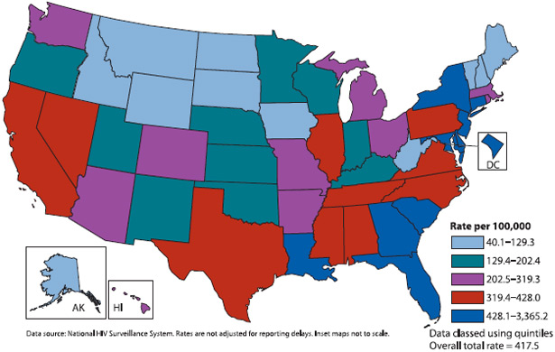
HIV/AIDS
Hans Rosling Stats about HIV/AIDS
Antiretroviral Therapy
33 million people in the world are
infected with HIV, over 25 million
people have died from an AIDS
related illness.

Slide 10
Plague
Bubonic plague, black death
From a bacteria carried by fleas
Commonly on rats
Symptoms; swollen glands, black spots, extreme pain
Killed about ¼ of the European population in the 1300s
Antibiotics are effective at killing bacteria
Clip

Slide 11
Zika Virus
CBS News Story

