Slide 1
Pollution Control & Indoor Air Pollution
Cha. 15

Slide 2
Pollution Control
Best way = avoid emissions in the first place
use fuels with fewer impurities
use low sulfur coal or oil (more $)
increase efficiency & conservation
Develop alternative energy sources not dependent on combustion

Slide 3
Control of Sulfur and Nitrogen Oxide Emissions
Remove SO2 from coal exhaust during combustion = fluidized bed combustion. Coal is burned near calcium carbonate which reduces sulfur emissions.
CaCO3 absorbs SO2 and produces calcium sulfate which is used to make gypsum and sheetrock
Decrease NOx by decreasing burn temps and amt. of oxygen used
incomplete combustion reduces efficiency and releases more particulates and CO :[
Catalytic converters in all cars after 1975 reduce NOx and CO, also reduce lead because metals in converter can’t be exposed to lead
Improvements in combustion technology of power plants and factories

Slide 4
Control of Particulate Matter
Removal of PM is the most common means of pollution control, sometimes removes sulfur in the process
Easiest method is gravitational settling, relies on gravity to remove particles as exhaust travels through smokestack
Ash must be disposed of in a landfill

Slide 5
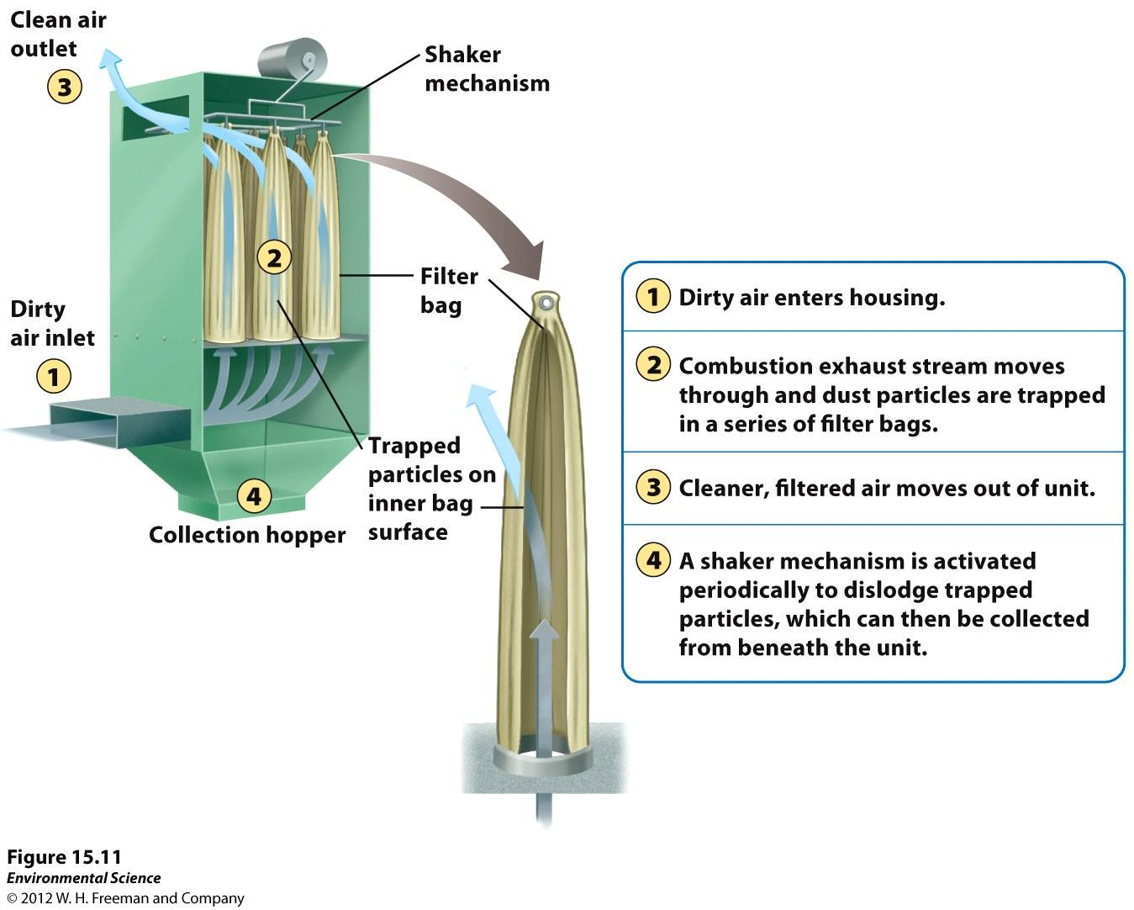
Baghouse Filter
Fabric filter can remove almost 100% of PM emissions

Slide 6
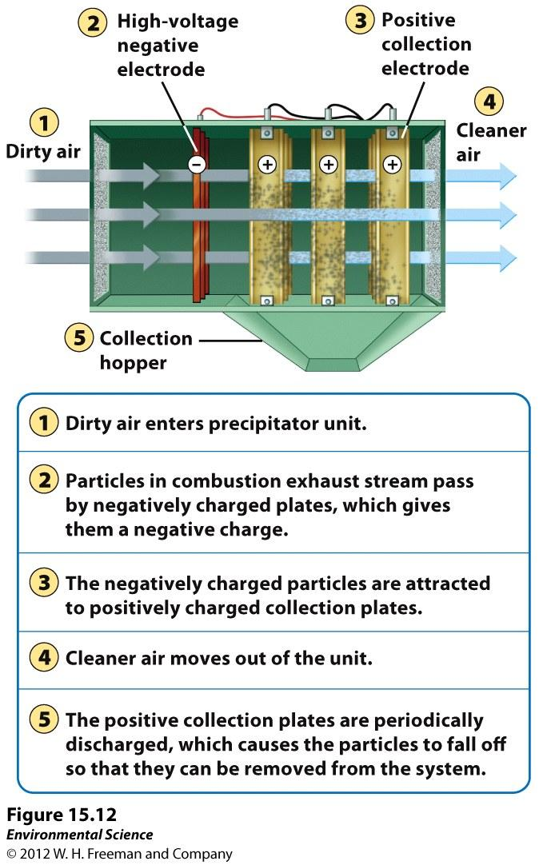
Electrostatic Precipitator
Uses electrical charge to separate particulate matter
Removes majority of PM

Slide 7
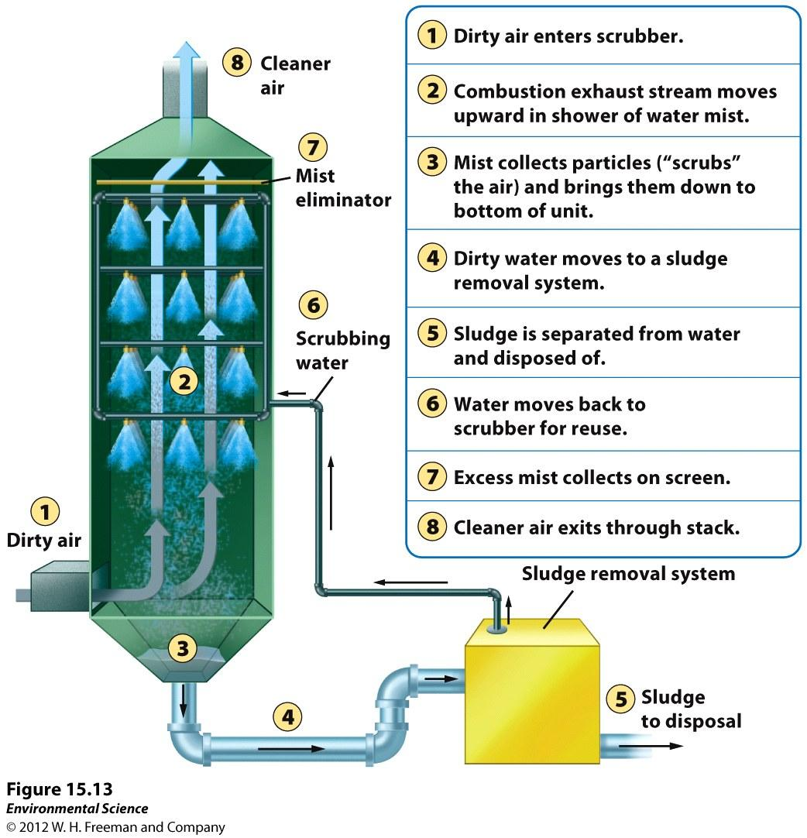
The Scrubber
Combo of water and air to separate and remove particles
Used also to reduce SO2 emissions
* All 3 types of pollution control devices require extra energy and increase the resistance of air flow. They require the use of more fuel and increase CO2 emissions :/ *

Slide 8
Innovative Pollution Control Ideas
Reduce amt. of gasoline spilled at fill stations
Restrict evaporation of dry cleaning fluid
Restrict use of lighter fluid (a VOC) for starting charcoal grills
Reduce wood burning stoves or fireplaces
California discussed reducing # of bakeries, emissions from rising bread contain VOCs
Reduce auto use
Mexico city cars driven every other day (even and odd license plates)
China Beijing olympics, expand public transportation, motor vehicle restrictions, shut down industries to reduce photochemical smog
Carpool lanes
Tolls

Slide 9
Clean Air Act, reducing SO2
Amendments to allow free-market to reduce SO2 emissions.
Buying and selling of allowances that authorize the owner to emit a certain amt. of sulfur
One allowance = 1 ton of SO2 a year
Awarded proportionally to amt of sulfur emitted before 1990
Must have allowances at least equal to emissions or fined
Bought and sold on the open market by anyone
Overtime amount of allowances distributed each year are reduced
U.S. declined from 26 million tons in 1982 to 11.4 million tons 2008

Slide 10
Indoor Air Pollutants
Indoor air pollution causes more deaths each year than outdoor air pollution
Much worse in developing countries
World Health Organization estimates indoor air pollution is responsible for more than 1.6 million deaths annually worldwide, and 56% of those deaths occur among children less than 5 years old
90% of deaths from indoor air pollution occur in developing countries

Slide 11
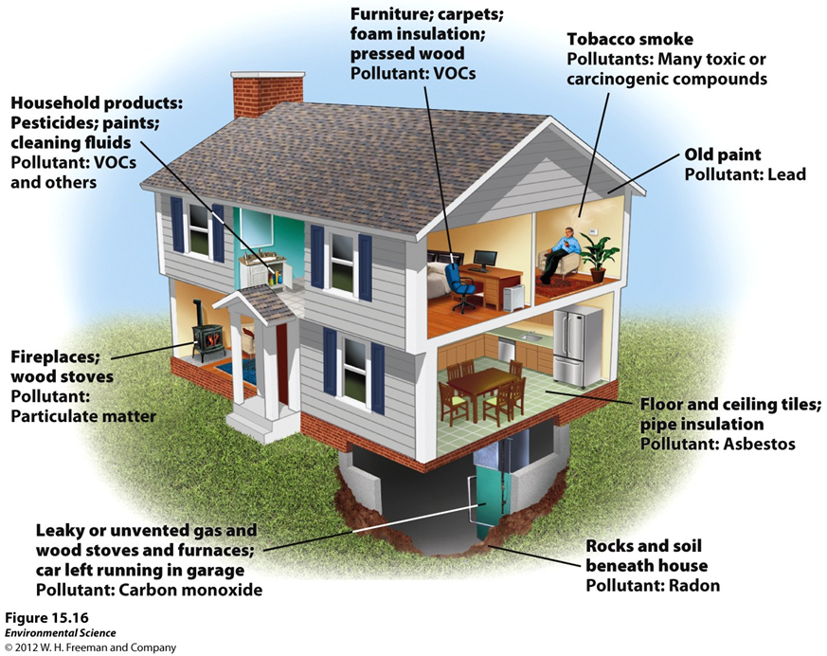
Indoor Pollution Developed World
Spend more time indoors
More insulation to decrease energy consumption means more trapped air
Materials in home made from plastics give off vapors
New house building materials

Slide 12
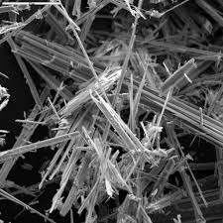
Asbestos
Long thin fibrous silicate mineral with insulating properties
Used as insulator on steam and hot water pipes, in shingles
Respiratory disease and lung cancer
Manufactured form stable, but harmful when disturbed
No longer used as insulating material, but in older buildings

Slide 13
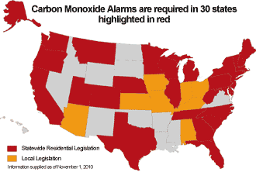
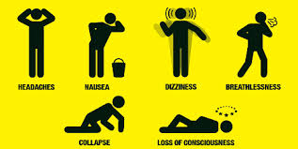
Carbon Monoxide
Malfunctioning exhaust systems on household heaters (natural gas heaters)
CO binds with hemoglobin more efficiently than O2, interferes with oxygen transport in blood

Slide 14
VOCs in home products
Formaldehyde used to manufacture building products, particle board and carpeting glue
New houses, pressed wood for cabinets
New carpet smell
Overtime can cause burning sensation in eyes and throat and breathing difficulties and sometimes asthma
Has caused cancer in lab animals, could be human carcinogen
Detergents, dry-cleaning, deodorizers, plastic, fabric,carpets

Slide 15
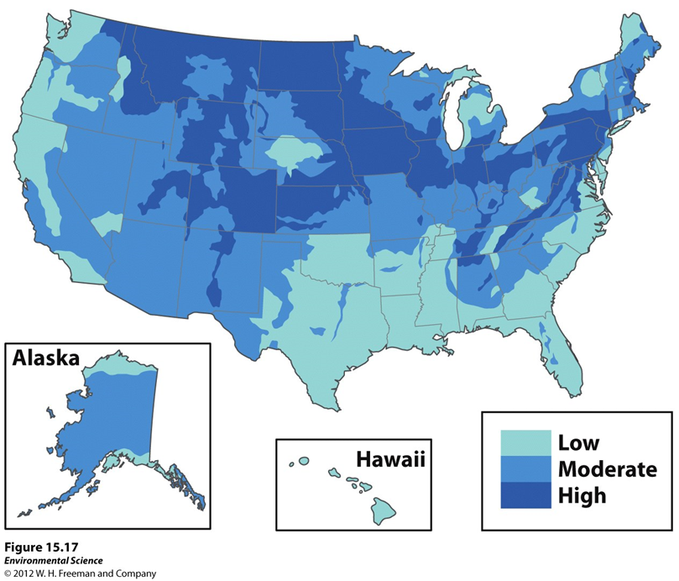
Radon
Radioactive gas that occurs naturally from decay of uranium exists in rocks and soils
Seeps into homes from cracks in foundation, drinking groundwater
Decays and attaches to dust particles
EPA estimates 21,000 people die/year of radon induced lung cancer, runner-up to smoking
Test homes, increase ventilation, seal cracks

Slide 16
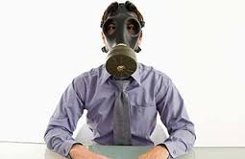
Sick Building Syndrome
Newer buildings have more insulation
Builds up toxic compounds and pollutants in a confined space
Contain products made with synthetic materials
Headaches, nausea, throat and eye irritations, fatigue
4 reasons
inadequate ventilation
chemicals from glues, carpet, furniture, cleaning supplies, copy machines
Vehicle exhaust through air intakes
bio contamination, molds and pollen

