Slide 1
Risks

Slide 2
Rank from 1-16 in order of most risk to least risk
alcohol, commercial aviation, construction, contraceptives, fire fighting, food preservatives, handguns, motor vehicles, motorcycles, nuclear power, pesticides, police work, private aviation, smoking, spray cans, surgery.

Slide 3
Actual Results
Experts
1. motor vehicles
2. smoking
3. alcohol
4. handguns
5. surgery
6. motorcycles
7. X-rays
8. pesticides
9. electric power
10. swimming
11. contraceptives
12. private aviation
13. construction
14. preservatives
15. bicycles
16. commercial aviation
College Students
1. nuclear power
2. handguns
3. smoking
4. pesticides
5. motor vehicles
6. motorcycles
7. alcohol
8. police work
9. contraceptives
10. fire fighting
11. surgery
12. preservatives
13. spray cans
14. construction
15. private aviation
16. commercial aviation

Slide 4
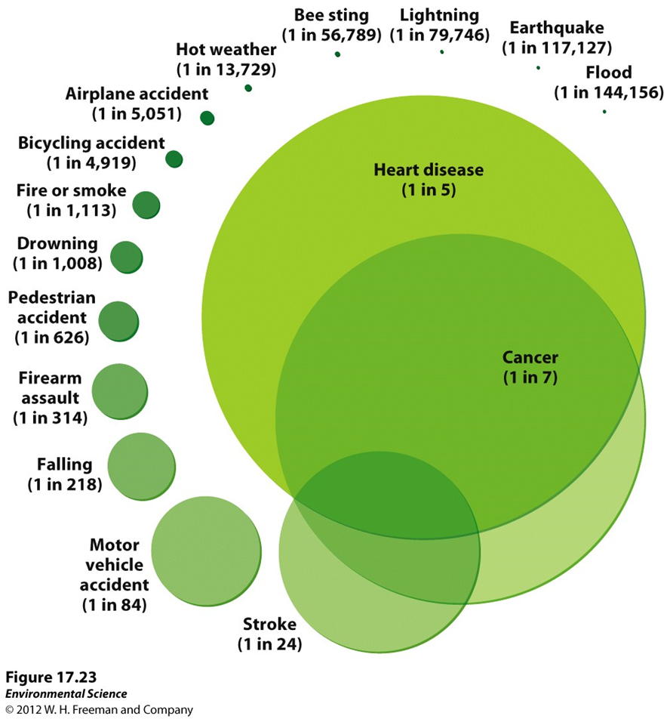

Slide 5
Factors that influence risk perception
Control - the ability of the individual or society to control the risk
Catastrophic potential - the possibility of fatalities or ill effects grouped in time and space as in an epidemic
Dread - the fear of the possibility of serious delayed effects, such as cancer
Familiarity - the degree of familiarity lay people have with the risk
Equity - refers to the equal distribution of risks and benefits throughout society
Level of knowledge - the general understanding lay people have with the process or activity posing the risk
Voluntariness of exposure
Effects on children and future generations - concerns about possible delayed effects on humans and the environment posed by the risk
Clarity of benefits - represents the awareness and understanding of the benefits provided by the activity posing the risk
Media attention
Trust in organizations or institutions

Slide 6
Risk Analysis

Slide 7
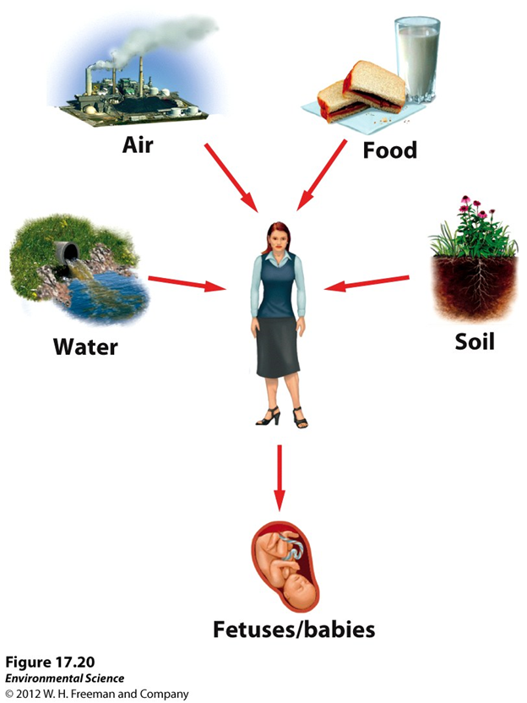
Chemical Exposure

