Slide 1
Toxins

Slide 2
Dirty Dozen
-Endocrine disrupters
-News
-Produce
-Dirty Dozen, Clean 15

Slide 3
Chemical Risks
Neurotoxins- chemicals that disrupt the nervous system
Carcinogens- chemicals that cause cancer
Teratogens- chemicals that interfere with the normal development of embryos or fetuses
Allergens- chemicals that cause allergic reactions
Endocrine disruptors- chemicals that interfere with the normal functioning of hormones in an animal’s body

Slide 4
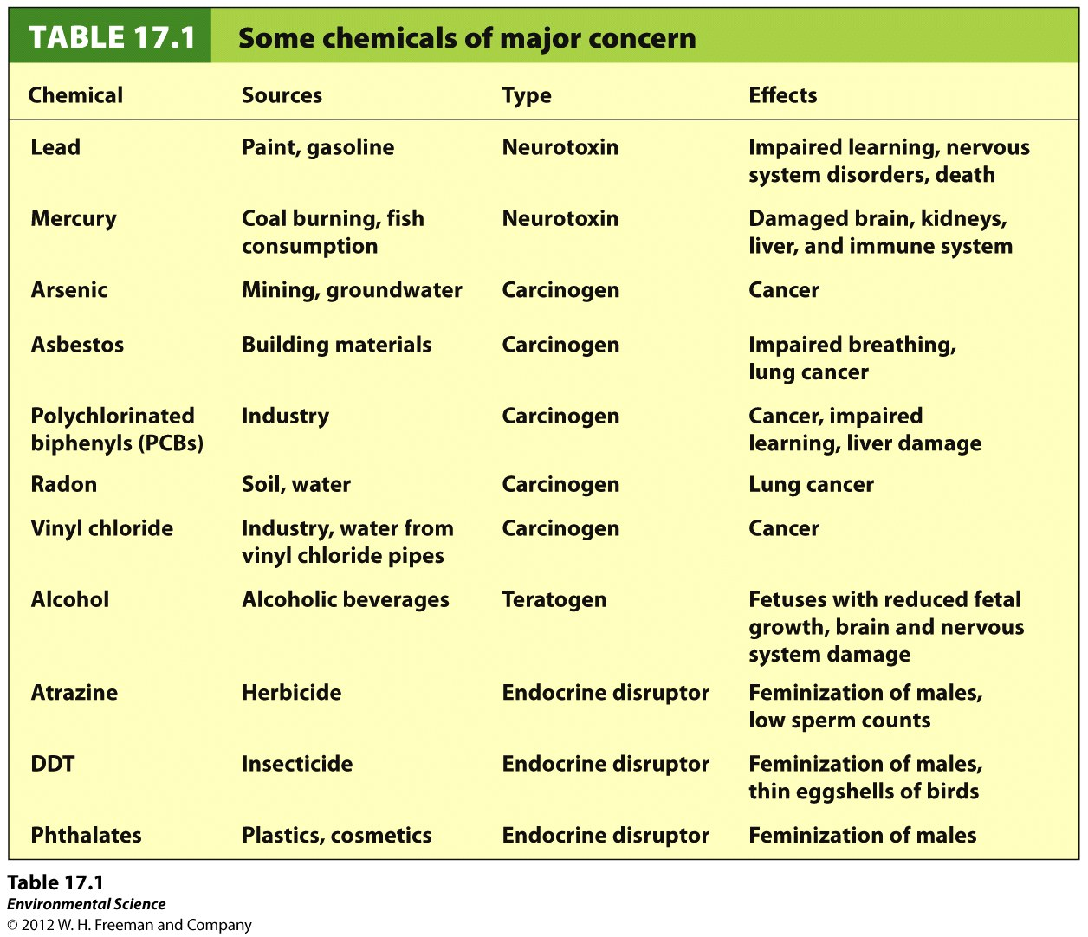

Slide 5
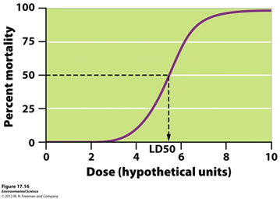
Dose Response Studies
LD50- lethal dose that kills 50% of the individuals
ED50- effective dose that causes 50% of the animals to display the harmful but nonlethal effect

Slide 6
Dose-Response Studies
Acute studies-Most dose-response studies only last for 1-4 days
Chronic Studies-Studies that last a long time. Goal is to determine long-term effects of chemicals.

Slide 7
Determining safe concentrations
For most animals, a safe concentration is obtained by taking the LD50 and dividing it by 10.
For humans, the agencies are more conservative. The LD50 values are divided by 10 to determine safe concentrations for mice/rats. That value is again divided by 10 to reflect that mice/rats may be less sensitive to something than humans. It is then divided by 10 again to ensure extra level of caution. Overall, LD50 is divided by 1000 for humans.

Slide 8
Retrospective vs. Prospective Studies
Epidemiology- Field of science that strives to understand the causes of illness and disease in human and wildlife populations
Retrospective Study- monitors people that have been exposed to a chemical at some time in the past.
Prospective Study- Monitors people that might be exposed to harmful chemicals in the future.

Slide 9
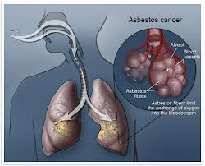
Synergy
Synergistic interactions- when two risks come together and cause more harm that one would. For example, the health impact of a carcinogen such as asbestos can be much higher if an individual also smokes tobacco.

Slide 10
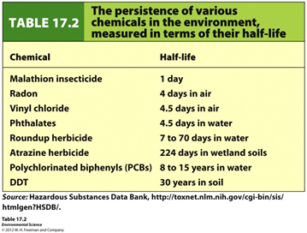
Persistence
Persistence- how long a chemical remains in the environment

